Slide 1
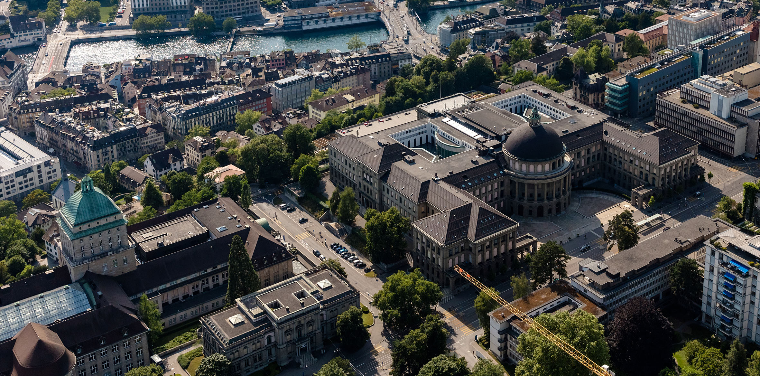
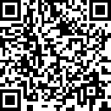
FAIR Data Practices for Qualitative Research in Transdisciplinarity
TdLab, D-USYS
GHE, D-MAVT
Franziska Mohr¹, Mollie Chapman¹, Bianca Vienni-Baptista¹, Lars Schöbitz², Elizabeth Tilley²
Advancing Open Research Data (ORD) Practices: collaboration and innovation in the ETH Domain
12.06.2025
Slide download
¹Transdisciplinarity Lab, Department of Environmental Systems Science, ETH Zurich, Switzerland; ²Global Health Engineering, ETH Zurich, Switzerland

Slide 2
FAIRqual project
FAIR Data Practices for Qualitative Research in Transdisciplinarity
Franziska
Mollie
Bianca
Liz
Lars
TdLab
Global Health
Engineering

Slide 3
FAIR data principles
Wilkinson et al. 2016; www.go-fair.org
Aim:
Guide to capture essential characteristics of data objects to make data reusable for humans and machines
Findable
I.e. (Meta)data have a persistent identifier
Accessible
I.e. (Meta)data are retrievable (open or authentication / authorization procedure where necessary)
Interoperable
(Meta)data use a formal, broadly applicable language for knowledge representation to integrate them with other data
Reusable
I.e. (Meta)data are well-described with accurate and relevant attributes
Notes:
-Guidance not strict measures / implementations
-inconsistens interpretations -> incompatible implementations

Slide 4
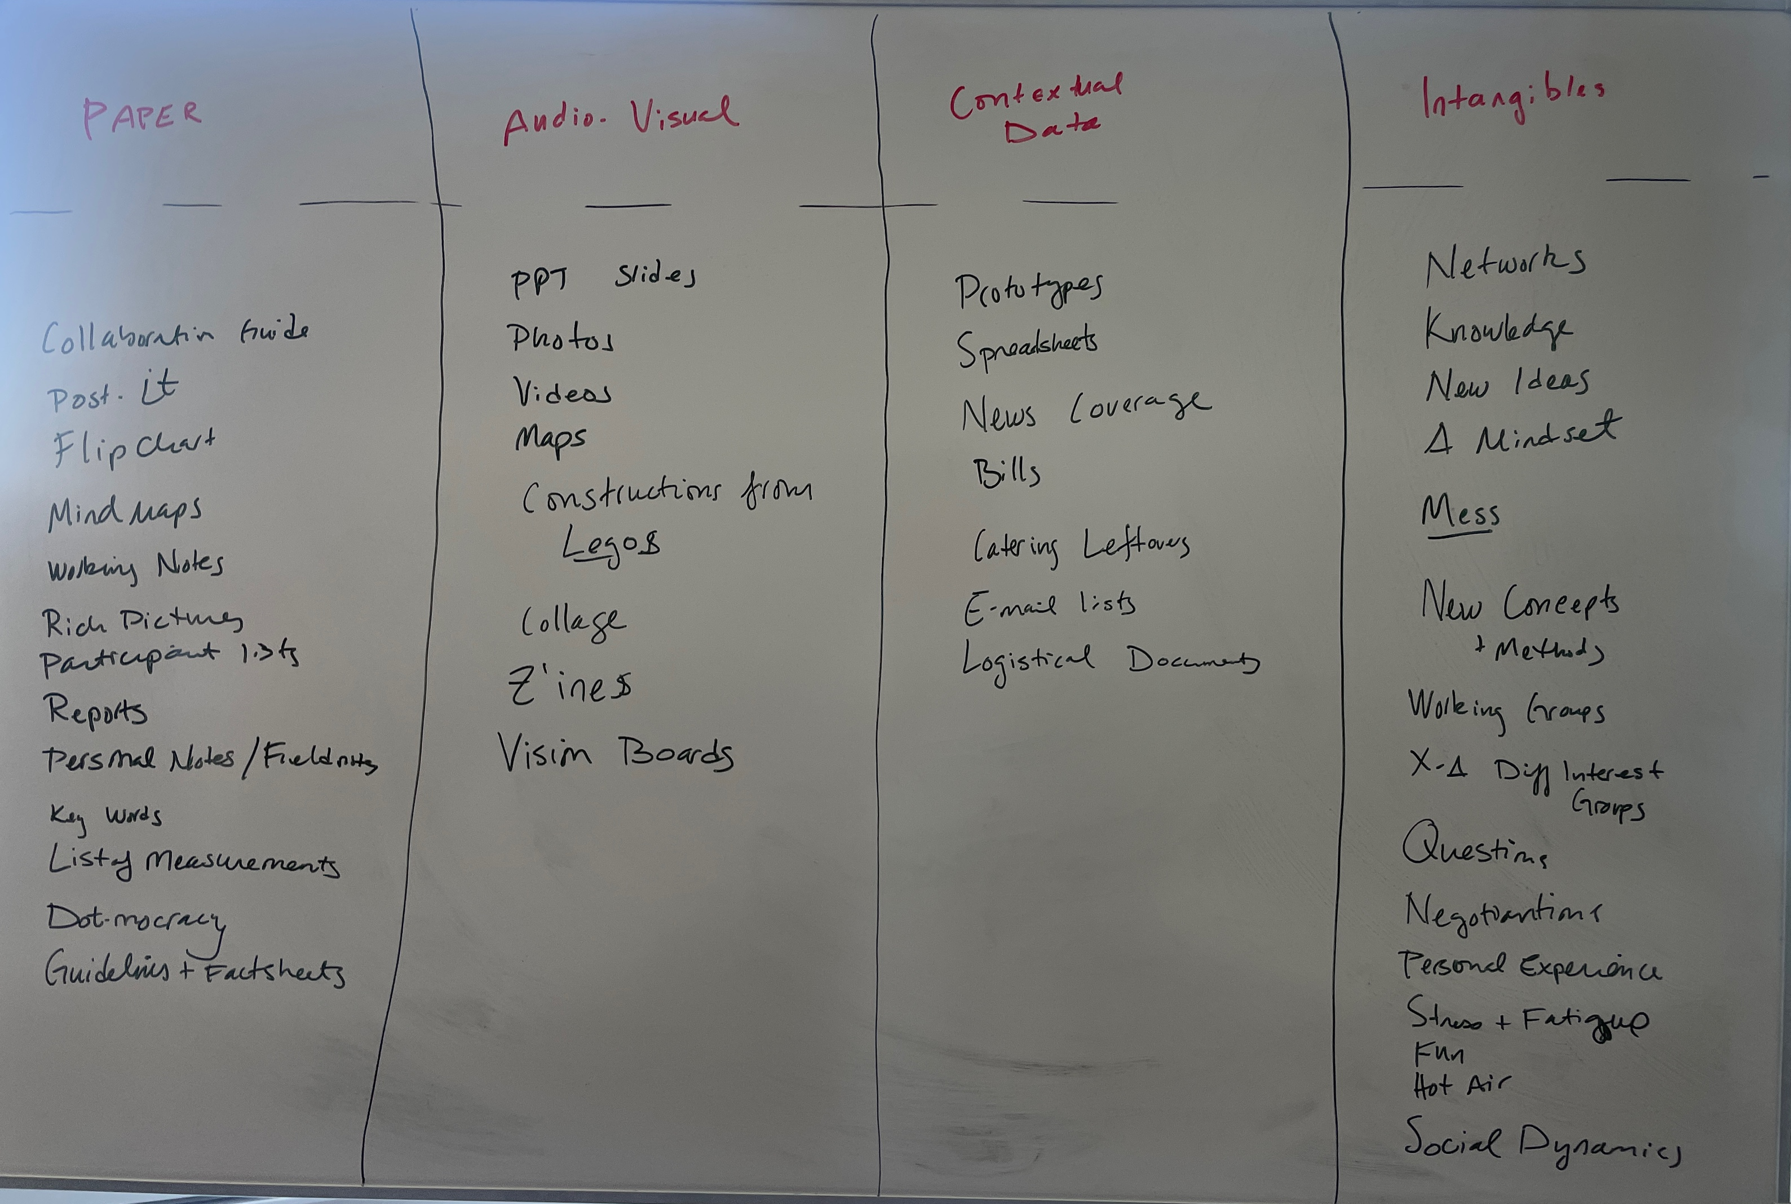
Challenges of sharing qualitative data and data of research in transdisciplinarity
Practical issues
Ethical commitments
Epistemological traditions
Origin of Open Science practices
Brainstorming data types, TdLab Brown Bags Lunch March 18, 2025
Notes:
Paper (e.g.
Audio Visual (e.g.
Contextual data (e.g.
Intangibles
Going through some of the challenges.
Practical issues (the amounts of types of data)

Slide 5
Challenges of sharing qualitative data: Practical issues
Interviews
Many hundreds of pages of transcripts that require often detailed reading to fully anonymize
Removing names is not enough
Audio recordings are highly personal (local storage only, no use of cloud services)
Other kinds of data are heterogenous, e.g.,
Workshop outputs (flip charts, post-it notes, manual summaries)
Audiovisual (photos or videos)
Focus groups
Participant observation and fieldnotes
Mapping
Artistic outputs

Slide 6
Challenges of sharing qualitative data: Ethical commitments
Standard research ethics require confidentiality
To protect participants
To create an atmosphere of trust
Sharing fears
Misuse of shared data
Politization of data
Loss of context

Slide 7
Challenges of sharing qualitative data: Epistemological traditions
“you had to be there”
Importance of embodied research (being in the place, feeling what happened)
Integration of emotion, experience, context
Need to immerse yourself in the data to analyze it properly

Slide 8
Challenges of sharing qualitative data: Origin of Open Science practices
Current movement mostly based in quantitative tradition means not always suited to qualitative or Td data and traditions

Slide 9
Sharing qualitative data in Transdisciplinary (Td) research
Co-production of knowledge between societal and scientific actors
Characteristics of qualitative research
Questions of data authority
Confidentiality
Notes:
Add OECD 2020 and Pohl et al.2021?
Co-production of knowledge between societal and scientific actors at core of Td research
Pressing question of data authority
Who has the power to create and manage such data?
Who is entitled to access it and how?
But at the same time qualitative research is bound to ethics / confidentiality

Slide 10
Qualitative data requires variable levels of access
“open by default” is not an option
 |  | Level of Access
 |  | Closed | Controlled | Restricted | Open
Level of processing | Raw data
 | Full data without identifiers
 | Excerpted / partial data
 | Final analysis
Figure based on Table 2, Alexander et al. 2020

Slide 11
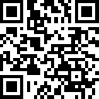
FAIRqual project
https://fairqual.org
Explore how to apply FAIR principles for qualitative data in Td research…
… from a conceptual angle
… from a technical angle
Based on what?
Workshop at ITD2024 – “feeling the pulse”
Expert interviews with Td researchers and open science experts
Develop guidelines and demonstrate potential practices based on data collected during FAIRqual on case studies of all project parts
Workflows that could work for TdLab
Wider outreach through publications, community of practice
Project website

Slide 12
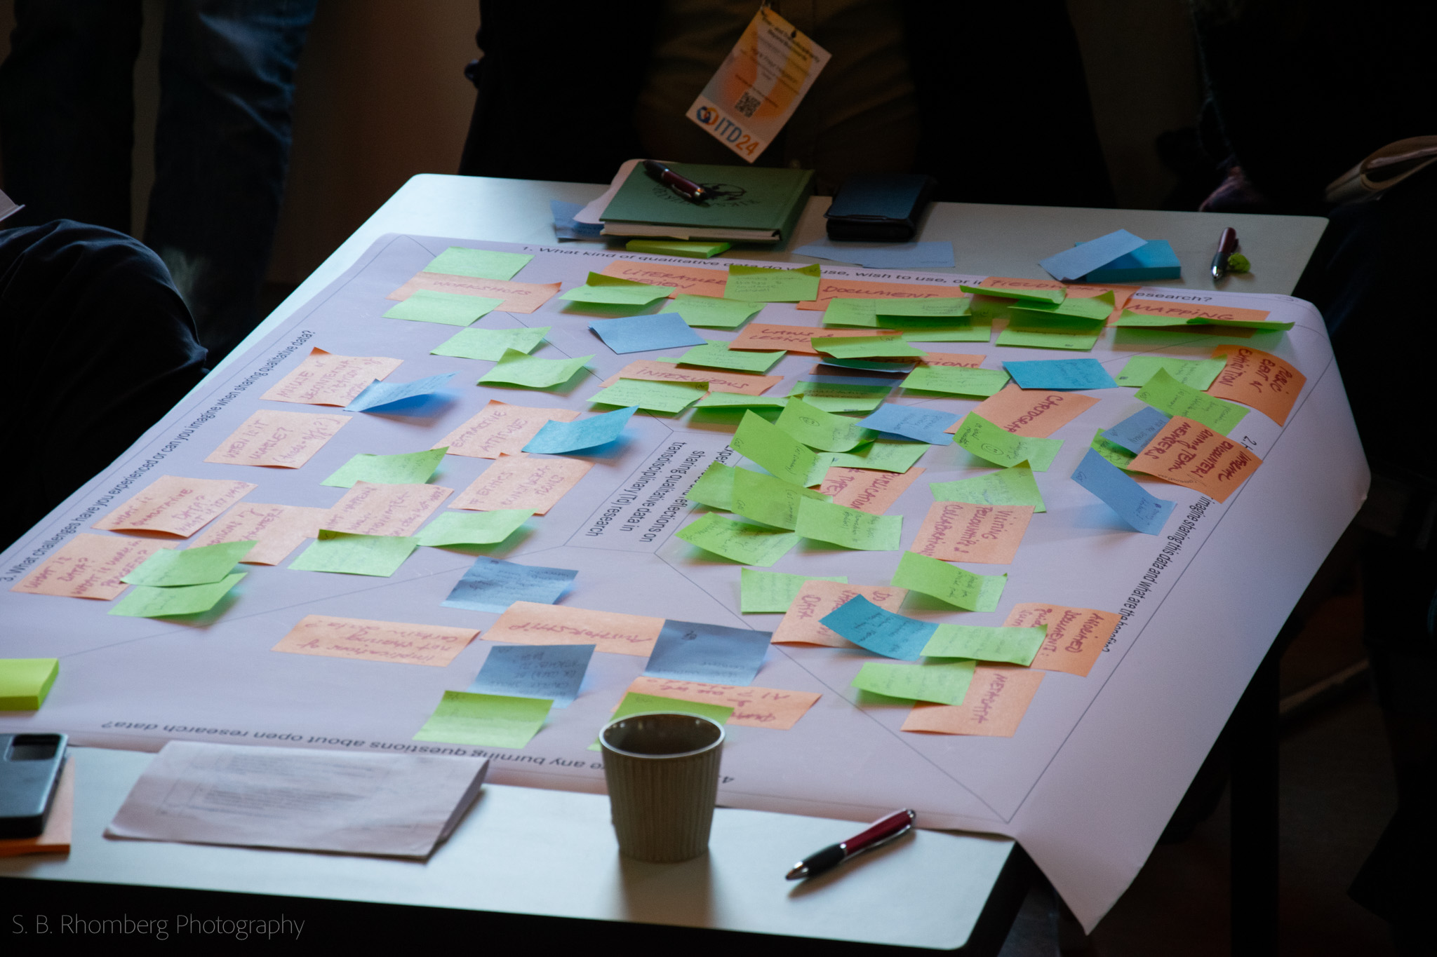
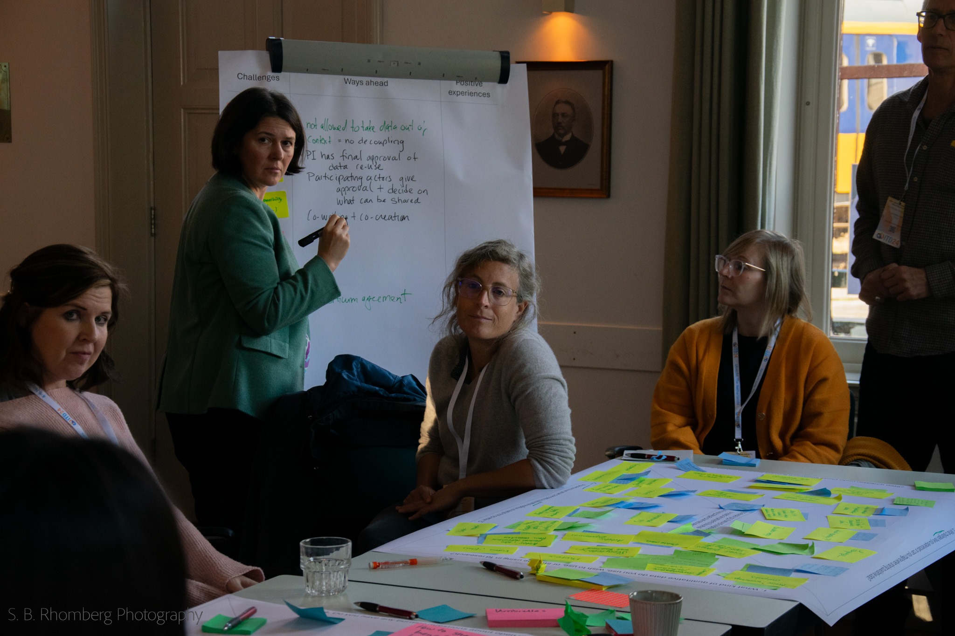
Workshop at ITD24

Slide 13


Road(s) ahead
Expert interviews
Interview guide & informed consent
Group and structure insights, write report
ITD24 workshop data
Publication of workshop data
Consent / shared co-authorship
Develop workflow
Share process as a «case study»
How to document workshops?
Document decisions

Slide 14
Literature
Alexander, S. M., Jones, K., Bennett, N. J., Budden, A., Cox, M., Crosas, M., Game, E. T., Geary, J., Hardy, R. D., Johnson, J. T., Karcher, S., Motzer, N., Pittman, J., Randell, H., Silva, J. A., da Silva, P. P., Strasser, C., Strawhacker, C., Stuhl, A., & Weber, N. (2019). Qualitative data sharing and synthesis for sustainability science. Nature Sustainability, 3 (81–88). https://doi.org/10.1038/s41893-019-0434-8
Go FAIR initiative (last accessed 01.11.2024) www.go-fair.org
Russo Carroll, S., Herczog, E., Hudson, M., Russell, K. & Stall, S. (2021). Operationalizing the CARE and FAIR Principles for Indigenous data futures. Scientific Data 8 (108). https://doi.org/10.1038/s41597-021-00892-0
Wilkinson, M. D., Dumontier, M., Aalbersberg, Ij. J., Appleton, G., Axton, M., Baak, A., Blomberg, N., Boiten, J.-W., da Silva Santos, L. B., Bourne, P. E., Bouwman, J., Brookes, A. J., Clark, T., Crosas, M., Dillo, I., Dumon, O., Edmunds, S., Evelo, C. T., Finkers, R., … Mons, B. (2016). The FAIR Guiding Principles for scientific data management and stewardship. Scientific Data, 3(1), 160018. https://doi.org/10.1038/sdata.2016.18
Notes:
-> review round (mention locks)

Slide 15
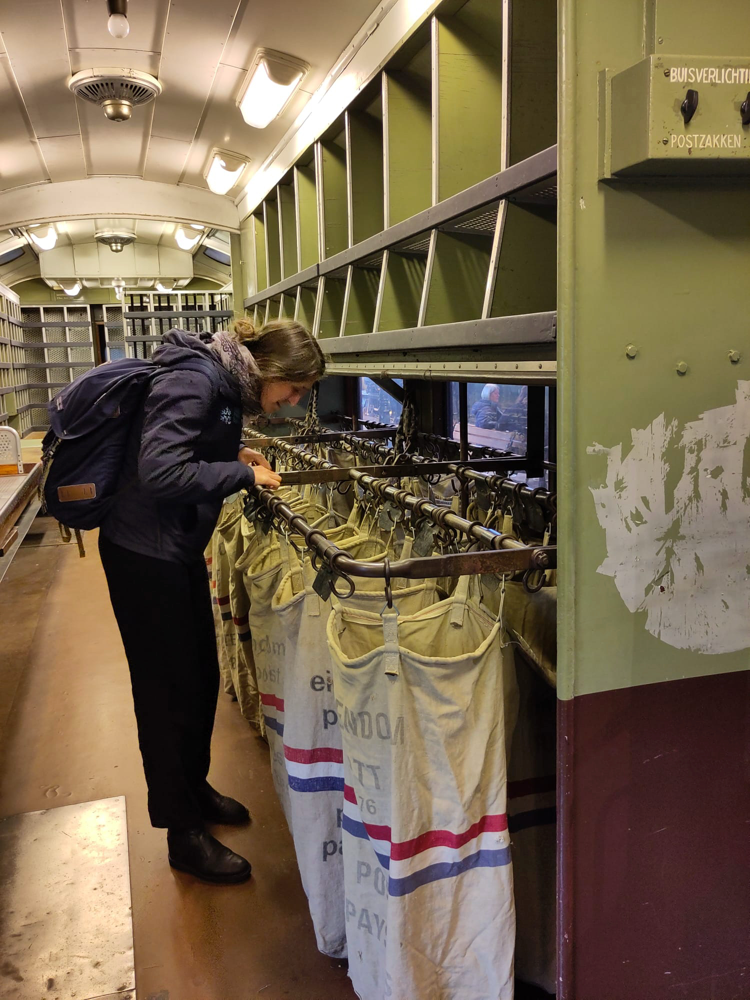
Questions & comments
?
?

