Slide 1

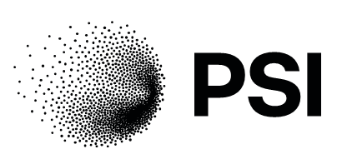



Open and Reproducible Materials Science Research
Enabling seamless ORD interoperability between experiment and simulation
Edan Bainglass
Bern, 12 June

Slide 2
Outline
Project overview
Phase 1 summary
Phase 2 activities

Slide 3

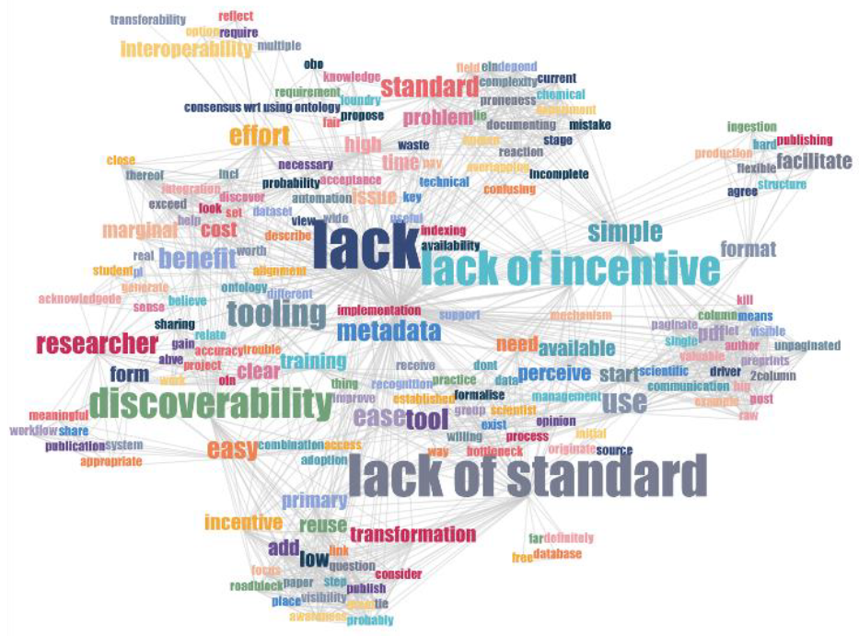
Barriers to the adoption of ORD practices
In short:
Why should we do it?
How do we do it?
To clarify:
Benefits
Standards & protocols
Results of a survey of ~120 participants at the MADICES 2022 workshop

Slide 5
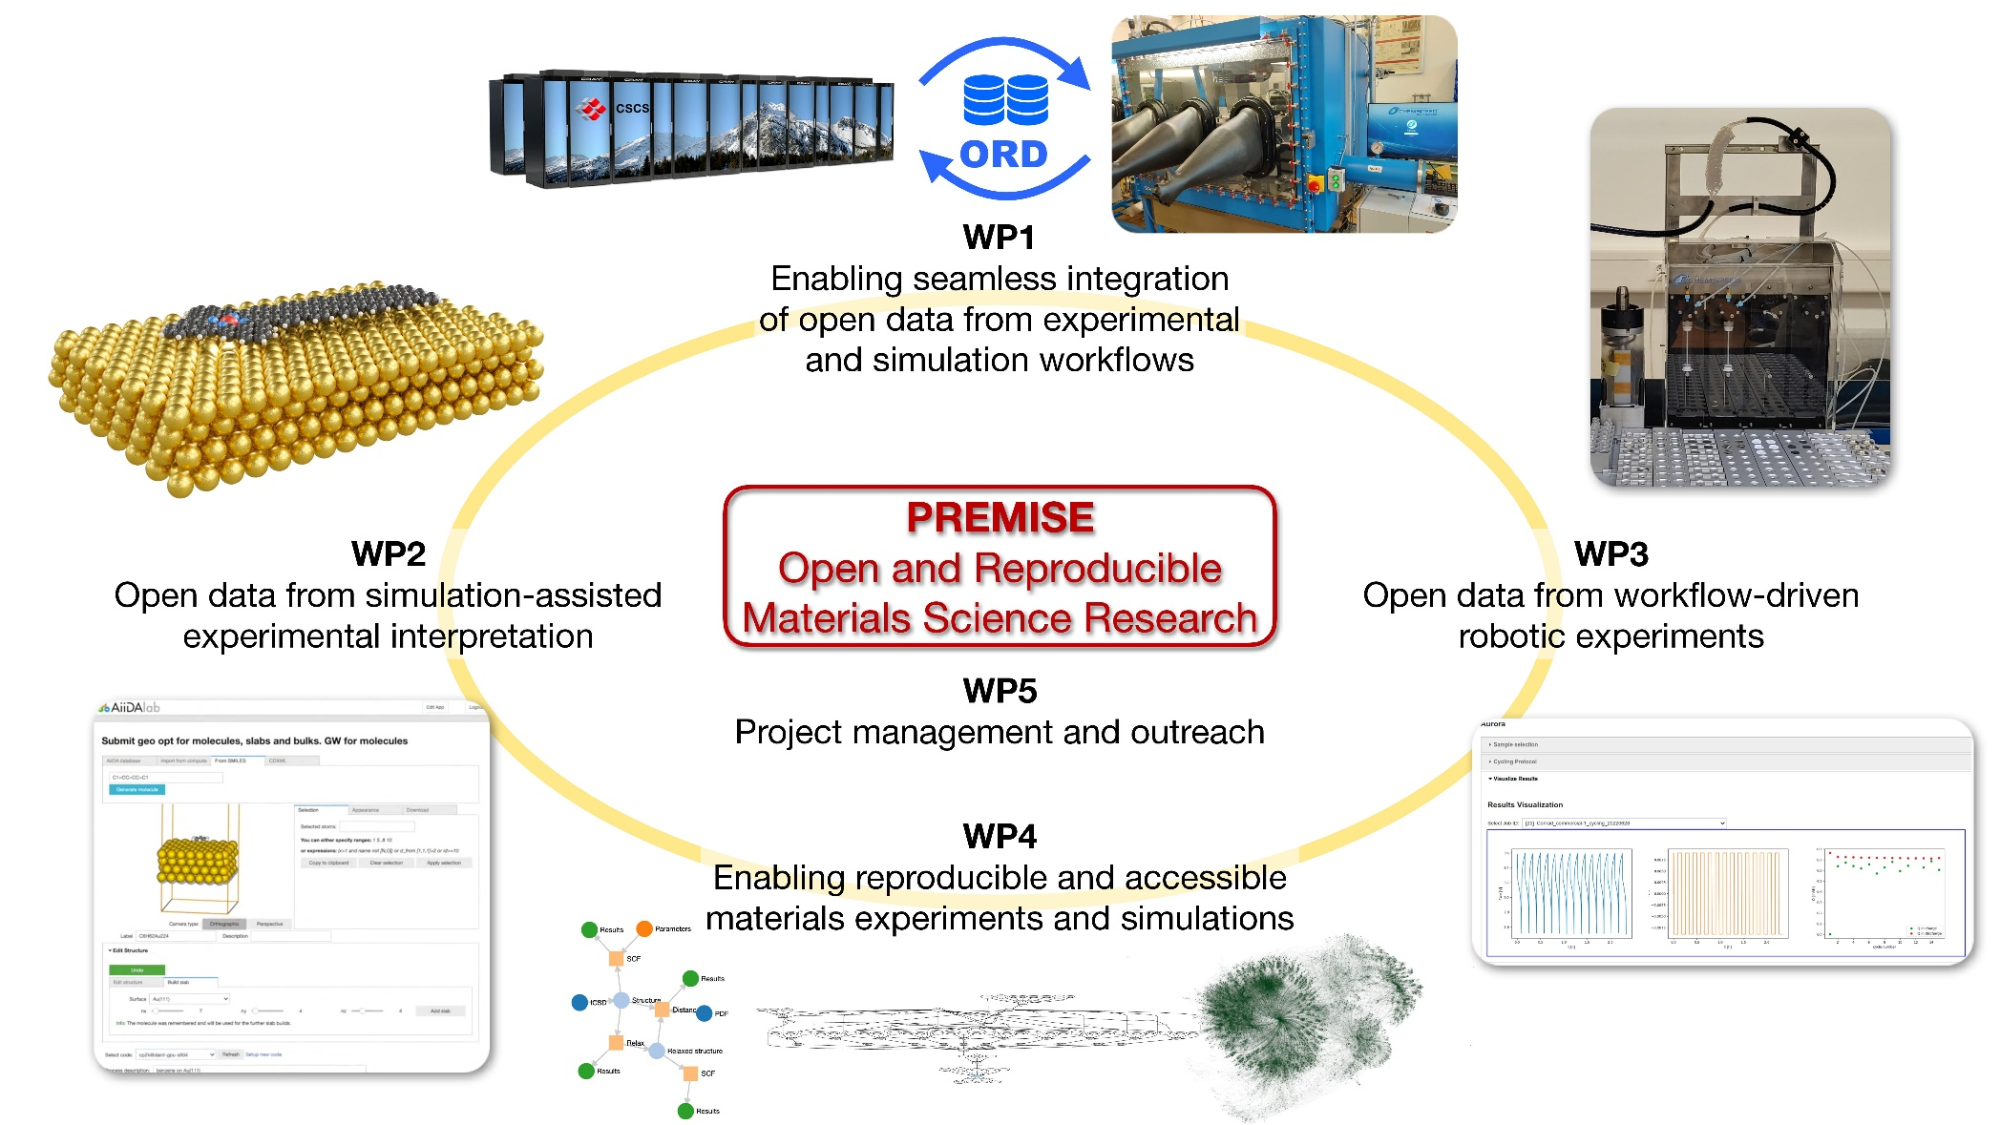









Carlo
Pignedoli
Corsin Battaglia
Giovanni
Pizzi
Bernd
Rinn
ord-premise.org

Slide 6
Platforms
AiiDA
openBIS

Slide 7

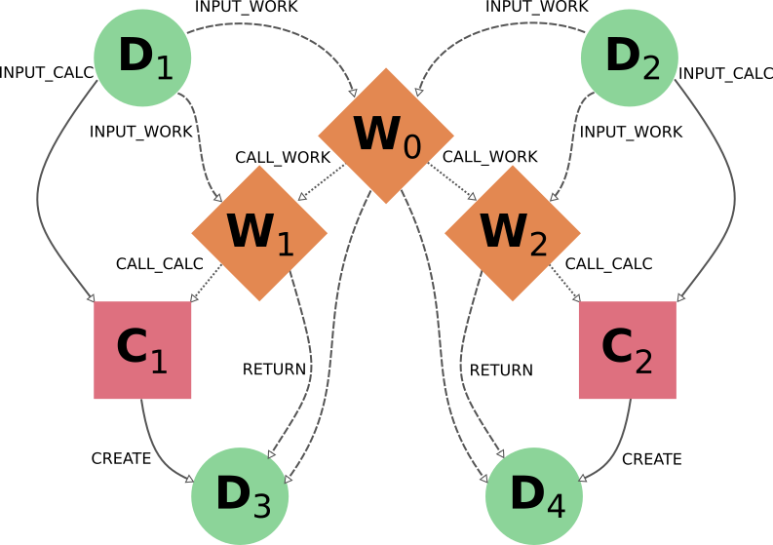

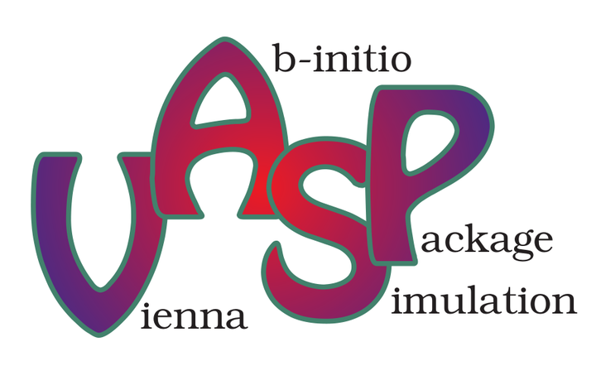








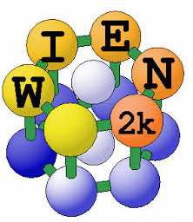


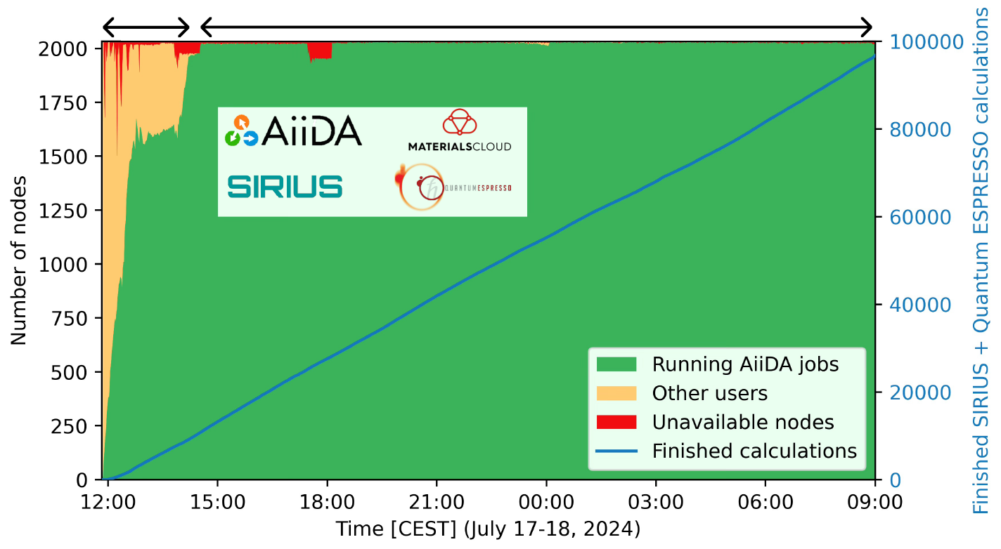

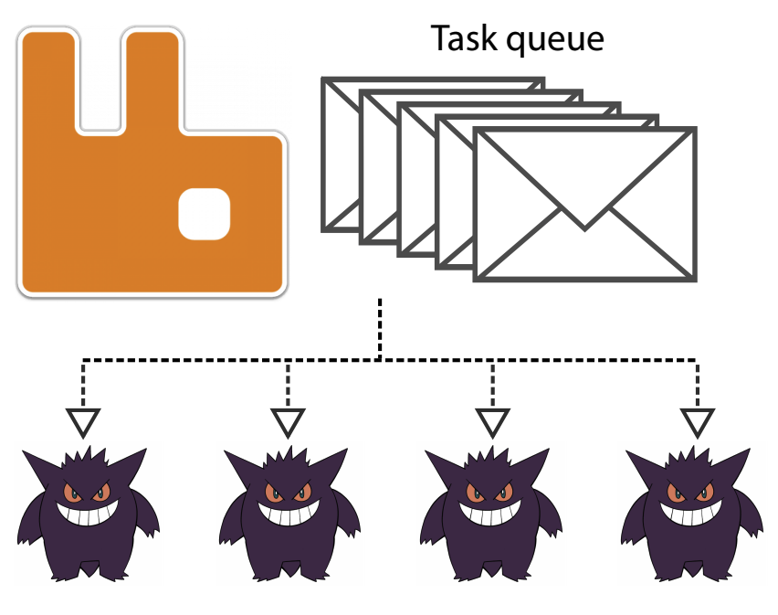

workflow management system
Automated
data provenance
Scalable workflow engine
Built-in support for HPC
Flexible plugin system

Slide 8
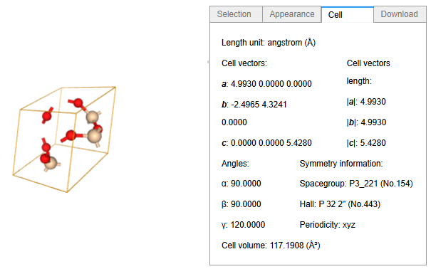

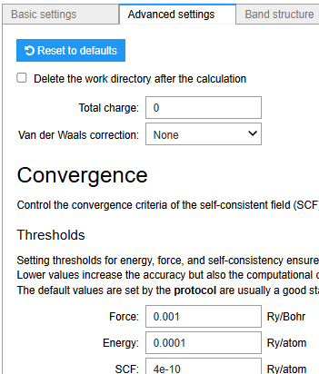
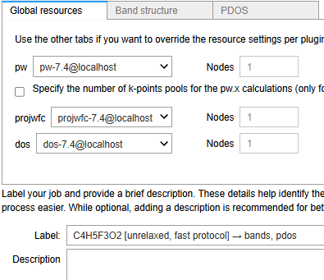
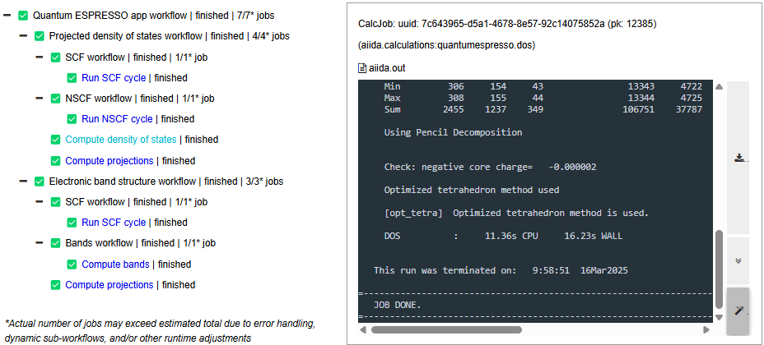

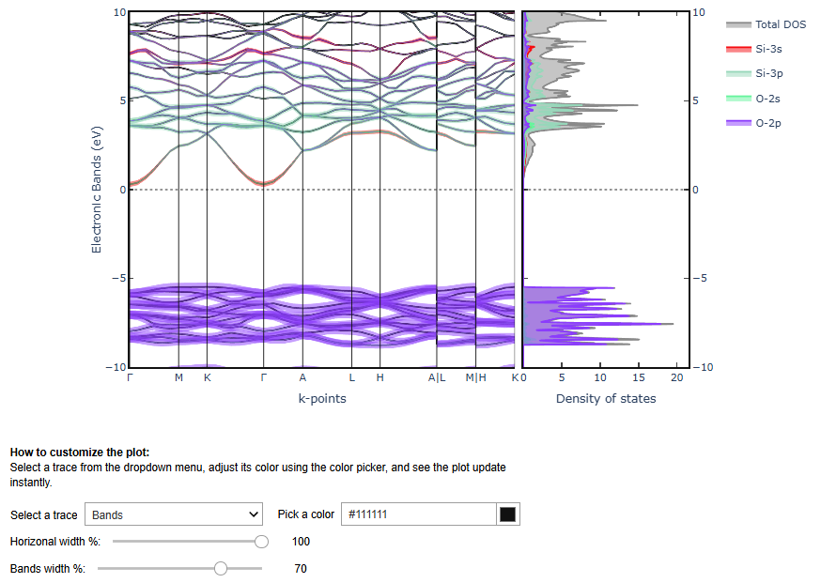
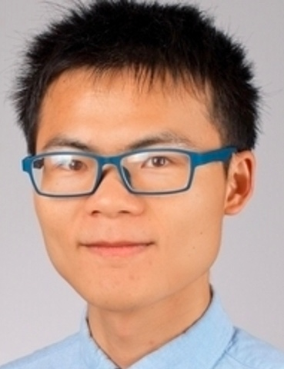
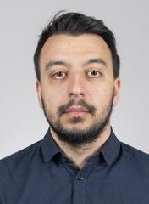
extended ecosystem
Xing Wang
(PSI)
Miki Bonacci (PSI)

Slide 9
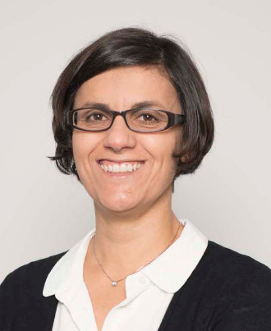
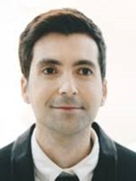
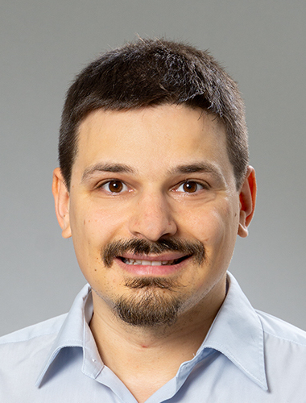
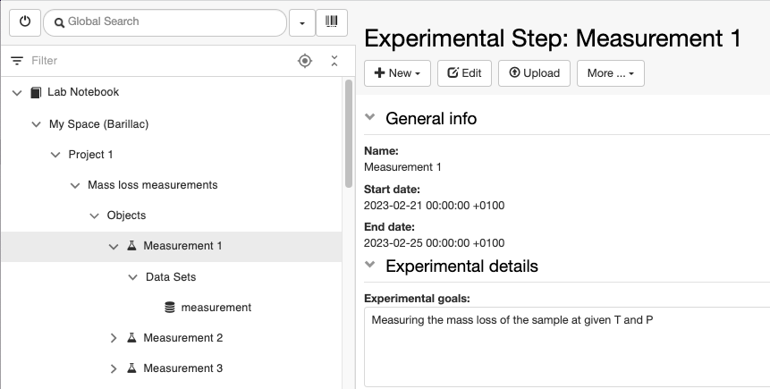
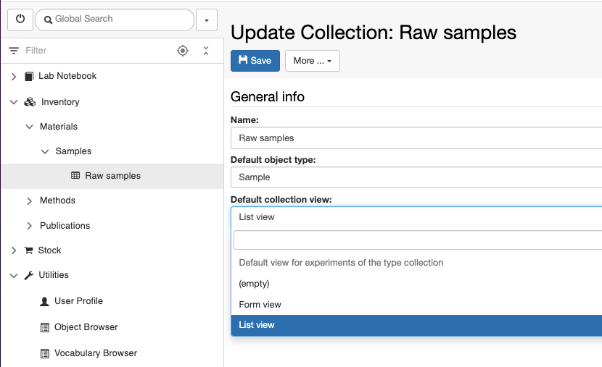
ELN/LIMS platform
Caterina
Barillari
(ETHZ)
Juan
Fuentes
(ETHZ)
Andreas
Meier
(ETHZ)
Inventory and lab management
FAIR data storage and access
Dedicated APIs for integration
Extensible with custom plugins

Slide 10
Use cases

Slide 11


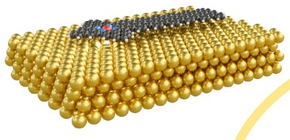
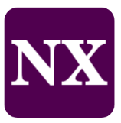


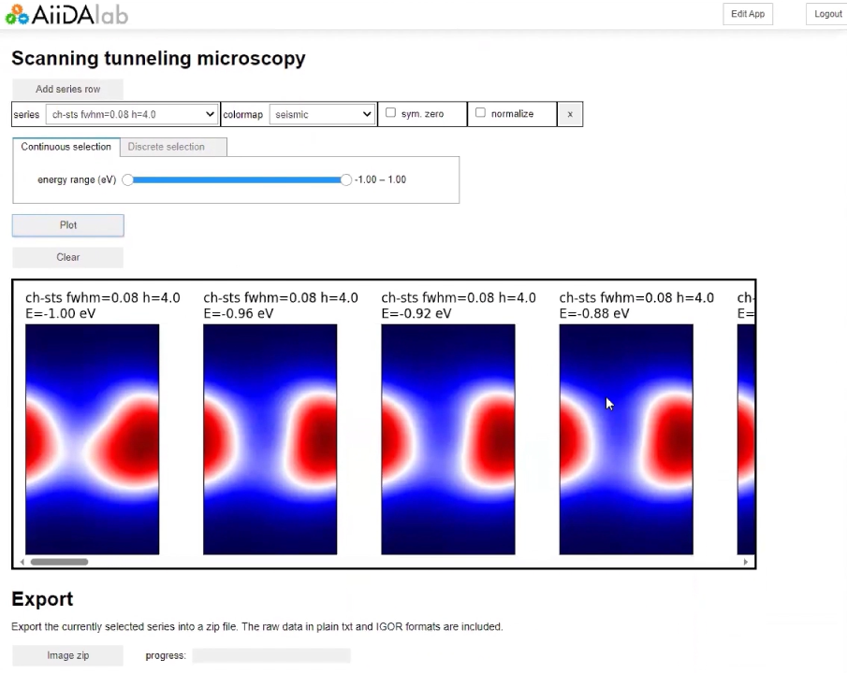
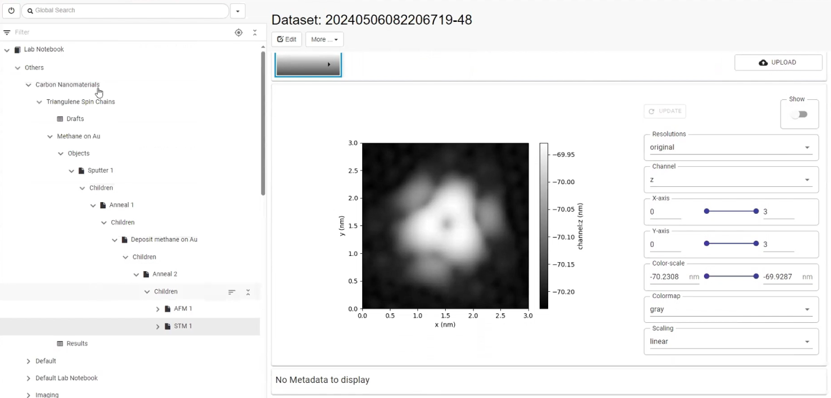

Simulation-assisted interpretation of experiments
Carlo
Pignedoli
(Empa)
Fabio
Lopes
(Empa)
Sasha
Yakutovich
(Empa)

Slide 12

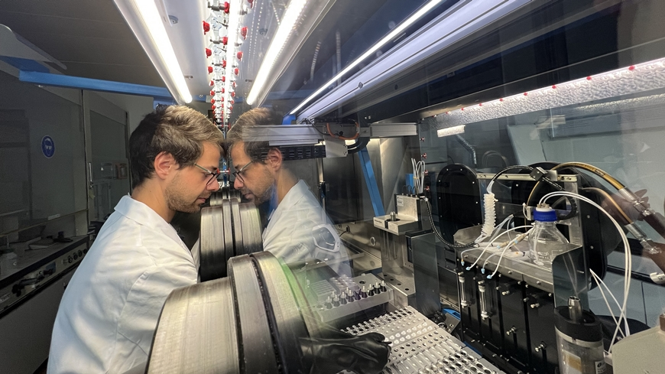


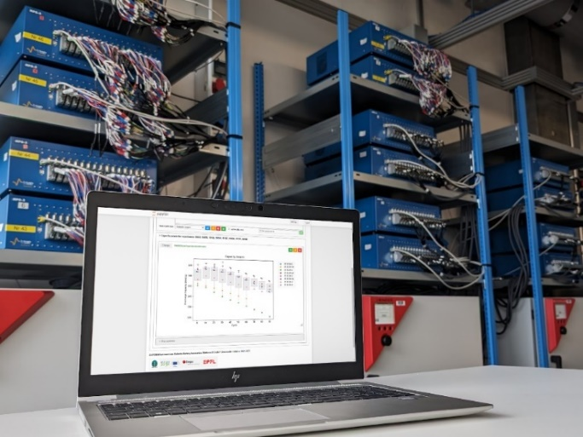



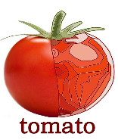
Workflow-driven robotic experiments
Corsin Battaglia
(Empa)
Nukorn
Plainpan
(Empa)
Graham
Kimbell
(Empa)

Slide 13
Phase 1
Standards & protocols
Outreach

Slide 14
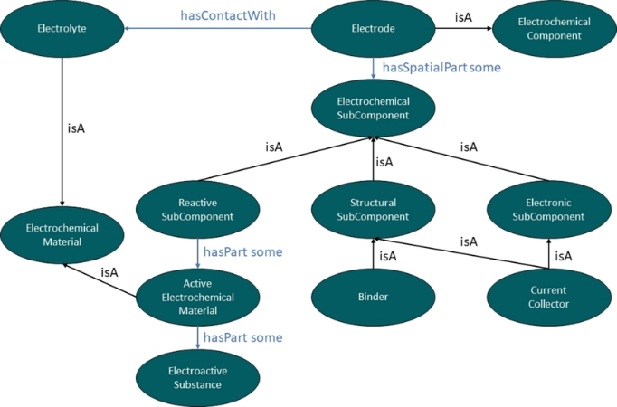

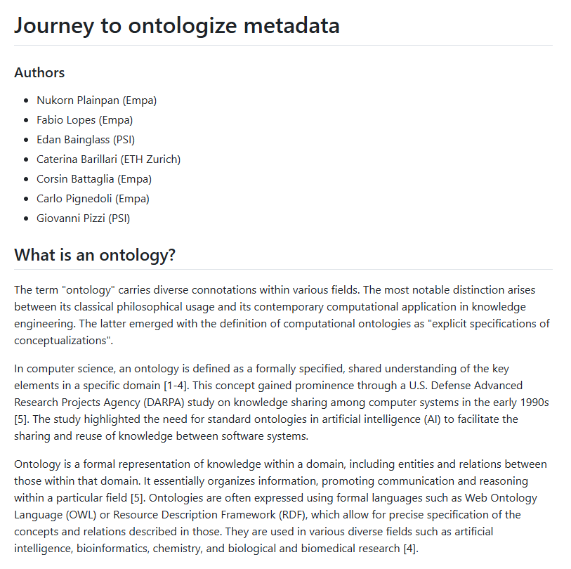


Phase 1 – standards & protocols
https://github.com/ord-premise/interoperability-guidelines
https://ord-premise.org/tutorials

Slide 15





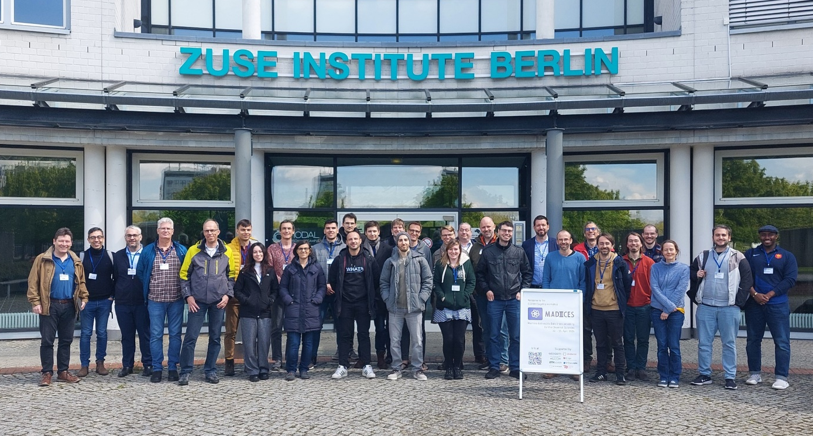
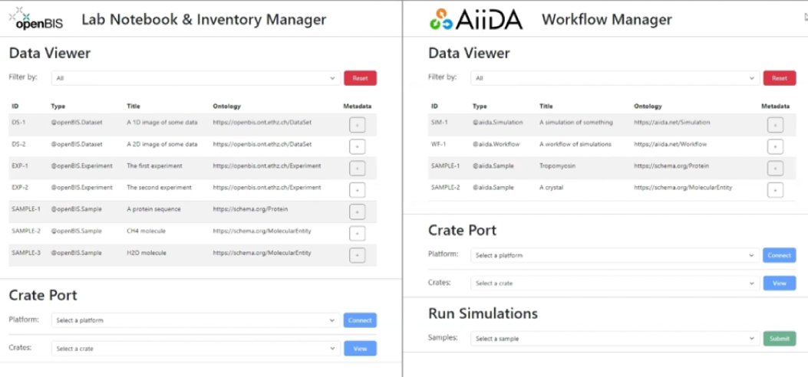
Phase 1 – outreach
https://madices.github.io/docs/2024
https://github.com/MADICES/interop-demo

Slide 16
Phase 2
Towards full ORD interoperability

Slide 17
Phase 2 – goals
Enable/demonstrate full ORD interoperability including ORD publishing
Extend platform feature set to support seamless ORD interoperability
Provide documentation and recommendations
Continue to engage community

Slide 18
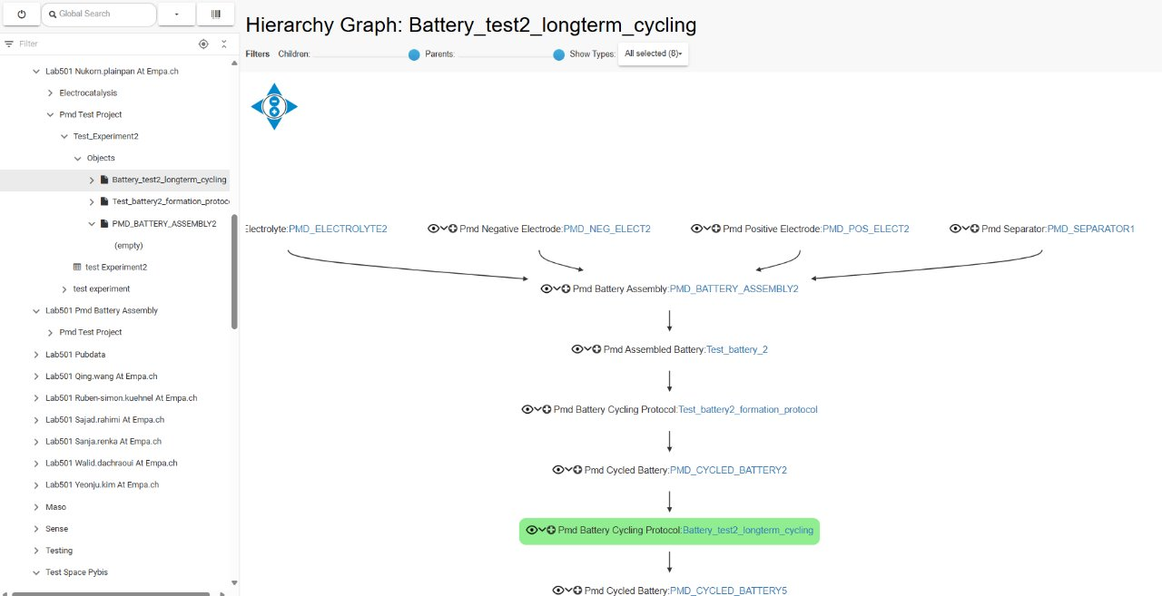
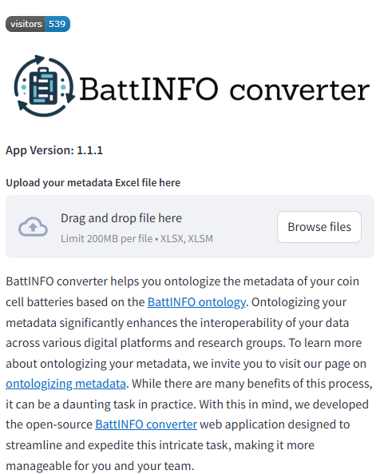
Phase 2 – tools & features & integration
Nukorn
Plainpan
(Empa)
https://battinfoconverter.streamlit.app
https://github.com/ord-premise/cell-digital-twin-integration

Slide 19
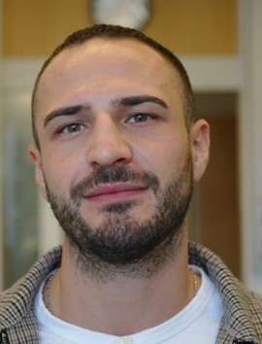

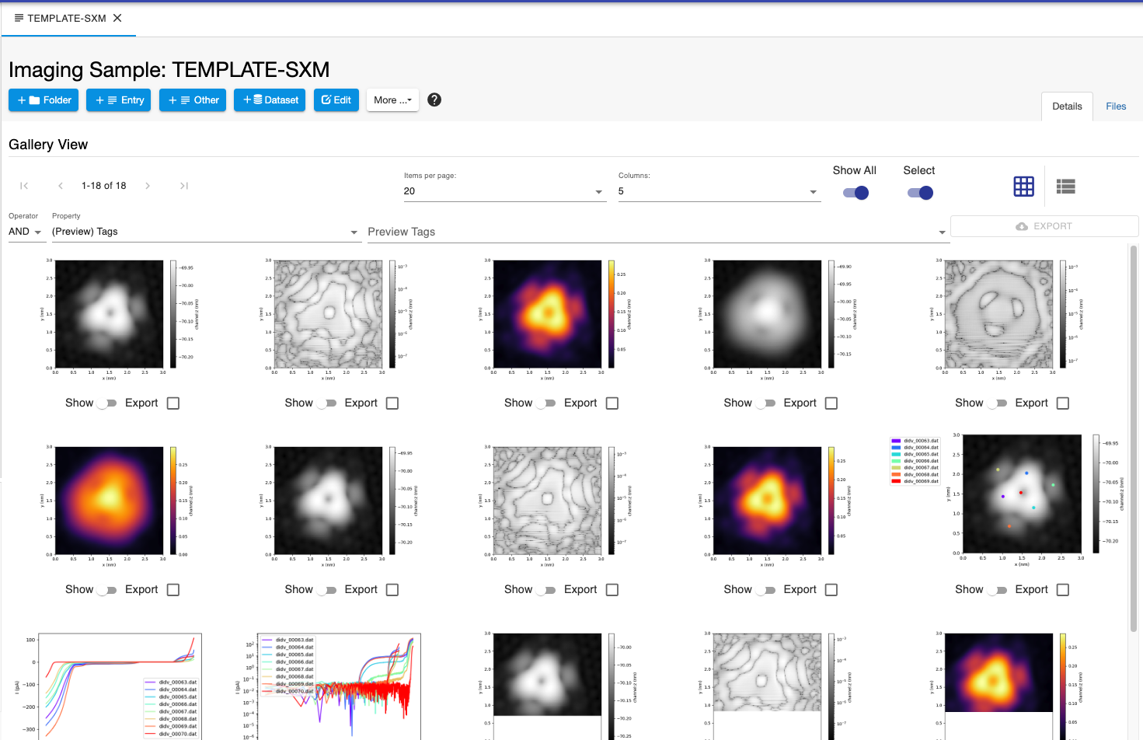
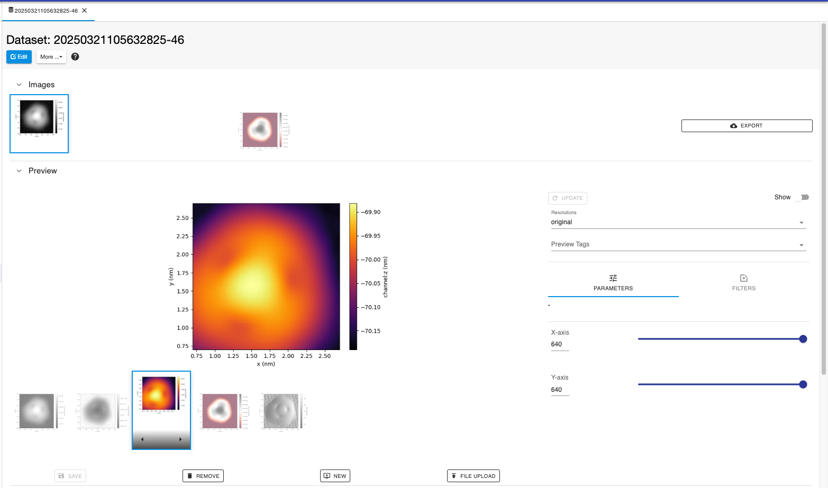
Phase 2 – tools & features & integration
openBIS imaging technology
Mihai-Cosmin
Danaila
(ETHZ)
Adam
Laskowski
(ETHZ)

Slide 20
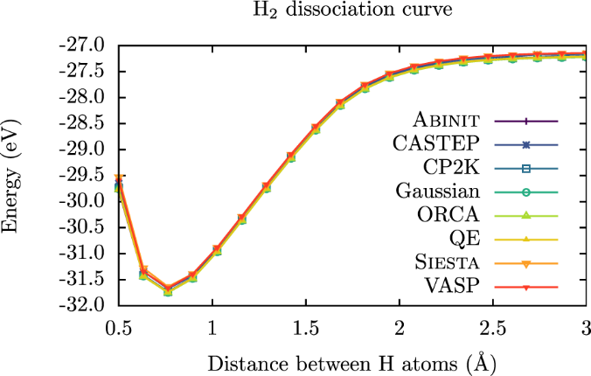
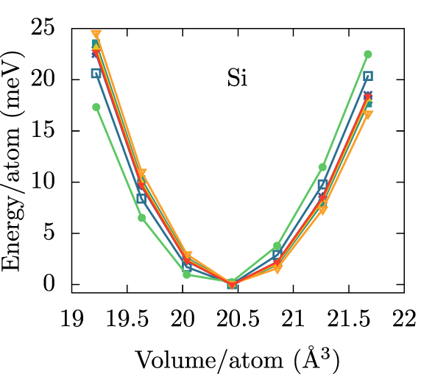

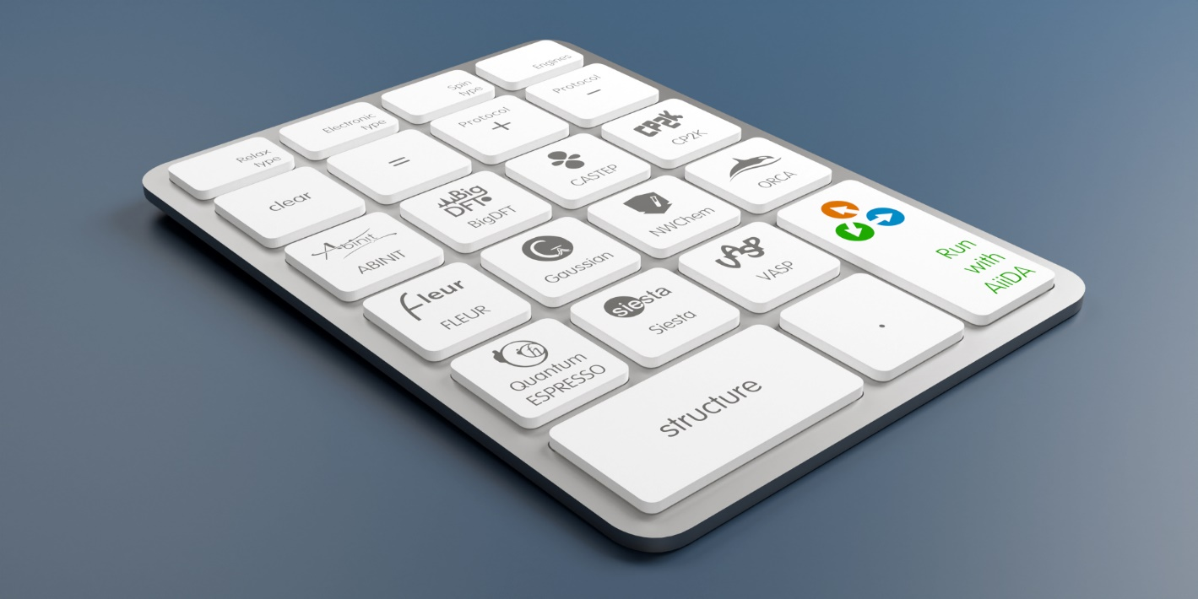



Phase 2 – tools & features & integration
Giovanni
Pizzi
(PSI)
IRIs
https://github.com/edan-bainglass/common-workflow-schemas

Slide 21
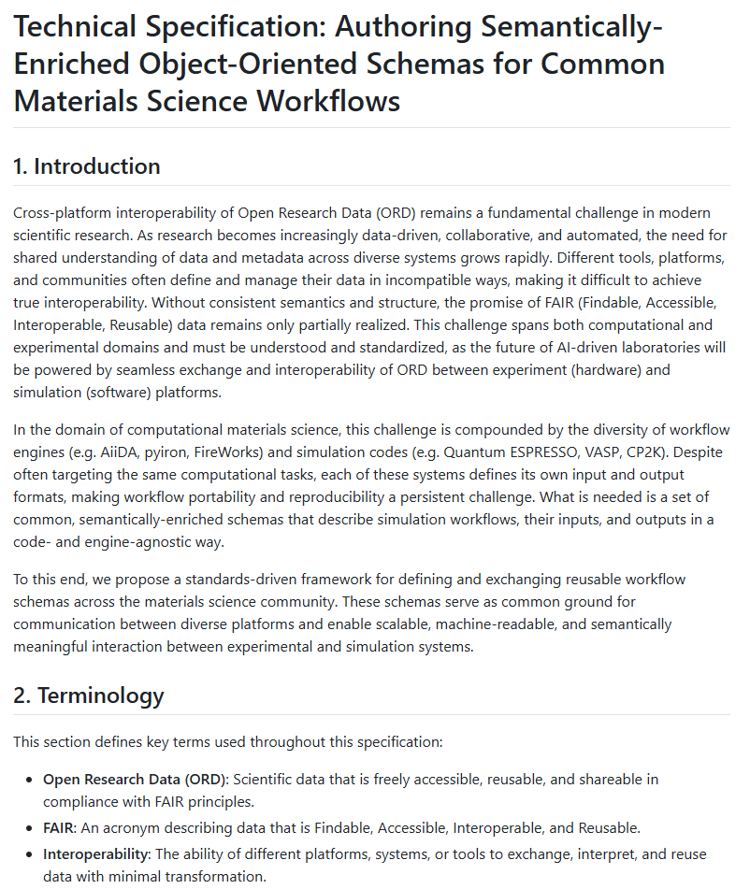


Phase 2 – tools & features & integration
{
"@context": {
"@vocab": "https://example.com/",
"ex": "https://example.com/",
"cw": "ex:commonWorkflows/",
"Code": "cw:Code",
"identifier": "cw:UniqueIdentifier",
"name": "cw:Code/Name",
"package": "cw:Code/Package",
"executionEnvironment": "cw:Code/ExecutionEnvironment",
"ExecutionEnvironment": {
"@id": "cw:ExecutionEnvironment",
"@context": {
"name": "cw:ExecutionEnvironment/Name",
"metadata": "cw:ExecutionEnvironment/Metadata"
}
},
"PackageManager": {
"@id": "cw:PackageManager",
"@context": {
"name": "cw:PackageManager/Name",
"metadata": "cw:PackageManager/Metadata"
}
},
"Package": {
"@id": "cw:Package",
"@context": {
"name": "cw:Package/Name",
"package_manager": "cw:Package/PackageManager",
"metadata": "cw:Package/Metadata"
}
}
},
"$defs": {
"ExecutionEnvironment": {
"properties": {
"name": {
"anyOf": [
{
"type": "string"
},
{
"type": "null"
}
],
"default": null,
"description": "The name of the execution environment.",
"title": "Name"
},
"metadata": {
"description": "The metadata of the execution environment.",
"title": "Metadata",
"type": "object"
}
},
"required": ["metadata"],
"title": "ExecutionEnvironment",
"type": "object"
},
"Package": {
"properties": {
"name": {
"description": "The name of the package.",
"title": "Name",
"type": "string"
},
"package_manager": {
"$ref": "#/$defs/PackageManager",
"description": "The package manager from which to obtain the package."
},
"metadata": {
"description": "The metadata of the package.",
"title": "Metadata",
"type": "object"
}
},
"required": ["name", "package_manager", "metadata"],
"title": "Package",
"type": "object"
},
"PackageManager": {
"properties": {
"name": {
"description": "The name of the package manager.",
"title": "Name",
"type": "string"
},
"metadata": {
"description": "The metadata of the package manager.",
"title": "Metadata",
"type": "object"
}
},
"required": ["name", "metadata"],
"title": "PackageManager",
"type": "object"
}
},
"properties": {
"identifier": {
"anyOf": [
{
"anyOf": [
{
"type": "string"
},
{
"format": "uuid4",
"type": "string"
}
],
"default": null,
"description": "Unique UUID identifier"
},
{
"type": "null"
}
],
"default": null,
"description": "The unique identifier of the code.",
"title": "Identifier"
},
"name": {
"description": "The name of the code.",
"title": "Name",
"type": "string"
},
"package": {
"$ref": "#/$defs/Package",
"description": "The code package."
},
"executionEnvironment": {
"$ref": "#/$defs/ExecutionEnvironment",
"description": "The execution environment of the code."
}
},
"required": ["name", "package", "executionEnvironment"],
"title": "Code",
"type": "object",
"@type": "Code",
"name": "Quantum ESPRESSO",
"package": {
"name": "qe",
"package_manager": {
"name": "conda",
"metadata": {
"channel": "conda-forge",
"version": "24.7.1"
}
},
"metadata": {
"version": "7.4"
}
},
"executionEnvironment": {
"name": "hpc-test",
"metadata": {
"hostname": "hpc",
"description": "Test HPC machine",
"transport_protocol": "ssh",
"scheduler": "slurm",
"queue": "compute",
"architecture": "x86_64",
"os": {
"name": "Linux",
"metadata": {
"distribution": {
"name": "RedHat",
"version": "Enterprise 7"
}
}
},
"preinstalled": false,
"path": "/usr/bin/pw.x"
}
}
}
{
"@context": {
"@vocab": "https://example.com/",
"ex": "https://example.com/",
"cw": "ex:commonWorkflows/",
"Code": "cw:Code",
"identifier": "cw:UniqueIdentifier",
"name": "cw:Code/Name",
"package": "cw:Code/Package",
"executionEnvironment": "cw:Code/ExecutionEnvironment",
"ExecutionEnvironment": {
"@id": "cw:ExecutionEnvironment",
"@context": {
"name": "cw:ExecutionEnvironment/Name",
"metadata": "cw:ExecutionEnvironment/Metadata"
}
},
"PackageManager": {
"@id": "cw:PackageManager",
"@context": {
"name": "cw:PackageManager/Name",
"metadata": "cw:PackageManager/Metadata"
}
},
"Package": {
"@id": "cw:Package",
"@context": {
"name": "cw:Package/Name",
"package_manager": "cw:Package/PackageManager",
"metadata": "cw:Package/Metadata"
}
}
}, …
}
---
"Package": {
"properties": {
"name": {
"description": "The name of the package.",
"title": "Name",
"type": "string"
},
"package_manager": {
"$ref": "#/$defs/PackageManager",
"description": "The package manager from which to obtain the package."
},
"metadata": {
"description": "The metadata of the package.",
"title": "Metadata",
"type": "object"
}
},
"required": ["name", "package_manager", "metadata"],
"title": "Package",
"type": "object"
}, ---
---
"package": {
"$ref": "#/$defs/Package",
"description": "The code package."
}, ---
https://github.com/ord-premise/technical-specs-for-common-workflows

Slide 22
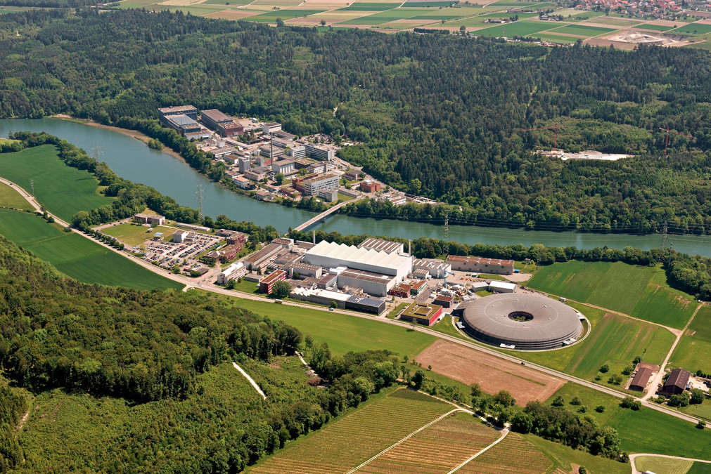

Phase 2 – outreach
Oct 20-24, 2025 PSI
discussions

Slide 23
Outlook

Slide 24
Remaining deliverables
Demo: full ORD interoperability including automated FAIR ORD publishing
Tech. spec: required metadata for FAIR ORD publishing
Report: enabling automated experiments
Feature: extensions of openBIS to facilitate materials science research
Demo: pilot GUI for common workflows
Report: final scientific report, project findings, conclusions

Slide 25
To conclude…

Slide 26

Developed standards & protocols for FAIR prep of ORD for interoperability
Demonstrated dedicated-API-driven interoperability
Engaged open science community
Developing integrated features to facilitate ORD interoperability and publishing
Demonstrating full ORD interoperability
Providing reports and tech. specs to enable seamless ORD interoperability

Slide 27



is supported by the Open Research Data Program of the
PREMISE
MADICES

