Slide 1









OpenEM: FAIR data practices for electron microscopy
Advancing Open Research Data (ORD) Practices: collaboration and innovation in the ETH Domain
Spencer Bliven, Henning Stahlberg, Robbie Loewith
Bern, 2025-06-12

Slide 2
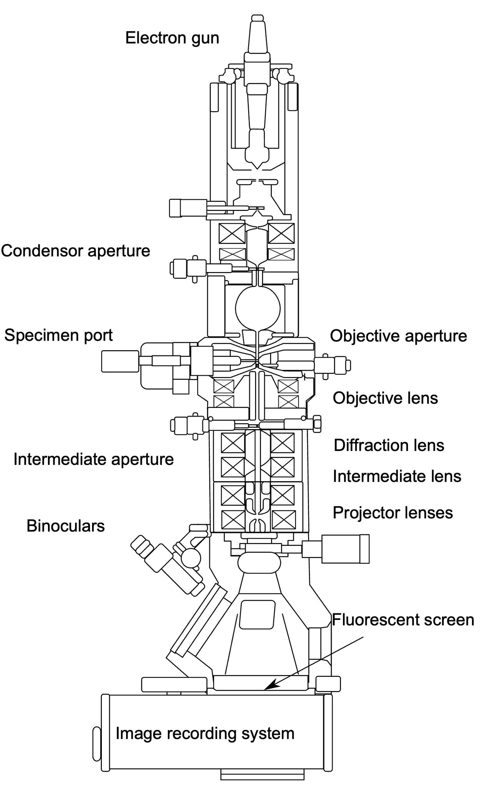
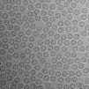
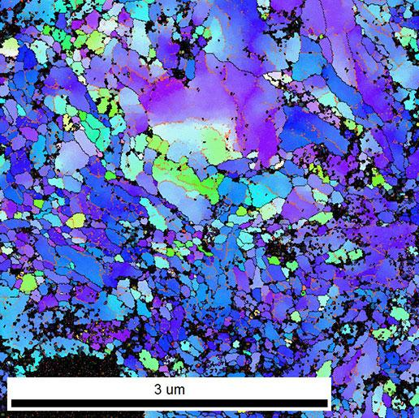
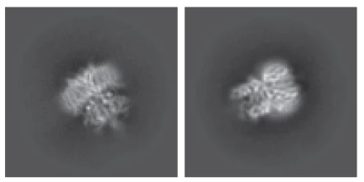
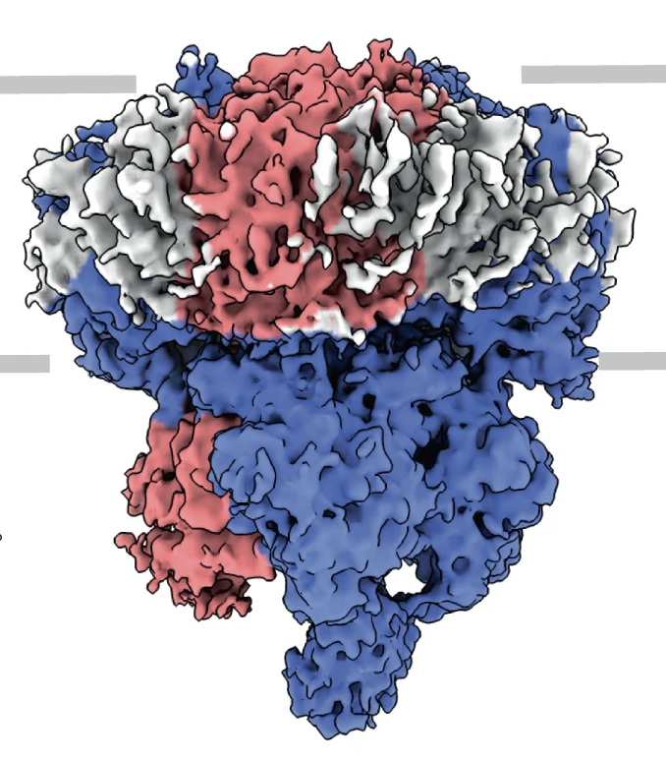
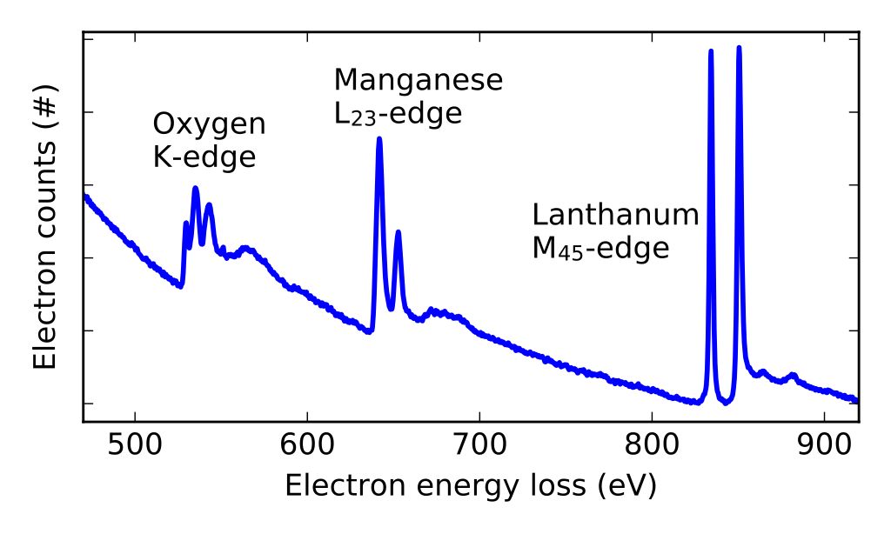
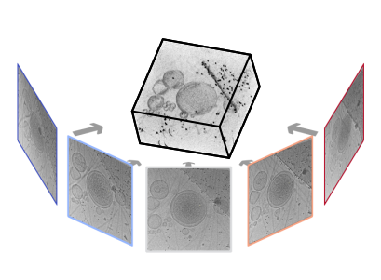
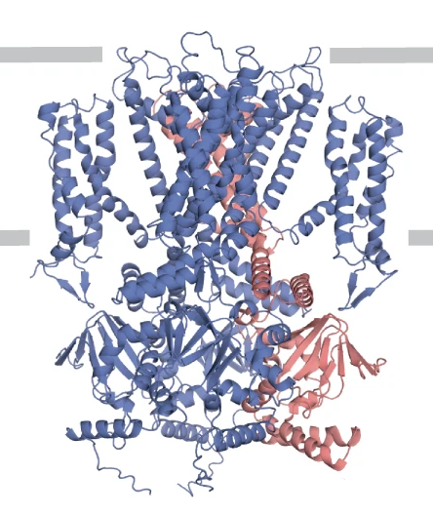
Electron Microscopy (EM)
Raw Data
Derived Data
Class averages
(Barret, PSI)
3D reconstructed volumes
2D Micrographs
Annotated Images
(EMPIAR-11016, Harder, EPFL)
(EMD-12718, Barret, PSI)
(Kunze and Sologubenko,
ETHZ)
Models
Spectrograms
(7o4h, Barret, PSI)
Magnunor, Wikimedia
Tomogram tilt-series
teamtomo.org
More: ptychography, 4D STEM, VolumeEM, …
More: Tomographic reconstructions, segmented models, …

Slide 3
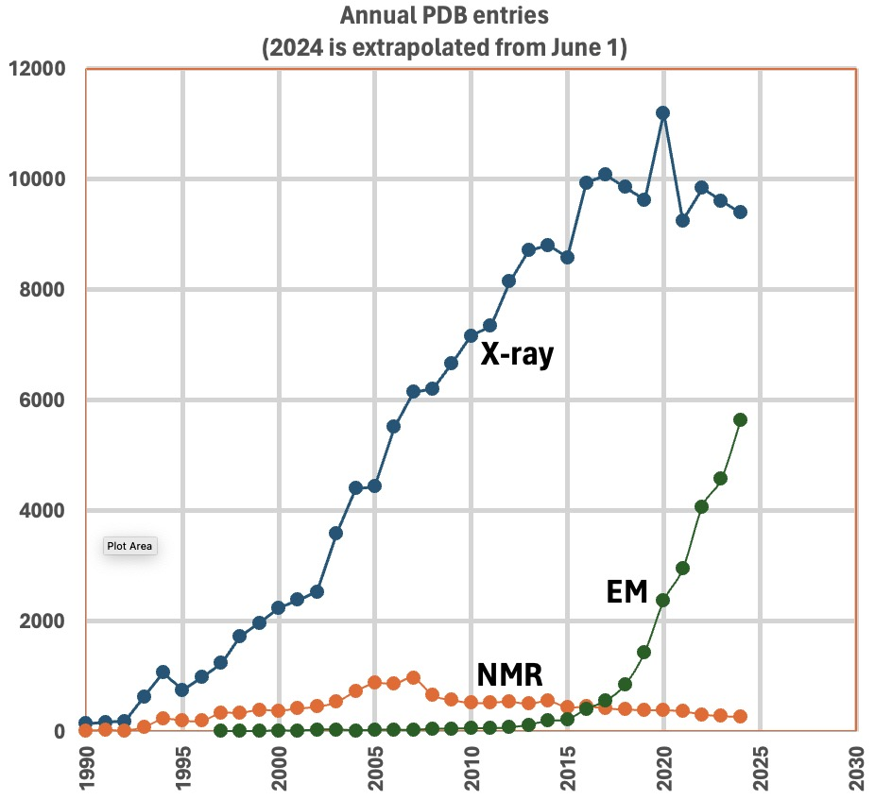

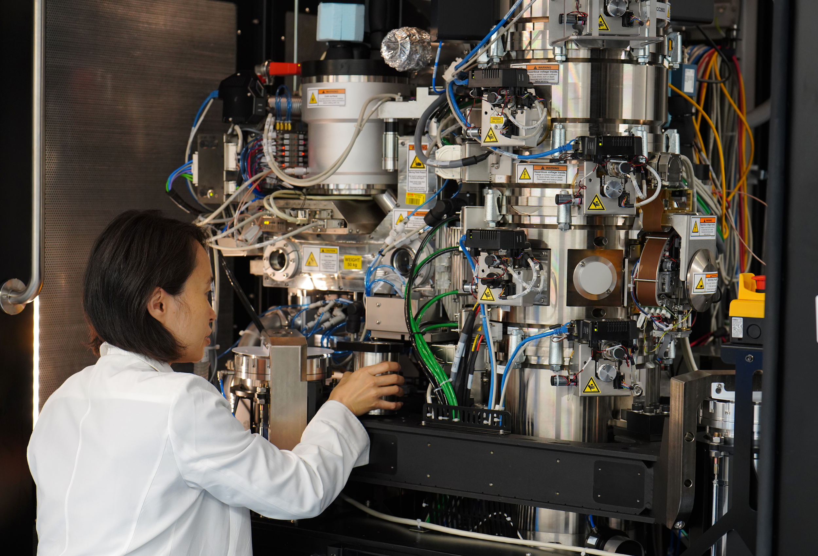
Growth of electron microscopy (EM)
OpenEM Facilities
Facilities | 7
Microscopes | 50
Yearly microscope users | 500
Data Produced | 6.4 PB/year
Notes:
Chart: https://www.ebi.ac.uk/emdb/statistics/builder

Slide 4
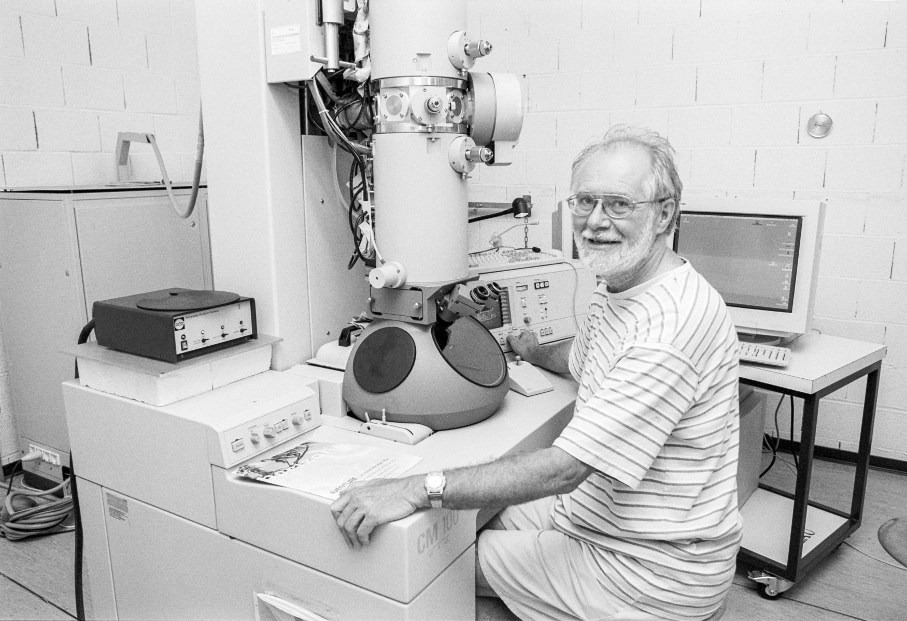
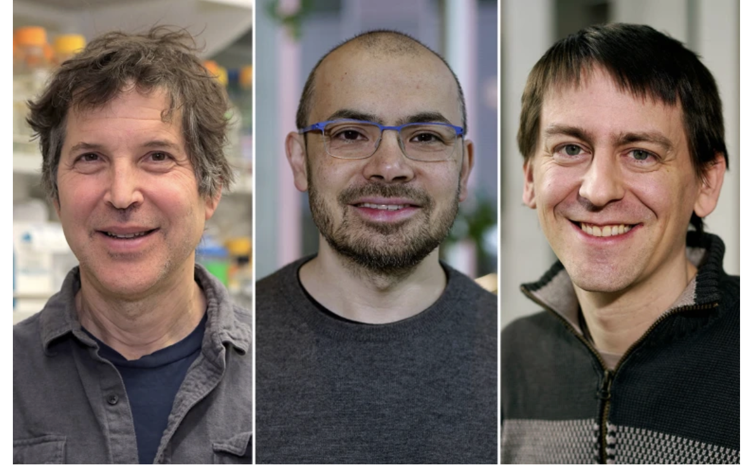
Benefits of FAIR Data (Findable, Accessible, Interoperable, Reusable)
Microscope Users
Standardization between facilities
Automation of metadata recording
Verifiability & reproducibility
Data consumers
Education. Example datasets and workflows
Interdisciplinary reuse of data in new contexts
Method development, especially machine learning
Jacques Dubochet, Lausanne, 2000
2017 Nobel Prize in Chemistry with Joachim Frank and Richard Henderson Credit: Willy Blanchard, EMF, Université de Lausanne
David Baker, Demis Hassabis and John Jumper
2024 Nobel Prize in Chemistry
Credit: BBVA Foundation
Notes:
Jacques Dubochet: 2017 Nobel Prize in Chemistry with Joachim Frank and Richard Henderson
Baker, Hassabis, Jumper: 2024 Nobel Prize in Chemistry
Images:
Professeur Jacques DUBOCHET, au CM100 Philips, LAU, Biophore. © Willy Blanchard, EMF, Université de Lausanne. https://wp.unil.ch/emf/jacques-dubochet-gallery/
Prof. Phil Bourne and student, UC San Diego, circa 2010 (https://web.archive.org/web/20100528041252/http://www.sdsc.edu/pb/index.php)

Slide 5
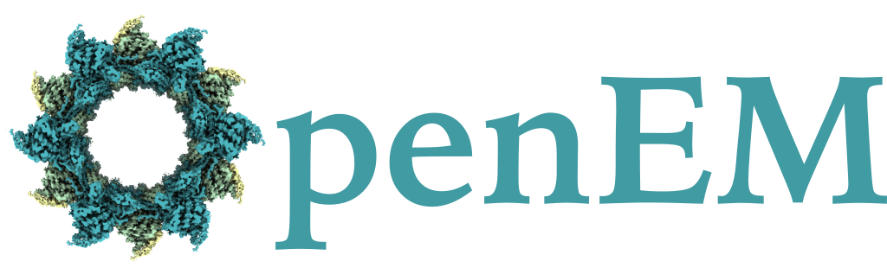
OpenEM
ETH ORD M1 Explore project, led by Henning Stahlberg
swissuniversities Swiss ORD Explore project, led by Robbie Loewith

Slide 6
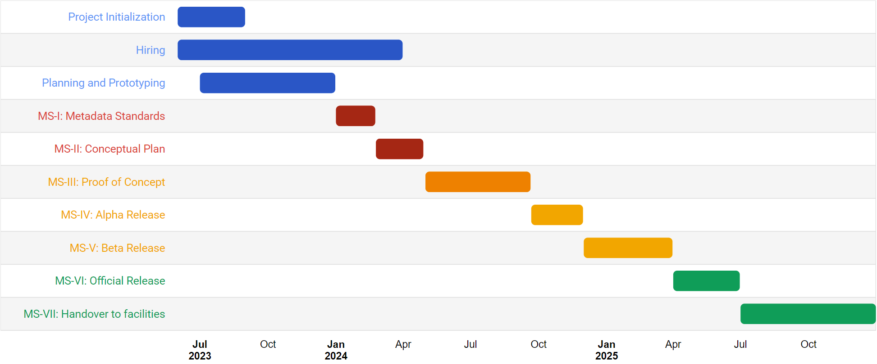
Timeline
OSC-EM Standards Workshop
Swissuniversities intermediate review
MADICES Workshop
MADICES Workshop
cryoET Workshop
ETHZ LTS support
ETH review 1
ETH review 2
SciCatCon User Meeting
Facility Workshop
First EM dataset transfered
Globus transfer

Slide 7
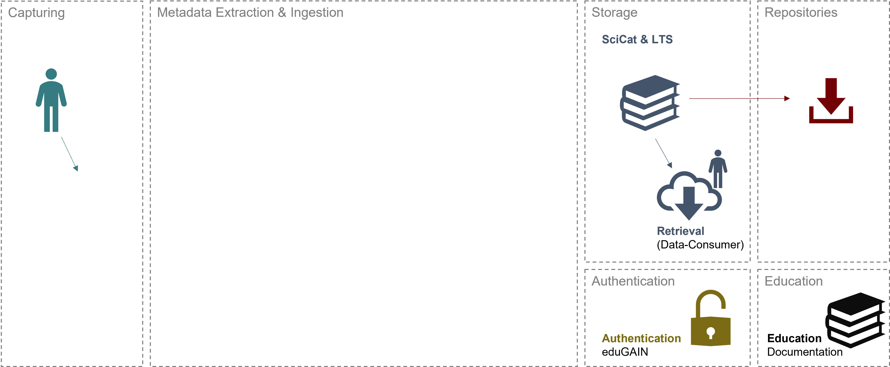







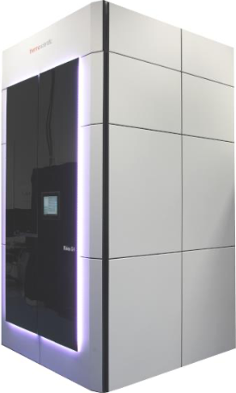

OpenEM: Overview
Catalog
Publishing
Ingestor-Backend
Data transfer via Globus/S3
Researcher
Cataloging and archiving
Ingestor-UI
for upload selection
Ingestor-Backend
Prepare and create Dataset
DOI
Publish in SciCat
Electron Microscopy
Deposition
Export to EMPIAR, EMDB, or PDB
(Automatic) Metadata Extractor
(Automatic) Metadata Extractor
CSCS Petabyte Archive
ETHZ Long Term Storage
Storage of Raw Data

Slide 8
OpenEM: Overview
Catalog
Publishing
Ingestor-Backend
Data transfer via Globus/S3
Researcher
Cataloging and archiving
Ingestor-UI
for upload selection
Ingestor-Backend
Prepare and create Dataset
DOI
Publish in SciCat
Electron Microscopy
Deposition
Export to EMPIAR, EMDB, or PDB
(Automatic) Metadata Extractor
(Automatic) Metadata Extractor
CSCS Petabyte Archive
ETHZ Long Term Storage
Storage of Raw Data

Slide 9







Open Science Community for EM (OSC-EM) https://github.com/osc-em
Rigorous schema for scientific metadata utilizing established community definitions from existing ontologies
Implemented in LinkML and compatible with JSON-LD, JSON Schema, RDF, etc
Multiple supported techniques: single particle, subtomogram averaging, cellular tomography, environmental tomography, and processing (Planned: EELS, STEM, 4D-STEM)
Import from cameras using SerialEM or Thermo-Fisher EPU (Planned: Gatan Digital Micrograph)
Convert to mmCIF/PDBx (used by EMDB and PDB)
Join our monthly meetings!
Scipion

Slide 10
OpenEM: Overview
Catalog
Publishing
Ingestor-Backend
Data transfer via Globus/S3
Researcher
Cataloging and archiving
Ingestor-UI
for upload selection
Ingestor-Backend
Prepare and create Dataset
DOI
Publish in SciCat
Electron Microscopy
Deposition
Export to EMPIAR, EMDB, or PDB
(Automatic) Metadata Extractor
(Automatic) Metadata Extractor
CSCS Petabyte Archive
ETHZ Long Term Storage
Storage of Raw Data

Slide 11
OpenEM: Overview
Catalog
Publishing
Ingestor-Backend
Data transfer via Globus/S3
Researcher
Cataloging and archiving
Ingestor-UI
for upload selection
Ingestor-Backend
Prepare and create Dataset
DOI
Publish in SciCat
Electron Microscopy
Deposition
Export to EMPIAR, EMDB, or PDB
(Automatic) Metadata Extractor
(Automatic) Metadata Extractor
CSCS Petabyte Archive
ETHZ Long Term Storage
Storage of Raw Data

Slide 12

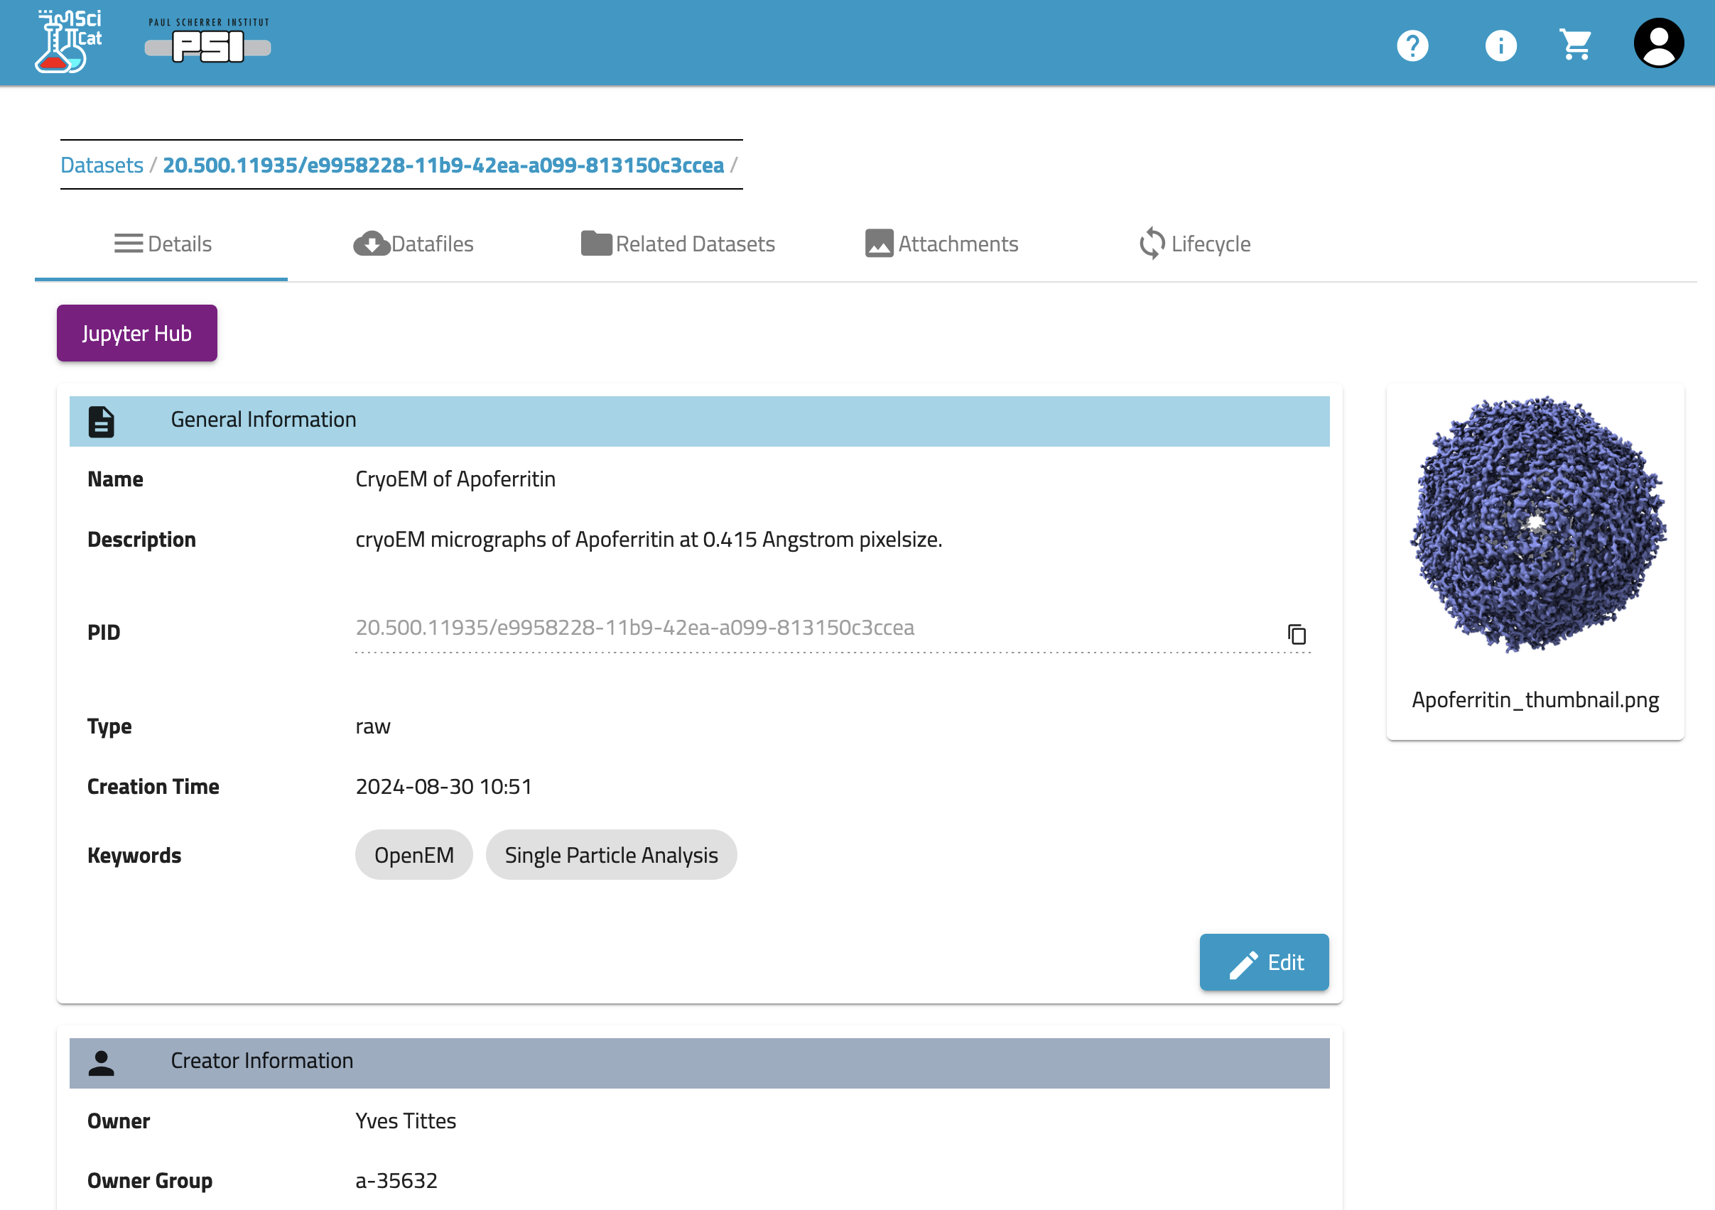
Data Catalog
https://discovery.psi.ch
https://www.scicatproject.org/

Slide 13
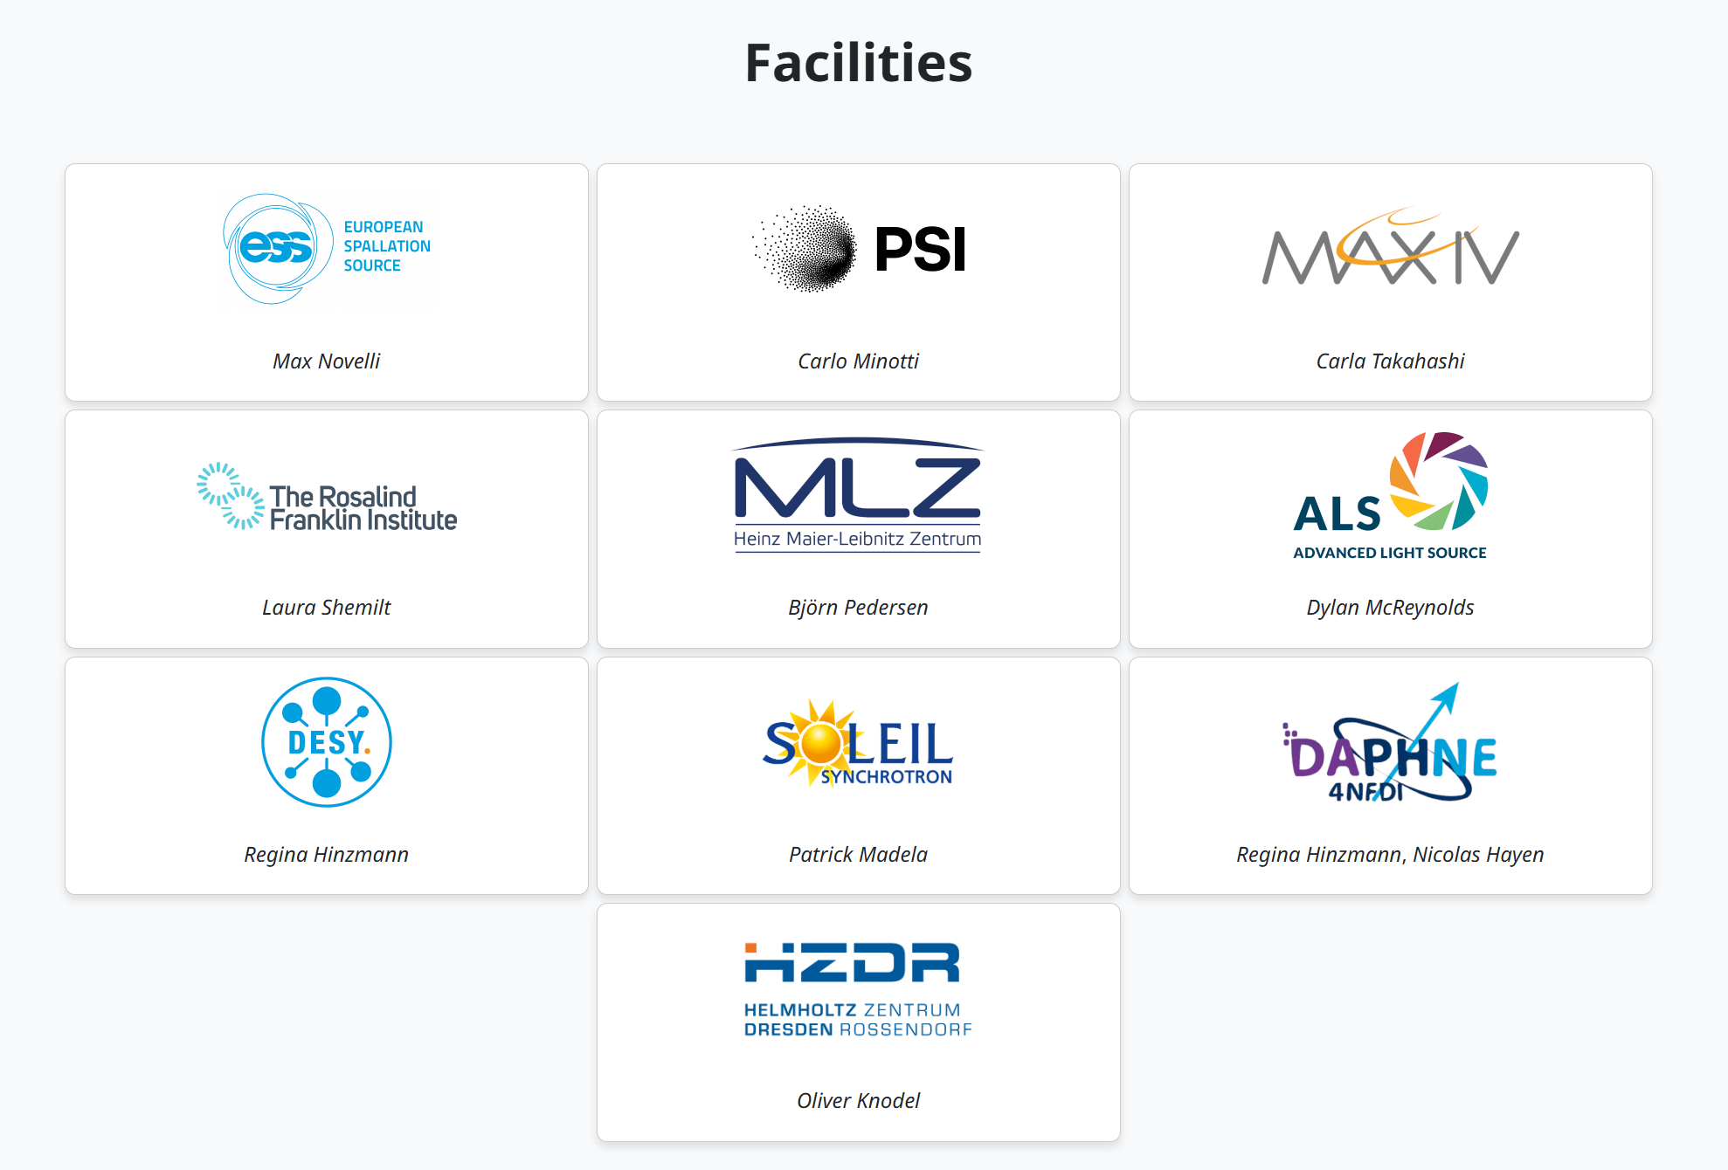

SciCat Collaboration
www.scicatproject.org

Slide 14
OpenEM: Overview
Catalog
Publishing
Ingestor-Backend
Data transfer via Globus/S3
Researcher
Cataloging and archiving
Ingestor-UI
for upload selection
Ingestor-Backend
Prepare and create Dataset
DOI
Publish in SciCat
Electron Microscopy
Deposition
Export to EMPIAR, EMDB, or PDB
(Automatic) Metadata Extractor
(Automatic) Metadata Extractor
CSCS Petabyte Archive
ETHZ Long Term Storage
Storage of Raw Data

Slide 15


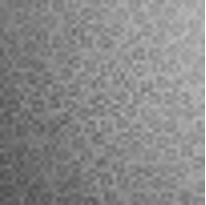
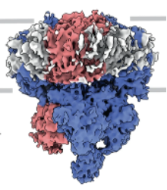
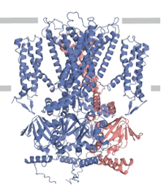
Publishing
Publish with SciCat
Assign a DOI
Retrievable via download links
Indexed by EOSC, b2find, Google dataset search, etc
Provide DataCite and OAI-PMH metadata for interoperability
Supports all data types
Publish to EMPA/PDB/EMPIAR
Suitable for life science datasets
Metadata can be downloaded in mmCIF format and uploaded to OneDep (EMDB+PDB)
Directly start a EMDB or PDB submission from the dataset and continue on the OneDep site
Migrate raw data to EMPIAR (planned)
micrographs
maps
models

Slide 16
Summary of benefits
Before OpenEM | After OpenEM
Diverse data collection workflows | Unified workflows at all facilities
Separate accounts per facility | Single sign-on
Manually log instrument settings | Standardized, automated metadata
Data stored on hard drives or lab storage systems | High-reliability tape storage
Access “by request” | Easy online access
Manual deposition in EMDB/EMPIAR/PDB | Pre-fill deposition forms
No data repository for many data types | FAIR publication in SciCat

Slide 17


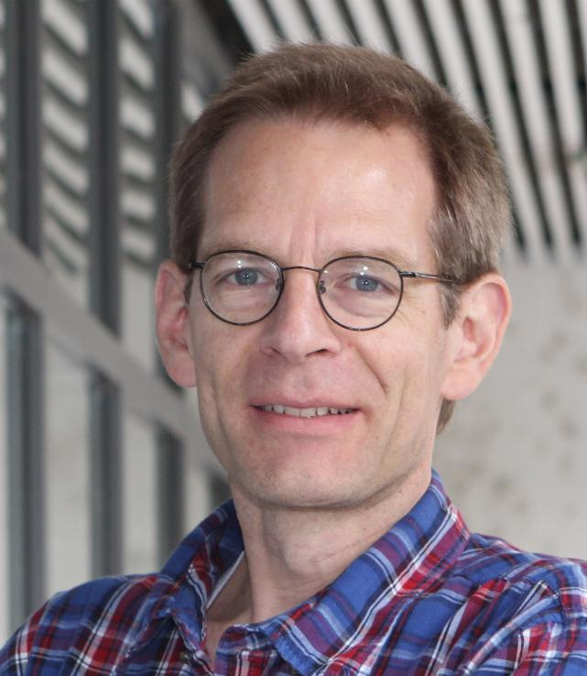
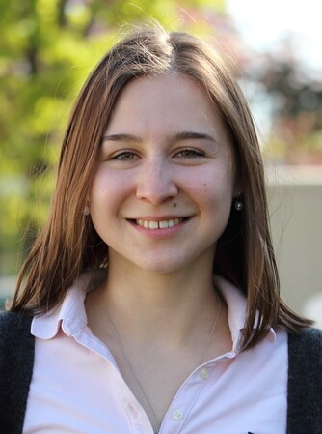
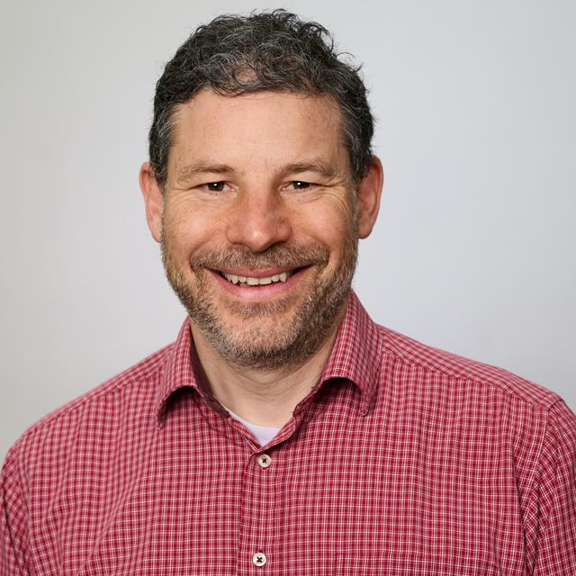
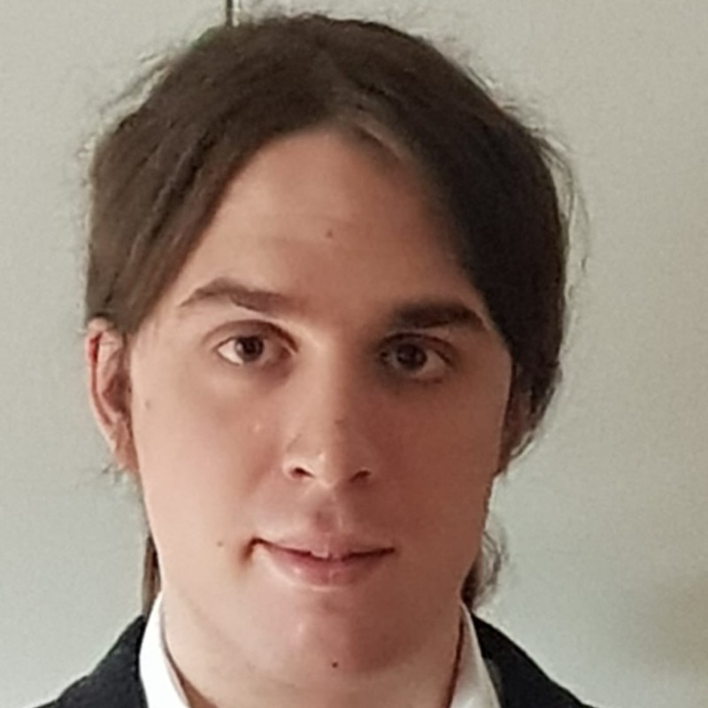
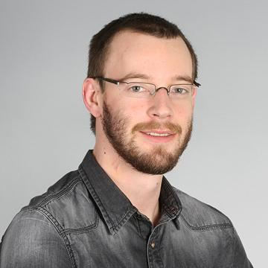

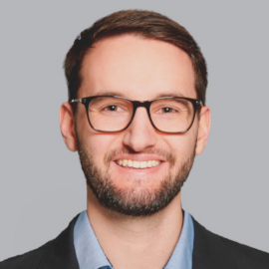
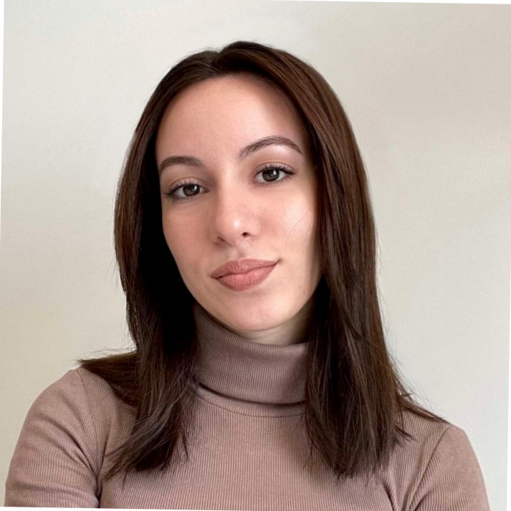

Acknowledgements
Funding: the Open Research Data Program of the
and by a Open Research Data Grant (CHORD).
Andreas Boland, Orsolyz Barabas, Andrew Howe, Attila Nacsa, Robbie Loewith
Marco Cantoni, Sofya Lakina, Alexander Myasnikov, Alexandra Radenovic, Henning Stahlberg,
Mohamed Chami, Timm Maier, Yves Tittes
Alun Ashton, Gregor Cicchetti, Peter Hüsser, Michael Kallmeier-Glanz, Volodymyr Korkhov, Carlo Minotti, Elisabeth Müller, Gebhard Schertler
David Kalbermatter, Benoît Zuber, David Wiessner, Daniel Alder
Rolf Erni, Despina Adamopoulou
Matthew Baker, Nicolas Blanc, Daniel Böhringer, Christophe Briand, Christophe Copéret, Miroslav Peterek, Bilal Qureshi, Andrzej J. Rzepiela, Philipp Wissmann
Notes:
26 participants
Possibly missing:
UNIBAS Markus Dürrenberger (Nano Imaging Lab), Ben Engel (Prof., Biozentrum), Marcus Wyss
UNIBE: Wanda Kukulski (Prof., DCI-Bern), Dimitrios Fotiadis (Inst. Biochem. & Mol. Medicine), Beat Haenni (EM lab head)
UNIGE: Paul Guichard (Prof., DCI-Geneva)
UNIZH: Raimund Dutzler (Prof., Dep. Biochem.), Ohad Medalia (Prof., Dep. Biochem.), Urs Ziegler (Cent. F. Microsc. & Image Analysis), Andres Käch (Cent. F. Microsc. & Image Analysis)

Slide 18
Resources
OpenEM Websites
Public project website: https://openem.ch
ETH ORD Portal: https://open-research-data-portal.ch/projects/open-em-data-network/
Github: https://github.com/SwissOpenEM
OSC-EM Standard
https://github.com/osc-em
SciCat Data Catalog
Data repository: https://discovery.psi.ch
Published datasets: https://doi.psi.ch
SciCat website: https://scicatproject.github.io

Slide 19
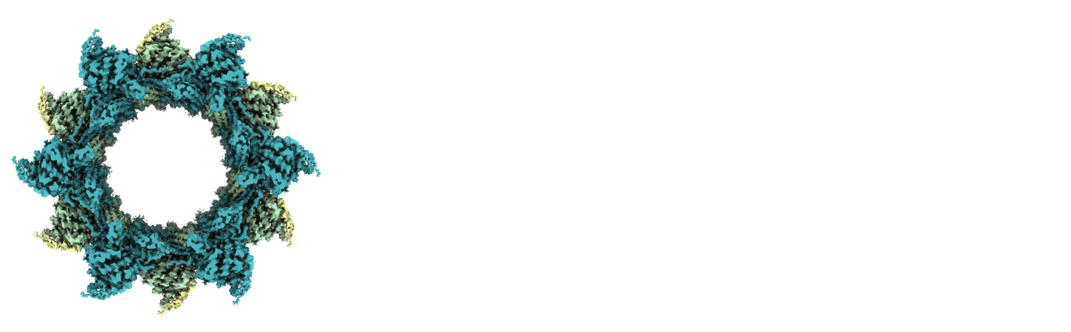
Extra slides

Slide 20
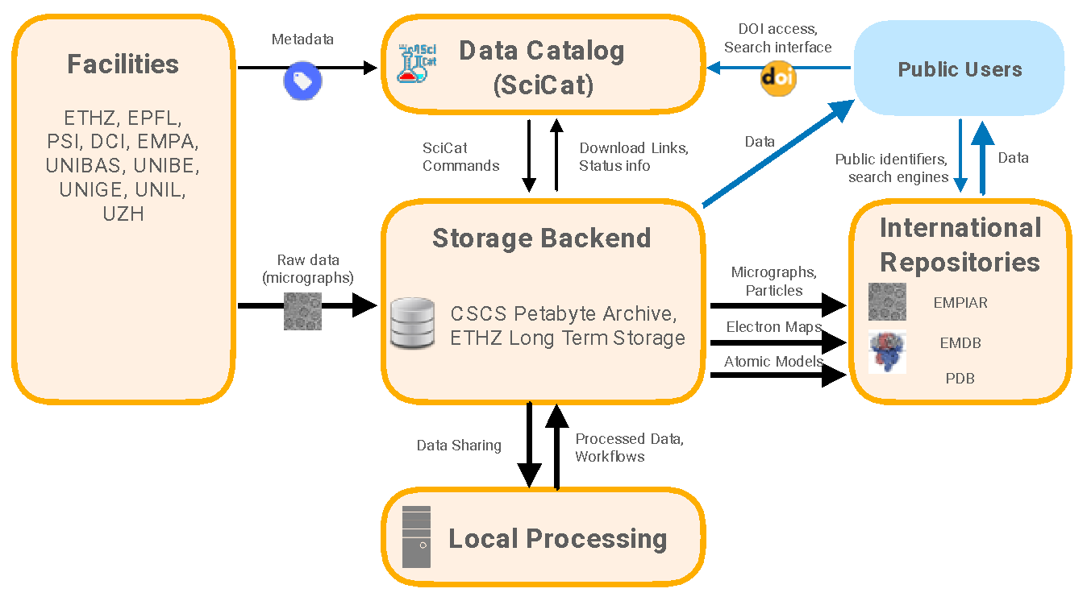

OpenEM Work Packages & Tasks
4.1 Website & Training
1.1 EM Standard
4.2 Workshops & Collaboration
1.2 Metadata
Collection
2.1
Ingestor Tool
2.1 Data Catalog Development
3.1 Deposition Tool
4.3 Sustainable Funding
2.1 Federated Authentication & Authorization
2.2 ETHZ Archiver System

Slide 21
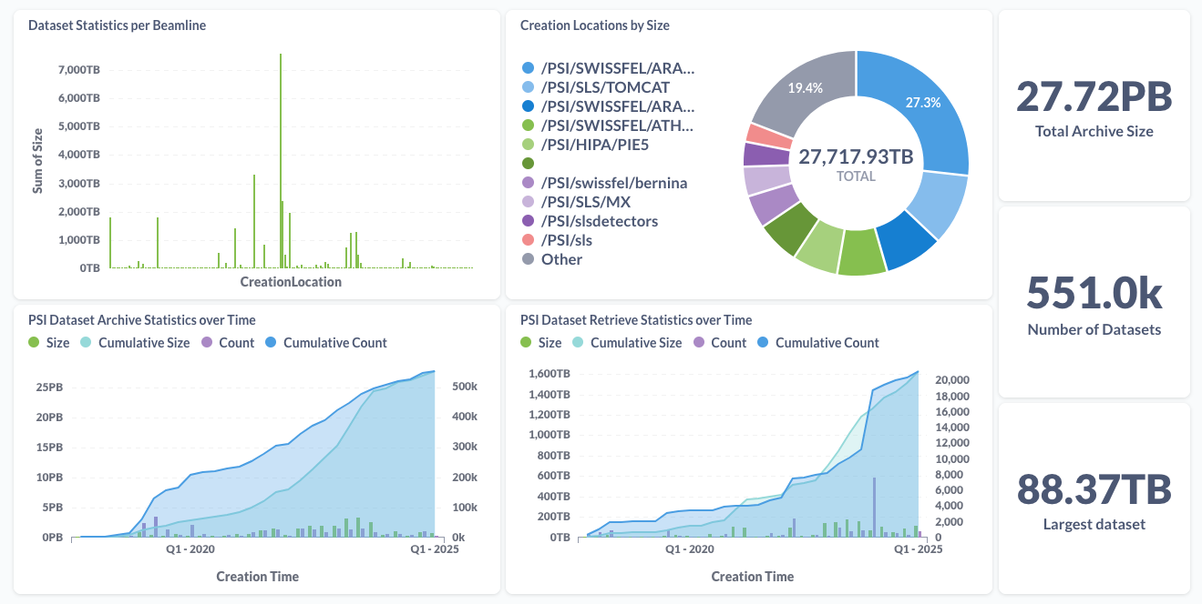
SciCat usage

Slide 22
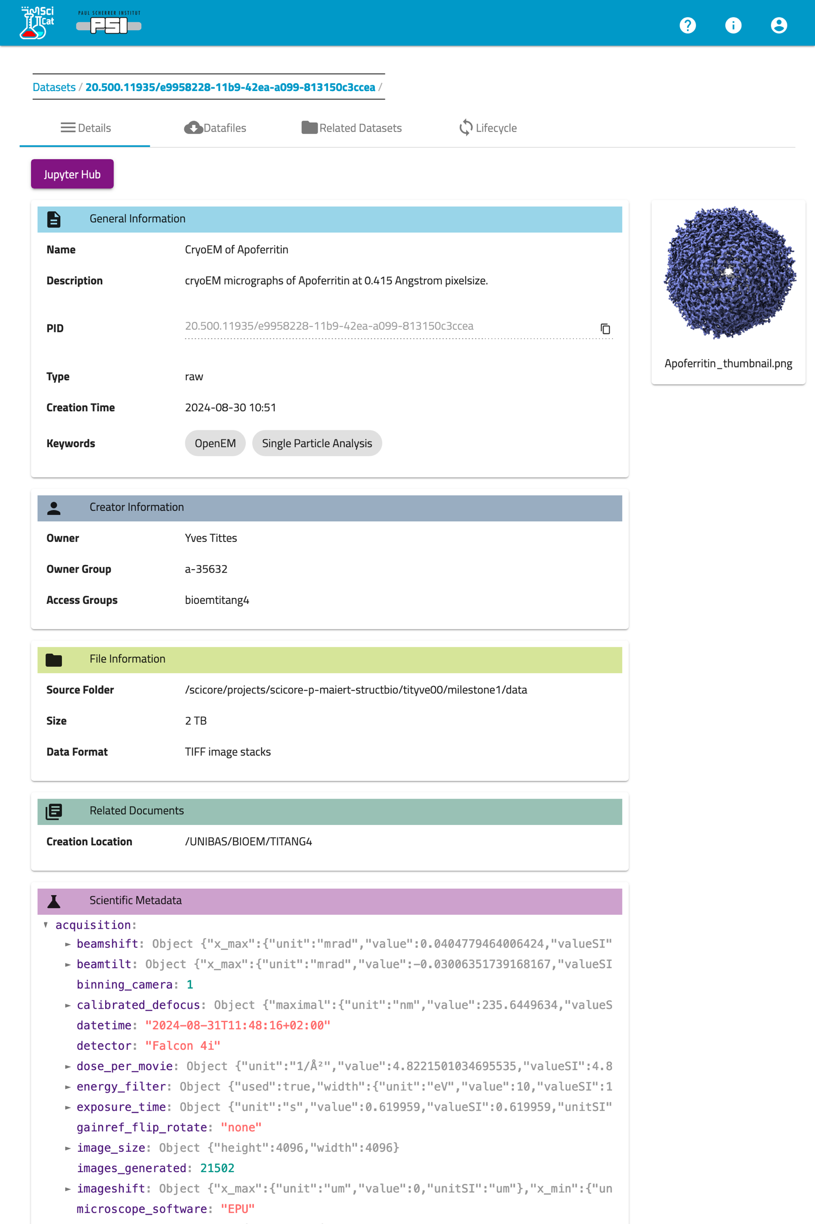
Example Dataset: Apoferritin
Single particle dataset of 21502 images collected at the UNIBAS BioEM Lab by Yves Tittes
https://doi.psi.ch/detail/10.16907%2Fa2ab7849-5de7-4e7f-8286-72ec73089ca8

Slide 23






Data Ingestion
Facility
Cloud
ETHZ, CSCS
EMDB, EMPIAR, PDB
discovery.psi.ch
User Client
SciCat
External repositories
Metadata
PSI, ETHZ
Mount data
Data
Instrument
Ingestor Service
Archiver System
Long-Term- Storage
🔥Firewall🔥

Slide 24
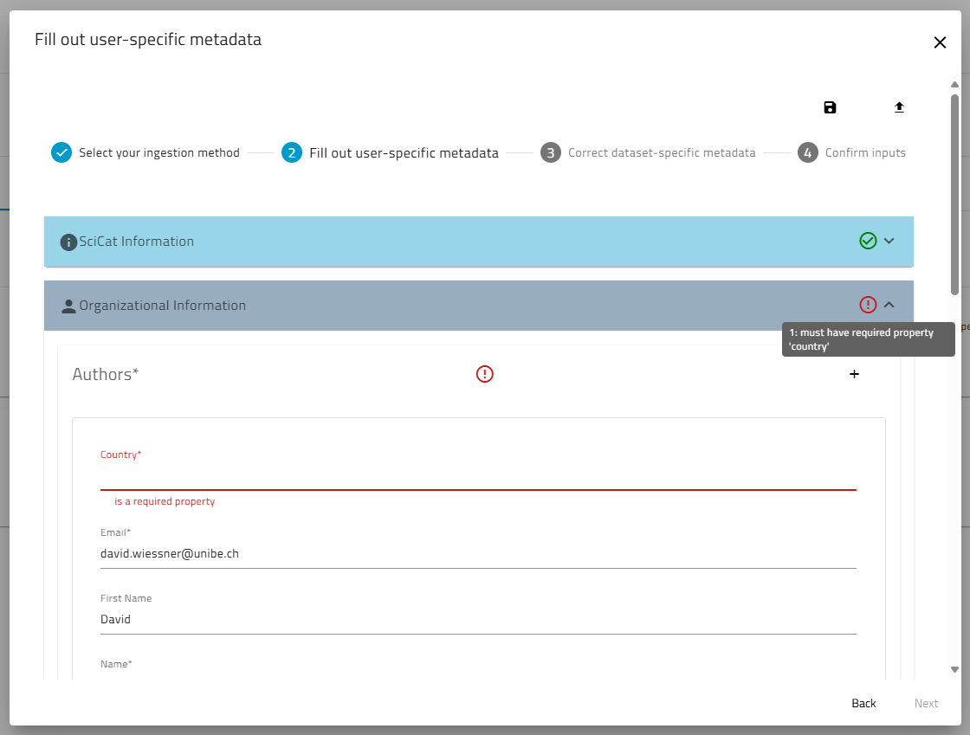
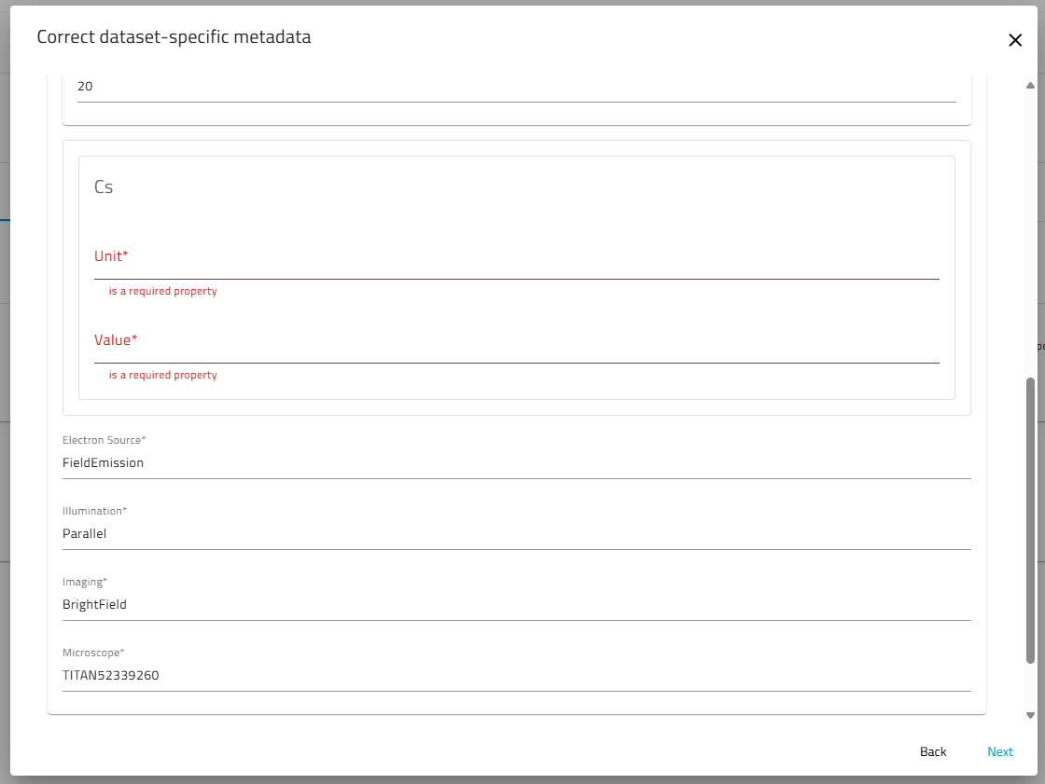
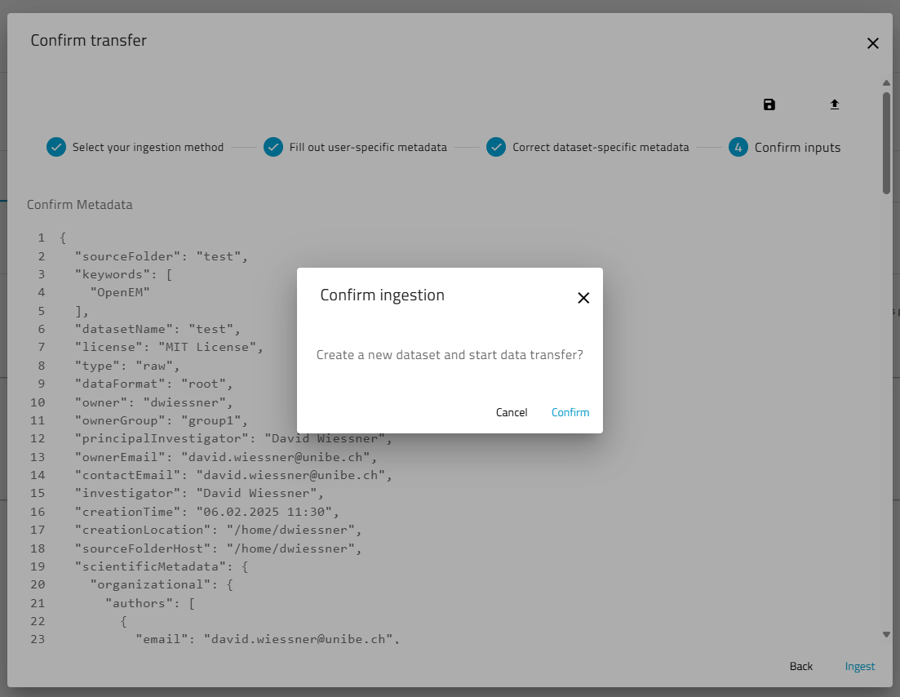
Ingesting Data
Select Dataset & Method
Provide user-related Metadata
Check extracted Metadata
Confirm and Ingest
User receives Mail
User Steps
Automatic Steps
Server starts Extraction
Server creates Dataset
Server starts data transfer

Slide 25
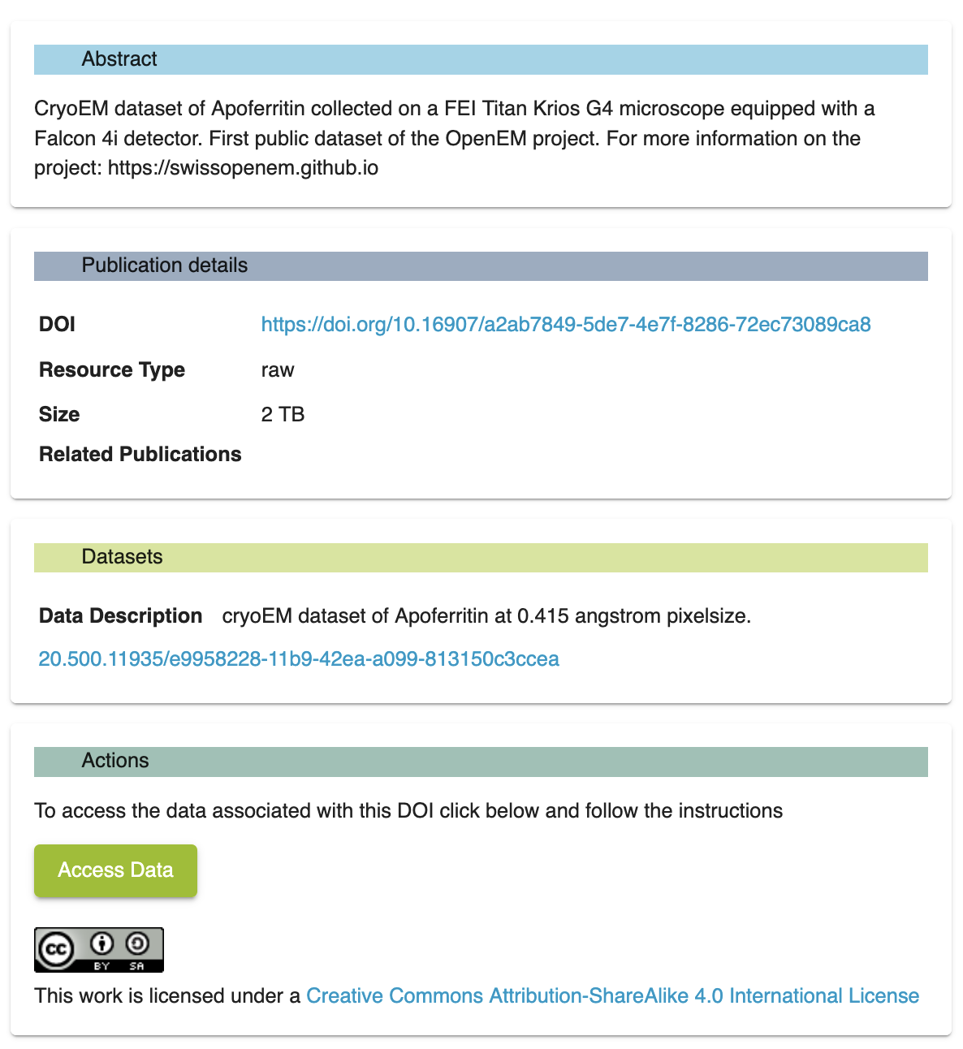
Retrieval and Reuse
Datasets can be retrieved via email links (or some more advanced tools)
Retrieval from tape may take minutes to days depending on load

Slide 26
Sustainability
Primary operations will be handed over to facility staff and PSI Science IT
Fees for storage and operations will be distributed fairly among facilities in accordance with the OpenEM Steering Committee
Additional funding is being sought for follow-up projects to continue development of additional features and continue community engagement

Slide 27

Slide License

