Slide 1
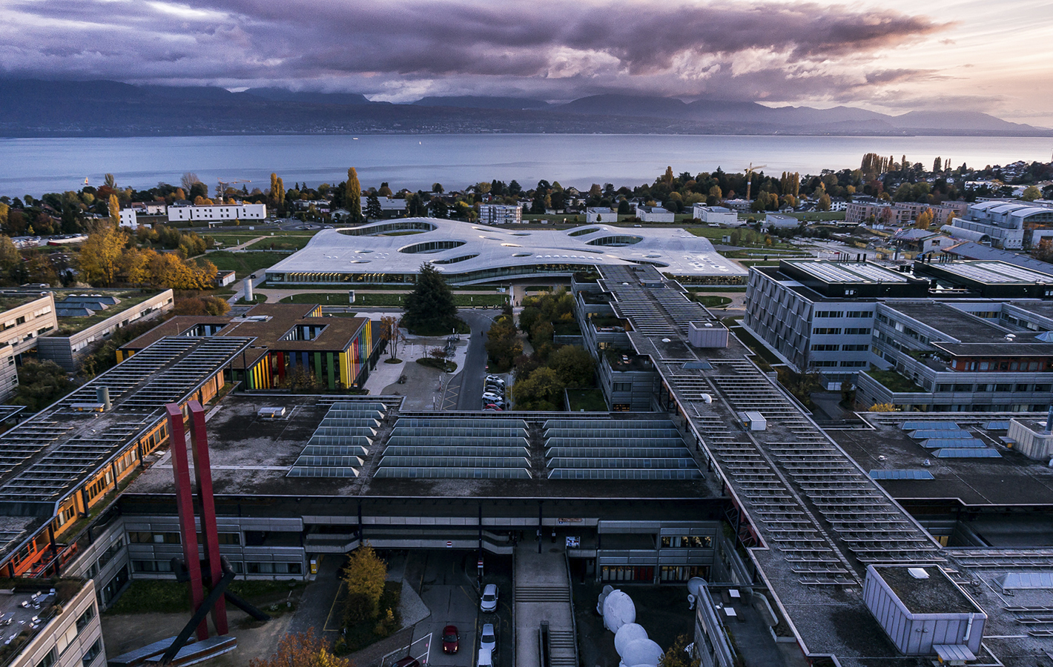
Lessons learned from 5 years of implementing FAIR practices
ETH Domain ORD Event
June 12th, 2025
Charlie Weil
IT4R, EPFL
Notes:
Hi I’m Charlie.
It’s been really inspiring to hear from the researchers – now I’m here to bring the perspectives of the research support staff.
>I’ll Introduce our team of RSEs and our lesson learned from 5 years of fostering a FAIR landscape at EPFL, specifically ENAC.

Slide 2

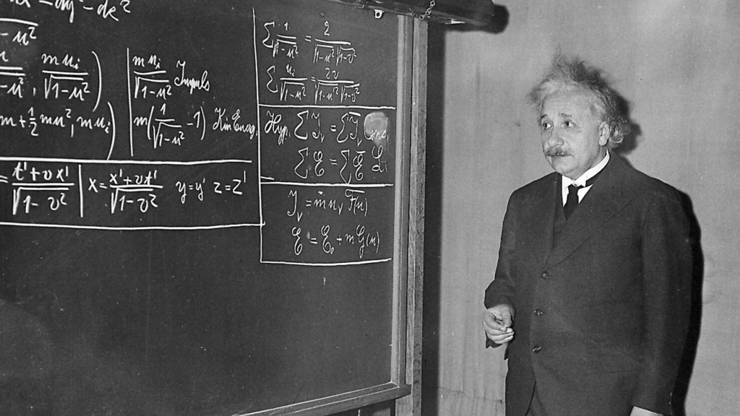
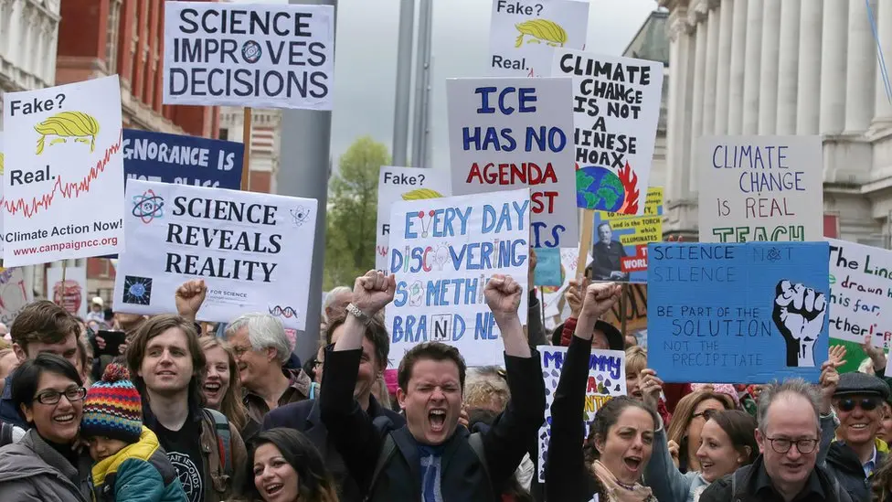
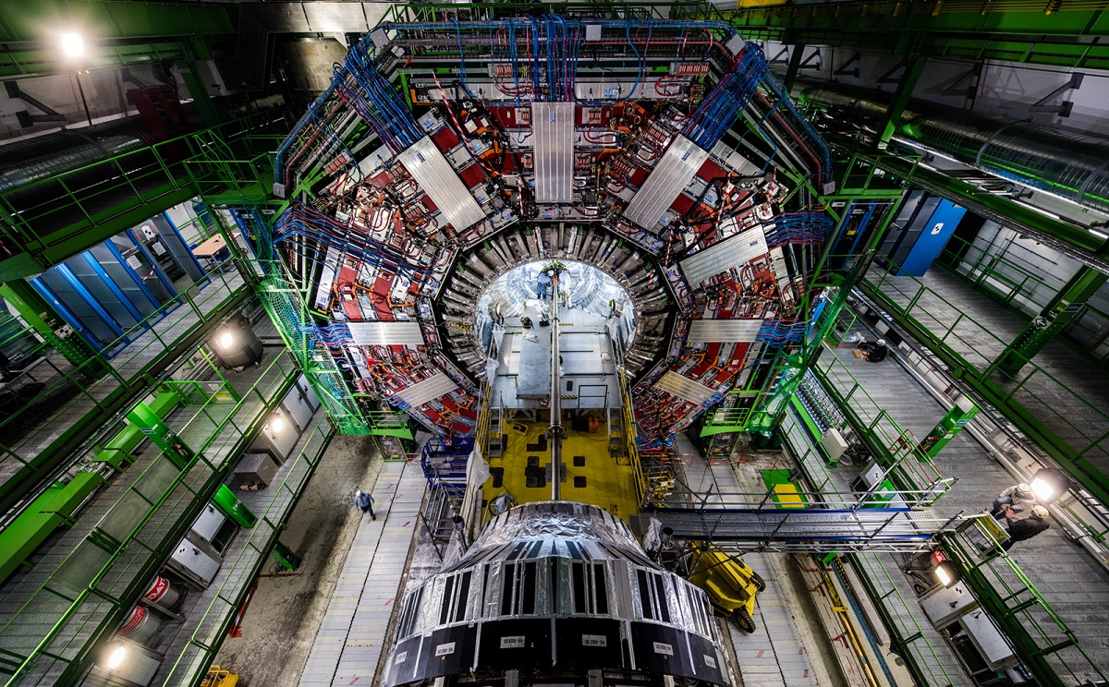
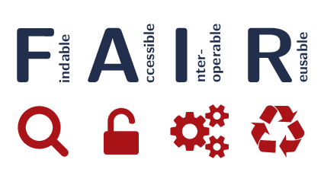
Why ?
Why ?
Science Under Pressure
Collaborative Research
Scientists need tech
Research now requires data & code
FAIR in practice is often complicated
⇢ Technical expertise are needed
Notes:
Before I jump in, I’d like to share a word on why this matters to me – enough that i’d make my way hobbling up here in crutches !
To solve today’s big issues. We need trustworthy,— now more than ever.-
We need Transparency : Findable accessible SCIENCE
(2) In the last century, science has shifted from the solo researcher/genius to increasingly large teams – (img : CERN: the Collider Involved over 10,000 scientists). To Coordinate across teams, we need research assets INTEROPERABLE, RESUABLE
But to do FAIR in practice isn't easy -> Scientists need technical expertise.
Image sources
FAKE NEWS image © Jeso Carneiro (CC BY-NC 2.0)
March for Science : AFP/Getty Images https://www.bbc.com/news/world-39679629

Slide 3
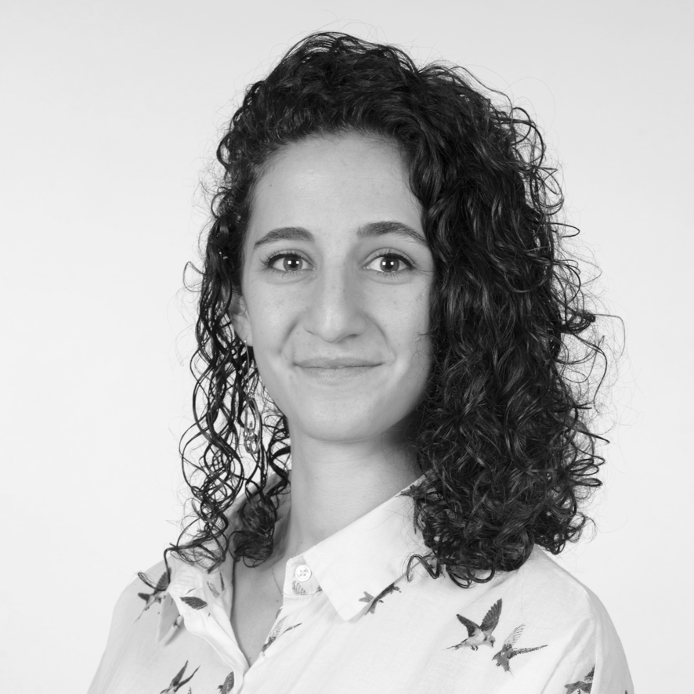
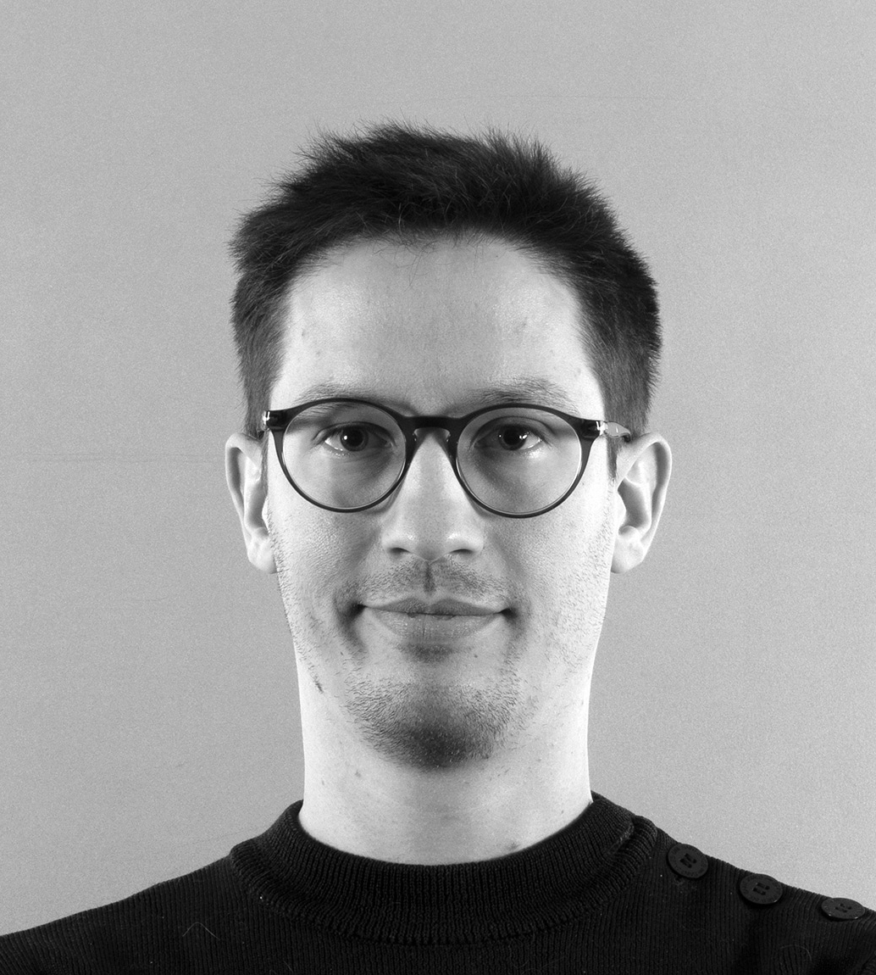
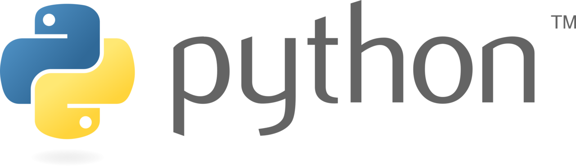

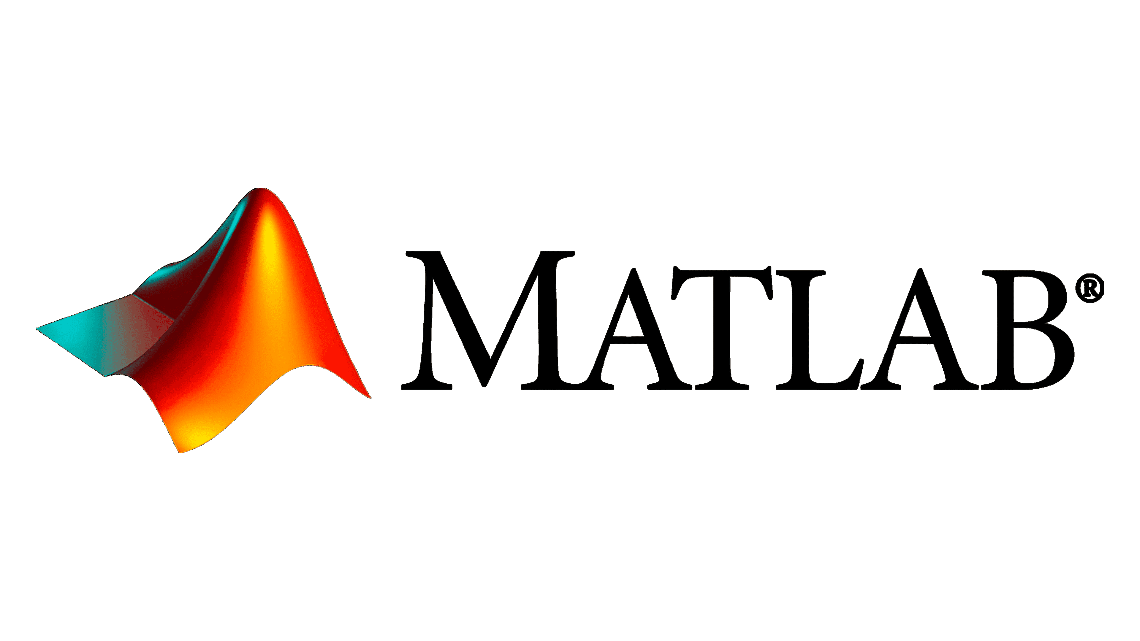

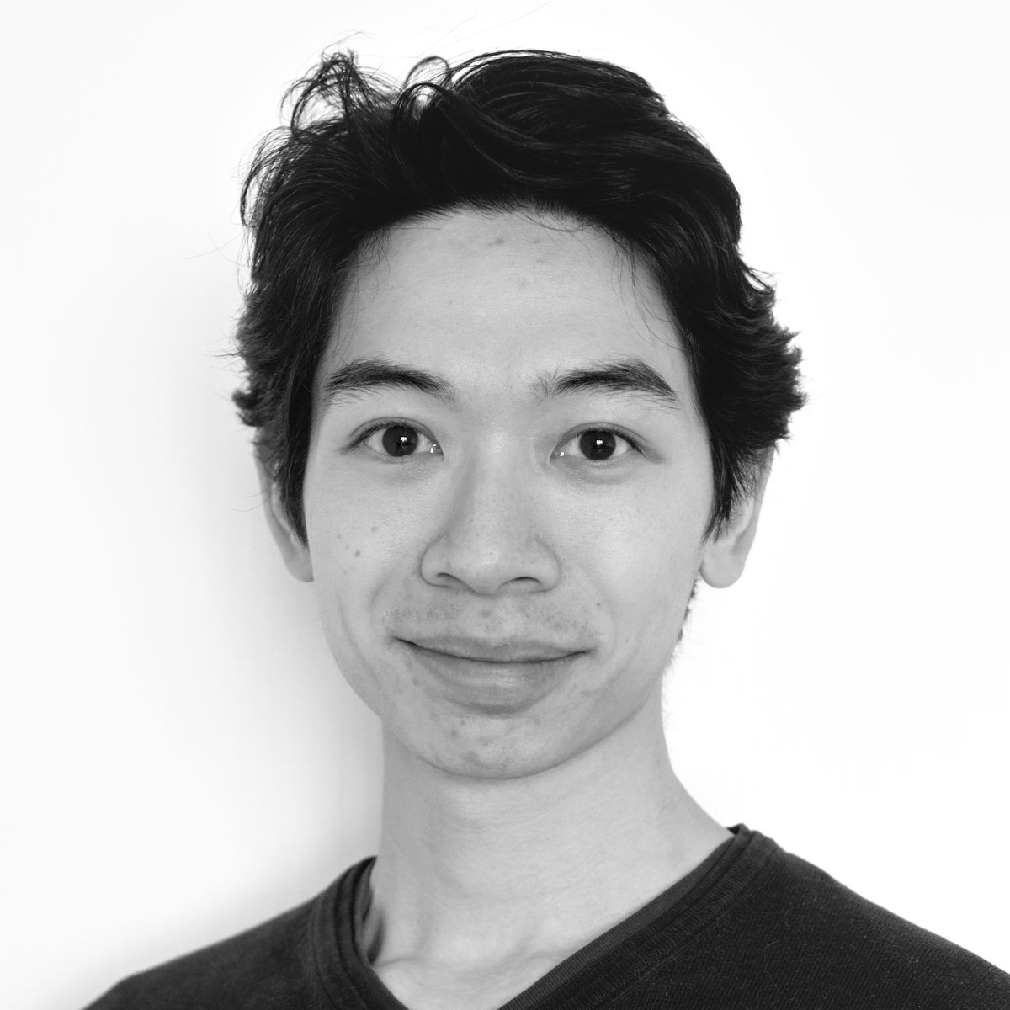
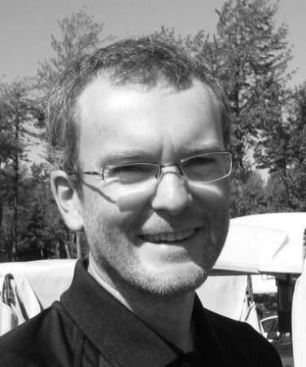



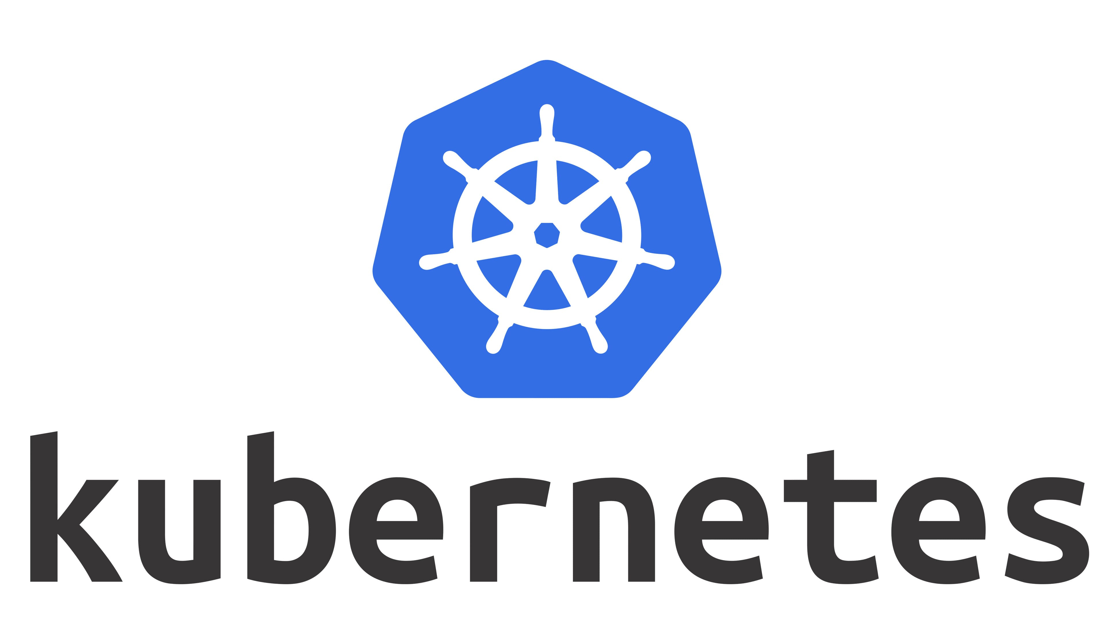
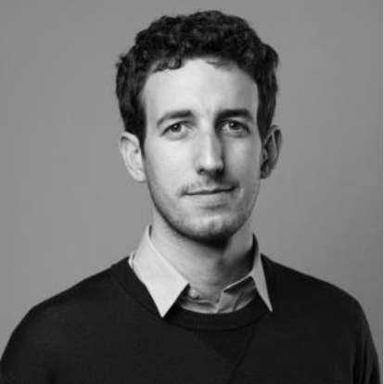
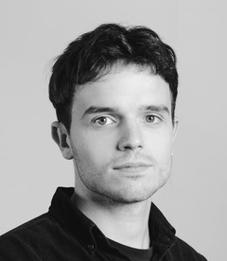

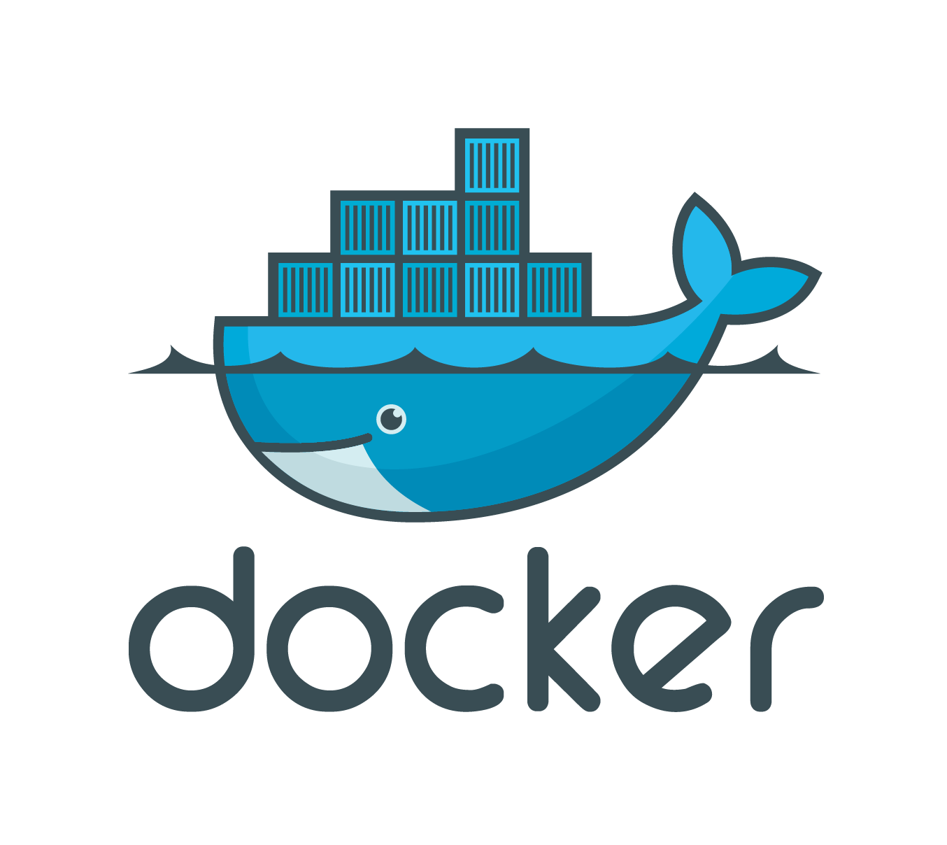
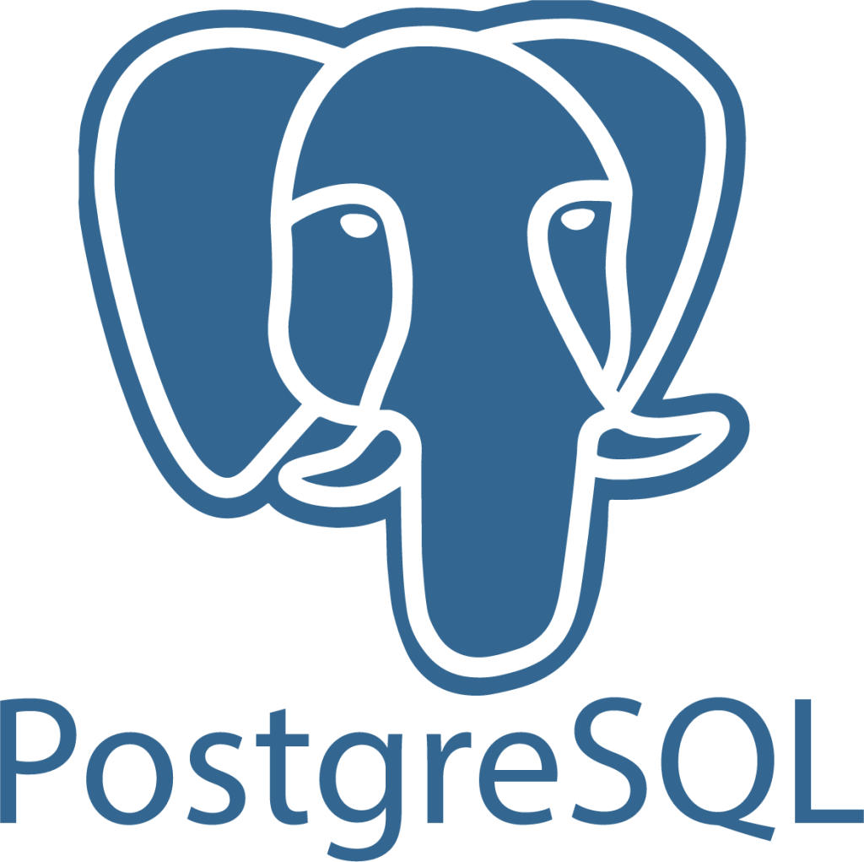

Data & software engineers at-hand for researchers Data & software expertise to cover diverse technologies
5 FTE with backgrounds in software + research
Data engineers
Web developers
“Research software engineers”
Notes:
ENAC-IT4R is a dedicated team of software and data engineers - to support researchers with their data & code, throughout the research data lifecycle - bringing data/software expertise to foster an open, FAIR and consistent ORD landscape.
We're a team of 6 RSEs (data eng, web) with various xps to cover the tech skills needed by our research community Mix of background in sotware engineering - & research (half of our staff has phDs) – making us polyvalent knowledgeable of both
state-of-the art tech / software engineering practices
Academic context and its constraints

Slide 4



Data & software engineers at-hand & on demand Pay-per-use model like any shared infrastructure for researchers
Benefits for researchers
On-demand, part-time expertise available
Diversity of skills
Long-term support
OS tools capacity building
Benefits for RSEs*
Career opportunities (long-term contracts)
Career development (within software team)
Stimulating research environment
Benefits for the School
Scientific valorization and outreach tools
Fostering open science practices, interdisciplinarity
Acquiring external research funding
*RSE: Research software engineer
Notes:
We function like any Shared Infrastructure for researchers -> On-demand, pay-per-hour model.
Because - Researchers need on-demand part-time support (Where labs typically need "20% full-stack dev for 6 months". Not worth hiring!)
Access to diverse skills
Long-term support (if some of us move on)
Increase literacy on OS/software tools
For us (RSEs)
It offers a real structure for this technical Roles Transversal to research:
Software engineers needs recognition and reliable jobs.
Career recognizing technical contributions (vs. papers only in academia)
Teamwork is key to effective software dev, and staying up-to-date with tech development
Stimulating work : meaningful, varied topics.
For the School
Clearly increases the impact of research by building tools to put research in the right hands
and economically interesting when the tasks would typically be outsourced to dev companies (much more expensive)

Slide 5





Supporting researchers with their data and code Fostering Open Research Data and FAIR practices
Research Data Lifecycle
Create
Data acquisiton
Organize
e.g harmonization
Store
Infrastructure
Share
Visualization
Use
Data analysis
Archive
Long-term
Software dev & packaging
Code packaging, refactoring, migration, deployment
Collaborative repository mgt
Data valorization
Web application development
Database set-up
Data pipelines automation
Notes:
We support researchers all throughout the Research Data Lifecylce,
But most of our projects fall either into
Dev : packaging research scripts –> - Packaging research code, into reusable librairies – including -- Code refactoring and optimization,
Data valorization : developing tailored web apps…

Slide 6
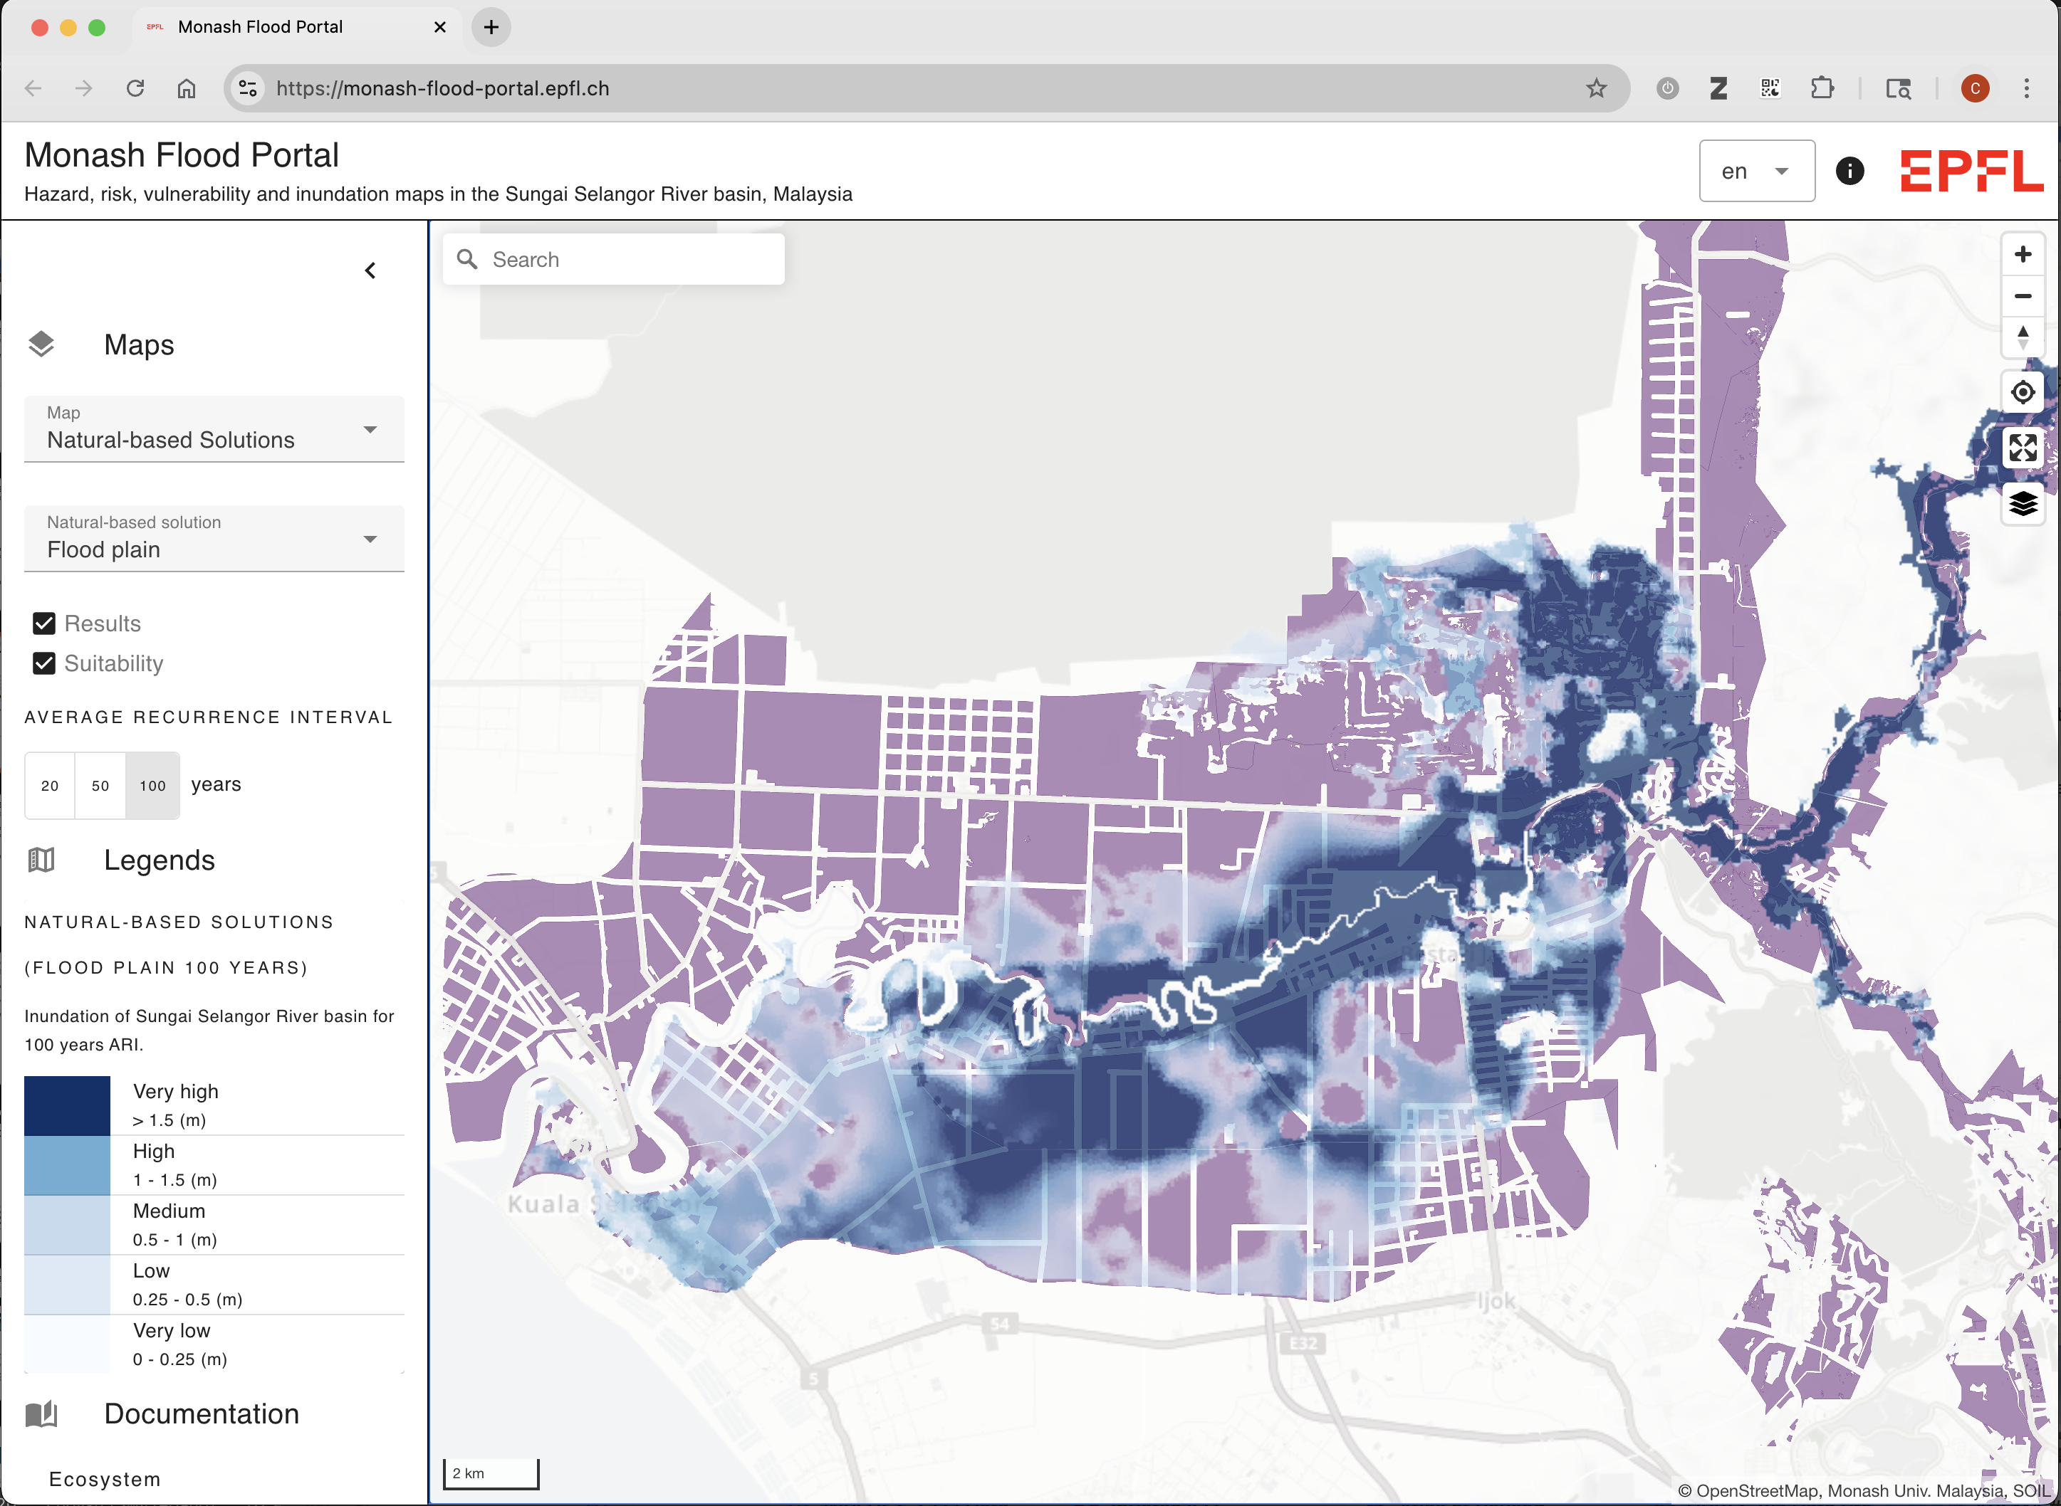
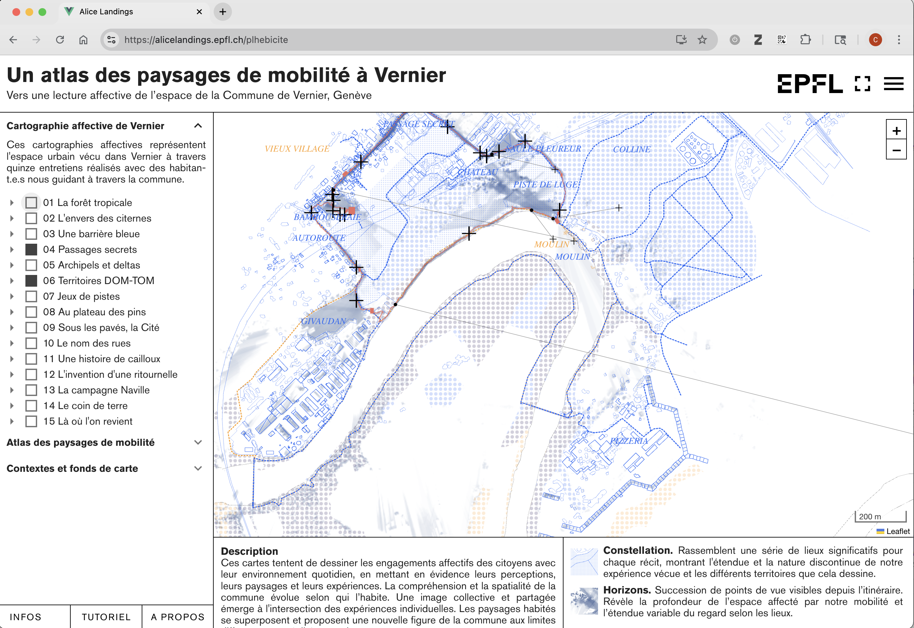
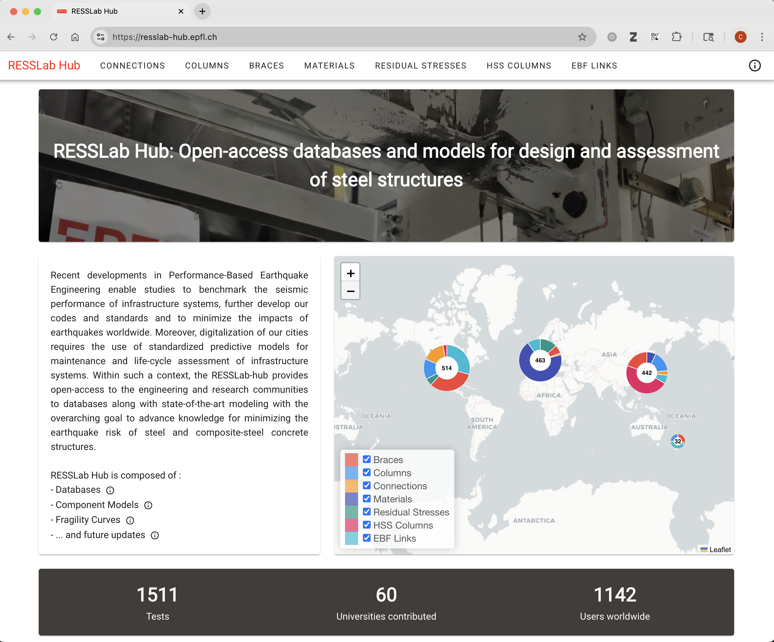
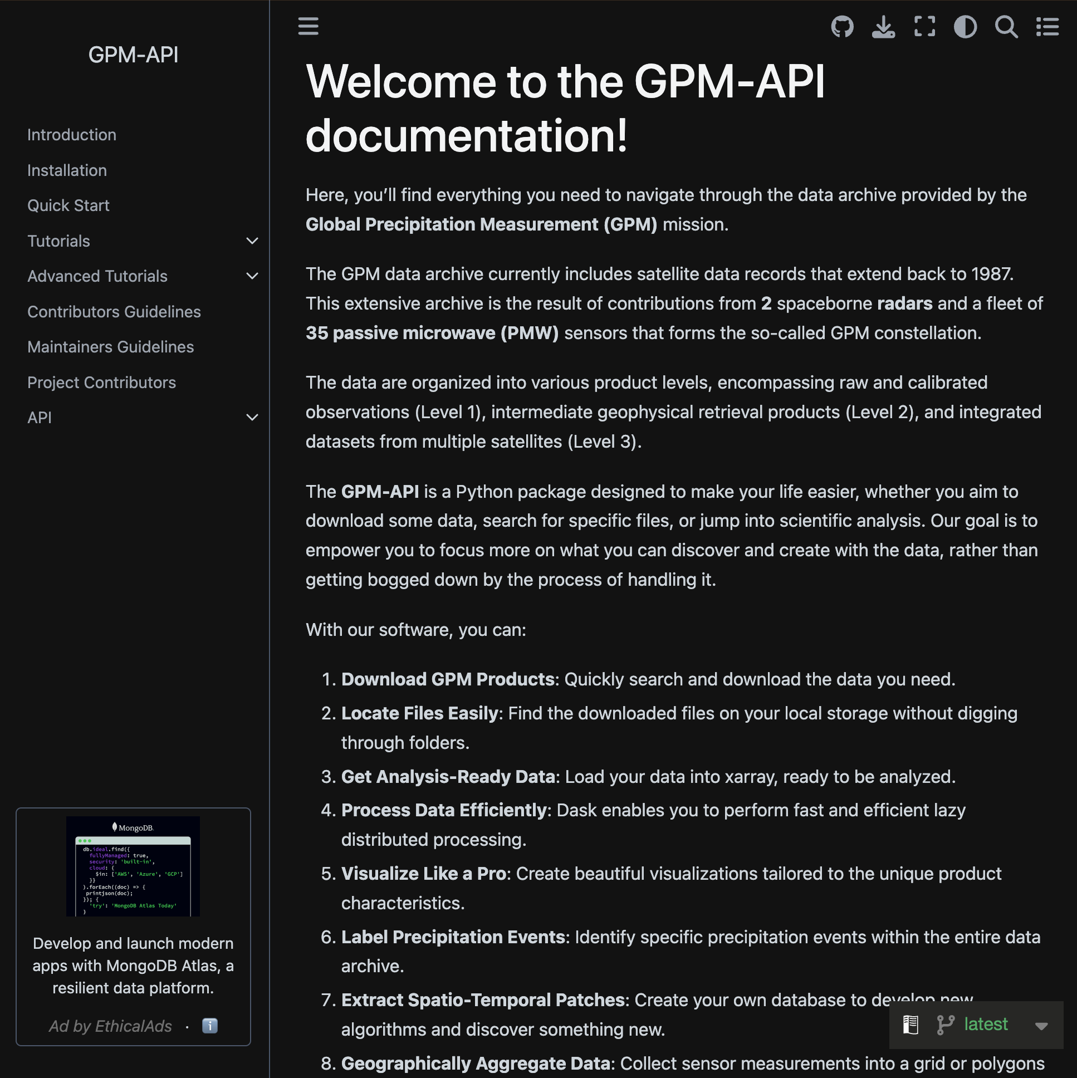
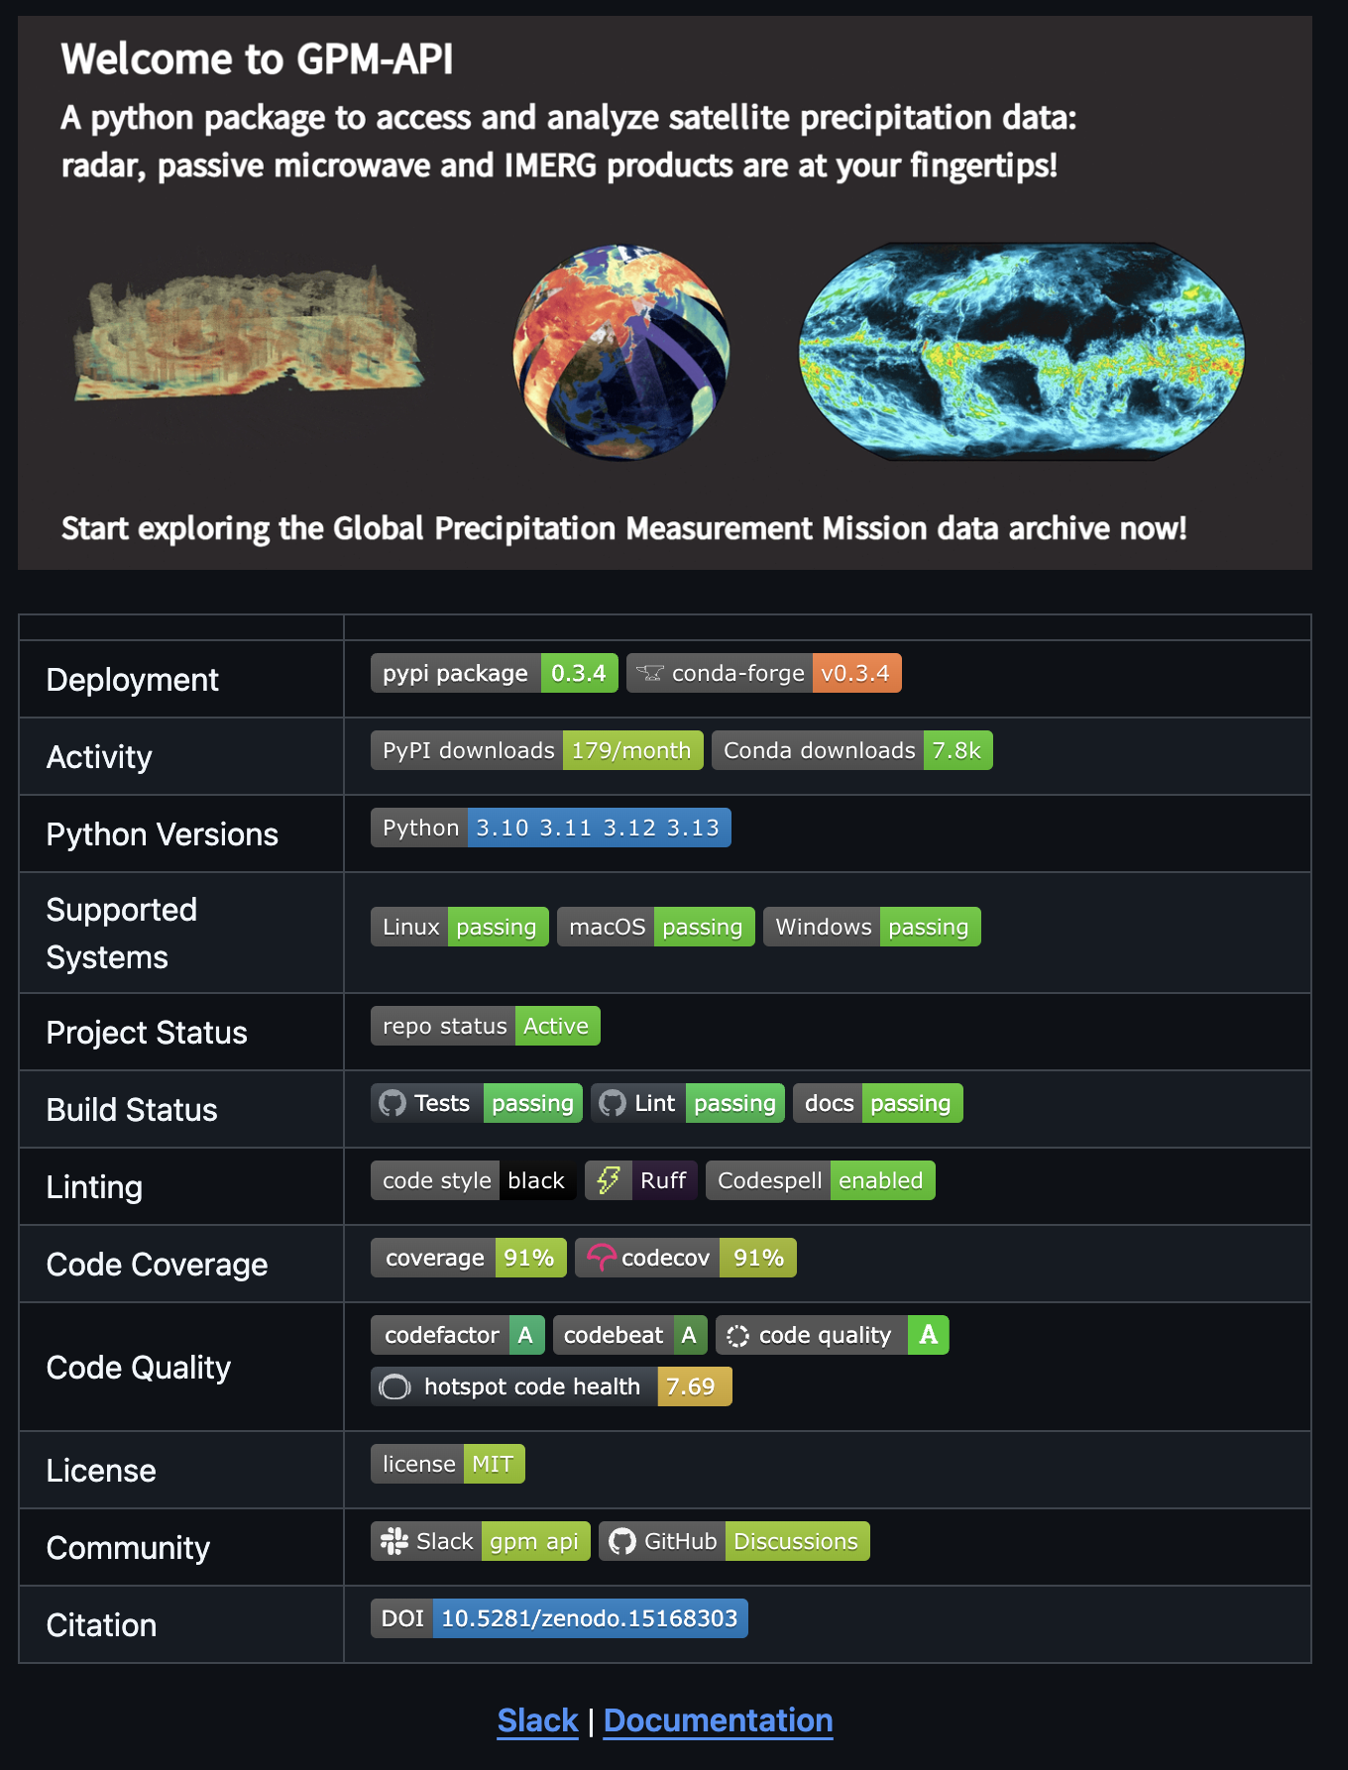
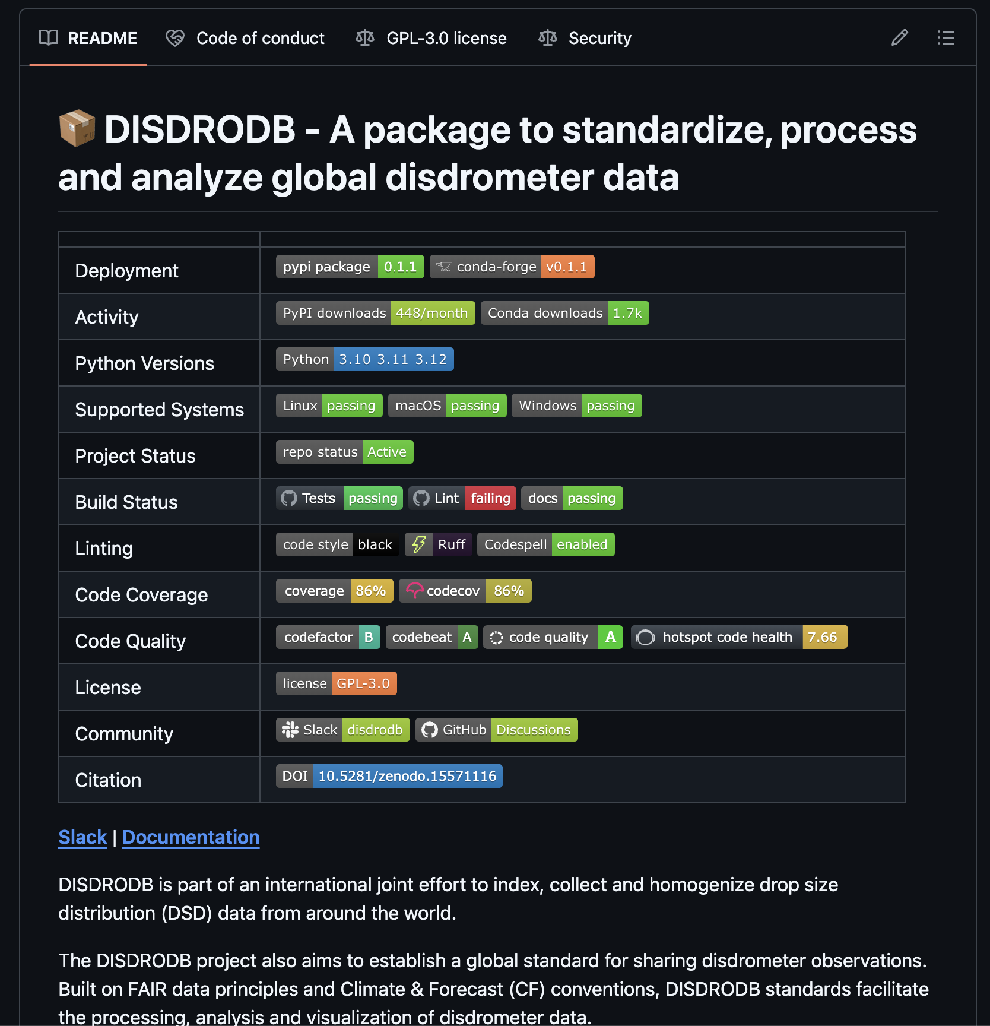
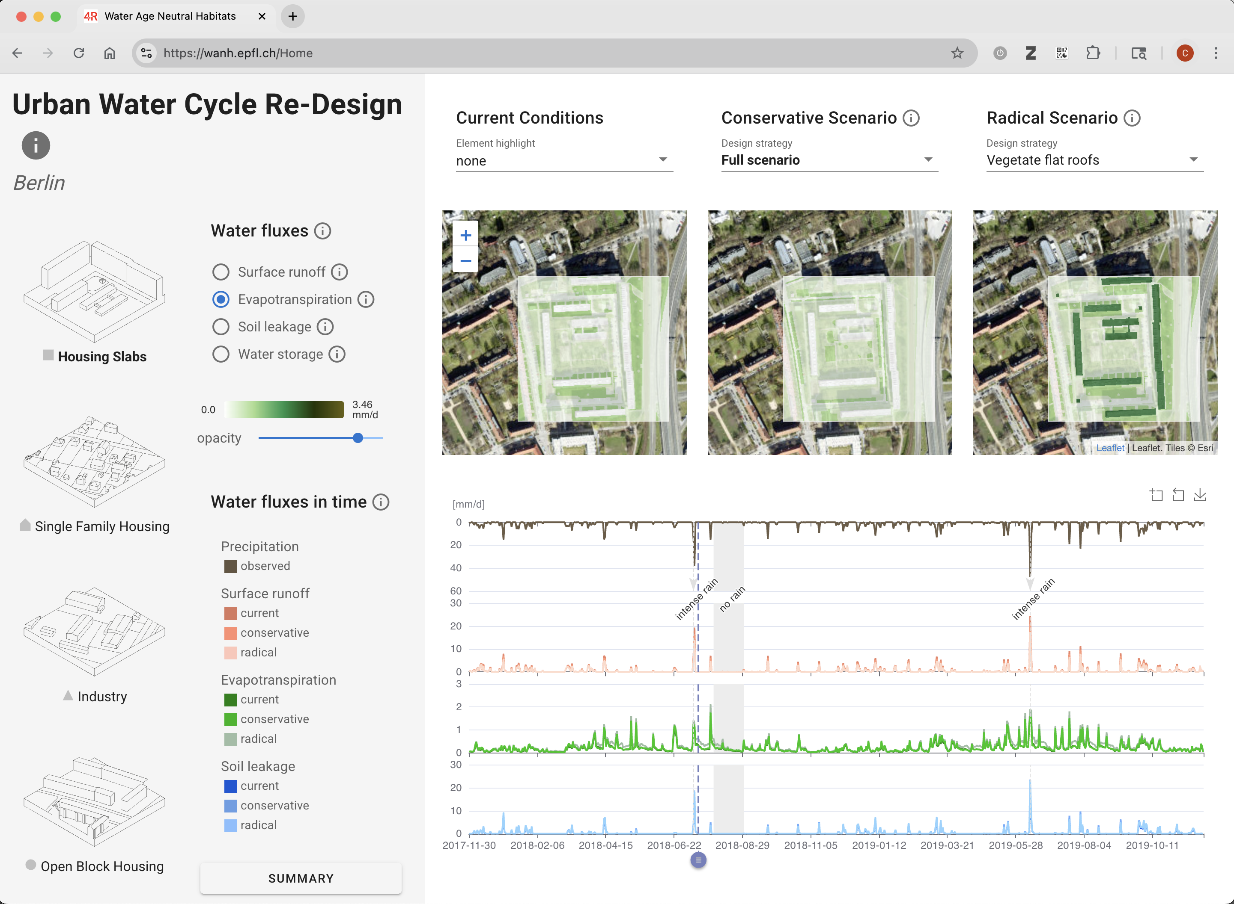
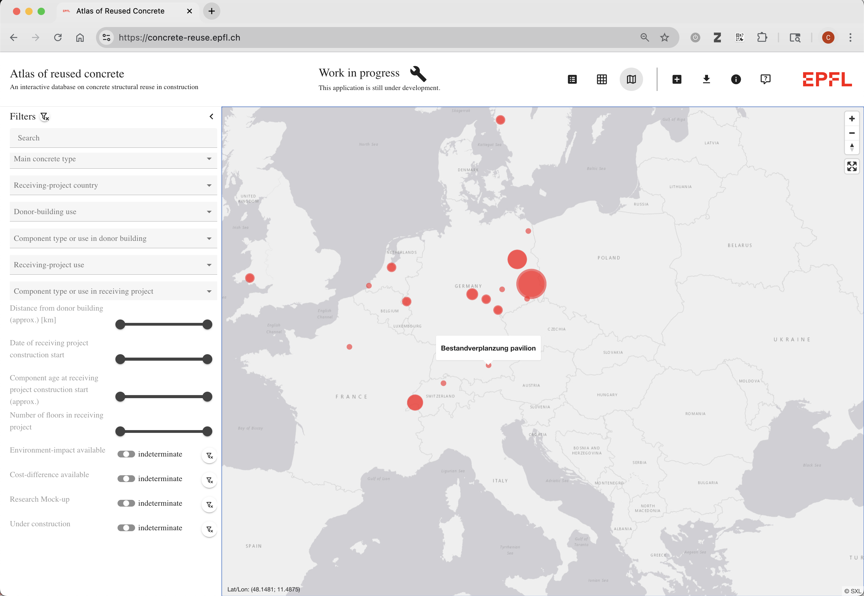
Supporting researchers with their data and code Typical projects
Notes:
To give you more concrete examples …
Together with a research lab in structural engineering, we built a DB of steel materials tested in the big facilities– harmonizing data from >1000 tests, from 60 univerisities. Not only making it accessible , but allowing research to easily explore the data, using models built by the researchers. Such DB speed up meta-analysis, and avoid duplication expensive tests…
Similar tailored web applications include
A DB of reused concrete for architects,
citizen-science mapping
A tool for analysis of gazillion maps of water flows for hydrologists
A webmap of flood risks
…and so on !
But also less visual projects, on the side of Packaging research code. This Python package for access and analysis of Global precipitation measurements, facilitating access, harmonization, merging and analysis of satelite precipitation data. -> already downloaded > 7000 times.

Slide 7
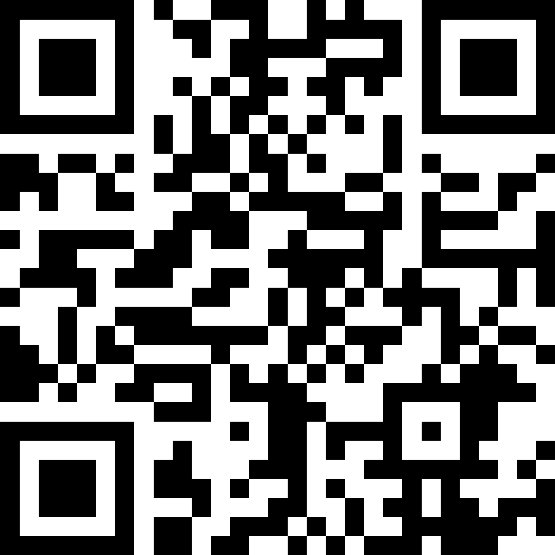
What are your biggest challenges & learnings when making research data FAIR?
Notes:
So now I’d love to take this opportunity of having such a group : an audience, concretely experienced with ORD to reflect on our challenges.
(take this opportunity to feed my curiosity on the topic I promised to talk about ;)
I’ll let us a minute to reflect and answer…
--(PAUSE)--
For the sake of time I won’t display all answers - And I’ll leave the QR code up, so please keep sharing thought – but I will still also attempt to answer the question, from our perspective.

Slide 8
Lessons learned from 5 years of ORD
Implementing FAIR in practice
Challenges
Poor documentation & metadata
Data harmonization
e.g., defining ontologies
Data collection obstacles
reluctance to data sharing (e.g., delayed until paper publication)
Choice of tools: easy, interoperable, maintainable
Often trade-offs between common & cutting-edge solutions…
Balance between rapid prototyping & scalable dev
No obvious short-term benefits for researchers
Learnings
Service-driven support eases FAIR efforts
🤝 Proximity: Collaborative development is key
Co-developing specificaitions, rather than just implementing
Integrating researchers in the development – e.g., in GitHub workflows, even if it's just opening issues.
🛠️ Flexibility: Adapt to academic fluctuating priorities
Availaibility thanks to simultaneous part-time projects
Agile development style
Also non-technical support
👥 Teamwork is essential to offer service of quality
Diverse skillsets needed for ORD
Systematic code reviews ensure quality
Co-maintainer ensures resilience.
Team continuous learning to follow fast-evolving tech landscape
⏭️ Questions remain around incentives & community
How do we fund, govern, and grow technical research commons, through open, community-driven models?
Notes:
So we’ve contributed to >20 ORD projects (13 Contribute & 7 Explore from ETH & SwissUniversities) -
Challenges– (should resonate, nothing particulary new !)
Documentation : missing or incomplete, metadata lacking.
Data harmo, ontologies
Data collection obstacles - reluctance to data sharing (e.g., delayed until paper publication)
Choice of common tools – make it easy, interoperable & maintainable
Balance the effort
How FAIR should it be / how much effort we can put in ?
Maintenance & curation plans always in mind
Interestingly one MAIN CHALLENGE (Not technical) : often No obvious benefits for researchers to do FAIR efforts.
→ Brings us to the LEARNINGS (more Organizational side) : we need the right structure, service-driven – so researchers benefit directly from FAIR efforts.
PROXIMITY to Research – Co-developing -> We’re collaborators, not contractors.
FLEXIBILITY to schedules, to shifting priorites .. Swiss Army knife !
- Non-technical support : : Coordination, workshops, grants writing… Community building and governance of shared assets
TEAM
Diversity of tech skills
Resilience/redundancy
Stay up-to-date -> Tech evolves fast — so do we! (it helps to be in a team)
---→ Service-driven approach so that Research rigor meets engineering efficiency – makes it easier, and directly useful to researchers to do FAIR.
Last learning is identifying the QUESTIONS Ahead for improving ORD Ecosystem: incentives & community building
- How do we fund and govern technical research commons (shared datasets, reusable components, living platforms.)?
- How can we shape the future of ORD, inspired by open-source communities, and shift towards more collaborative, value-driven, community-based research ecosystems?

Slide 9
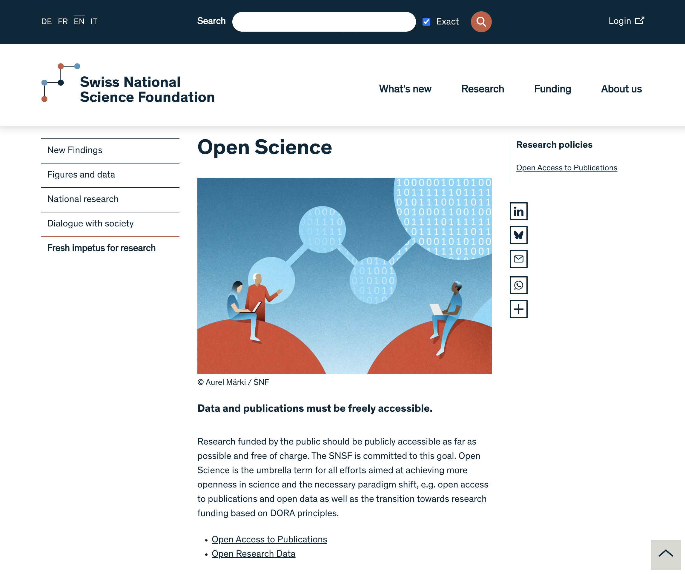
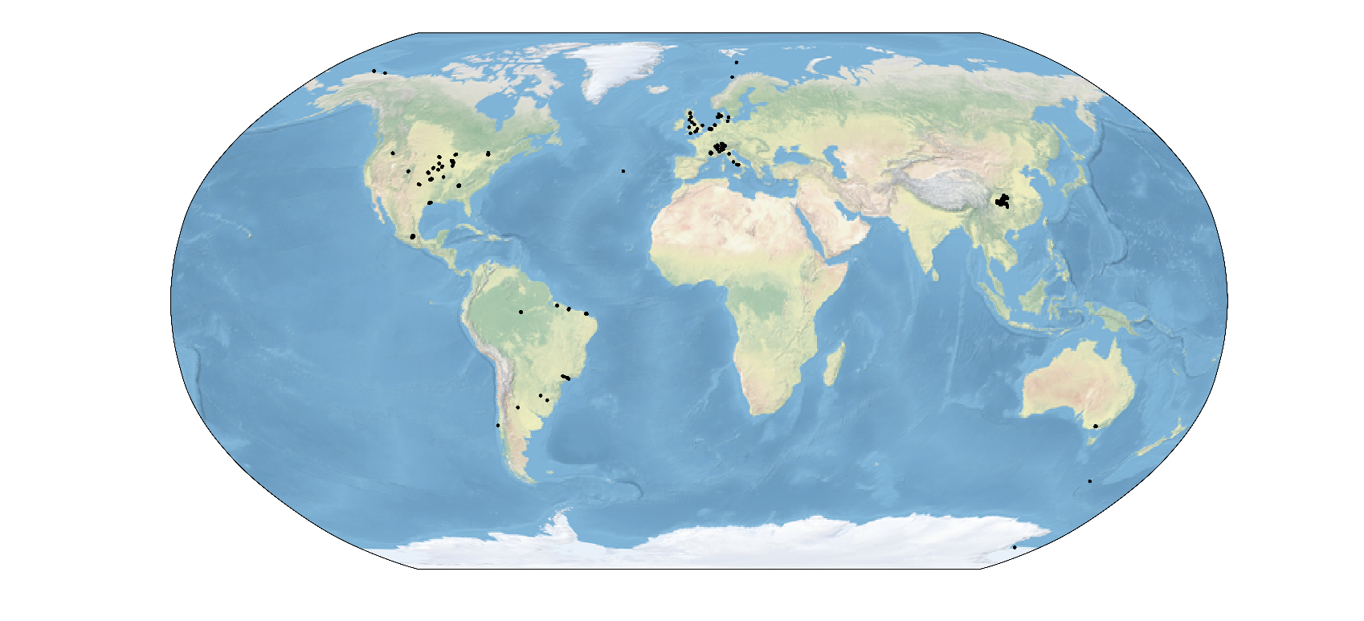
Let’s turn ORD from a requirement …
to an enabler of collaborative science !
DisdroDB Rain Decentralized Data Archive
Aim : to harmonize and access rain data
Currently data from ≥400 stations (30 institutions)
Python package to standardize & process data : ~500 downloads/month
GPM API
https://gpm-api.readthedocs.io
Let’s build research communities, not just research papers !
Notes:
So we all know most research funders now require OS/ORD pratices – but let’s make it not just a constraint, but actually an opportunity to build collaborative tools –
Like this Disdrometer (rainfall measurement -> Decentralized Data archive – to harmonize and access Rainfall data
(Ofc, ORD-funded, started with a Contribute grant - now results in plenty of collaborations/network for the phD student leading it and ≥ 2 papers).
LET’S BUILD RESEARCH COMMUNITIES, NOT JUST RESEARCH PAPERS !

Slide 10
Thank you!
What are your biggest challenges & learnings when making research data FAIR?
Data & software skills at-hand & on demand for researchers – IT4R

