Slide 1

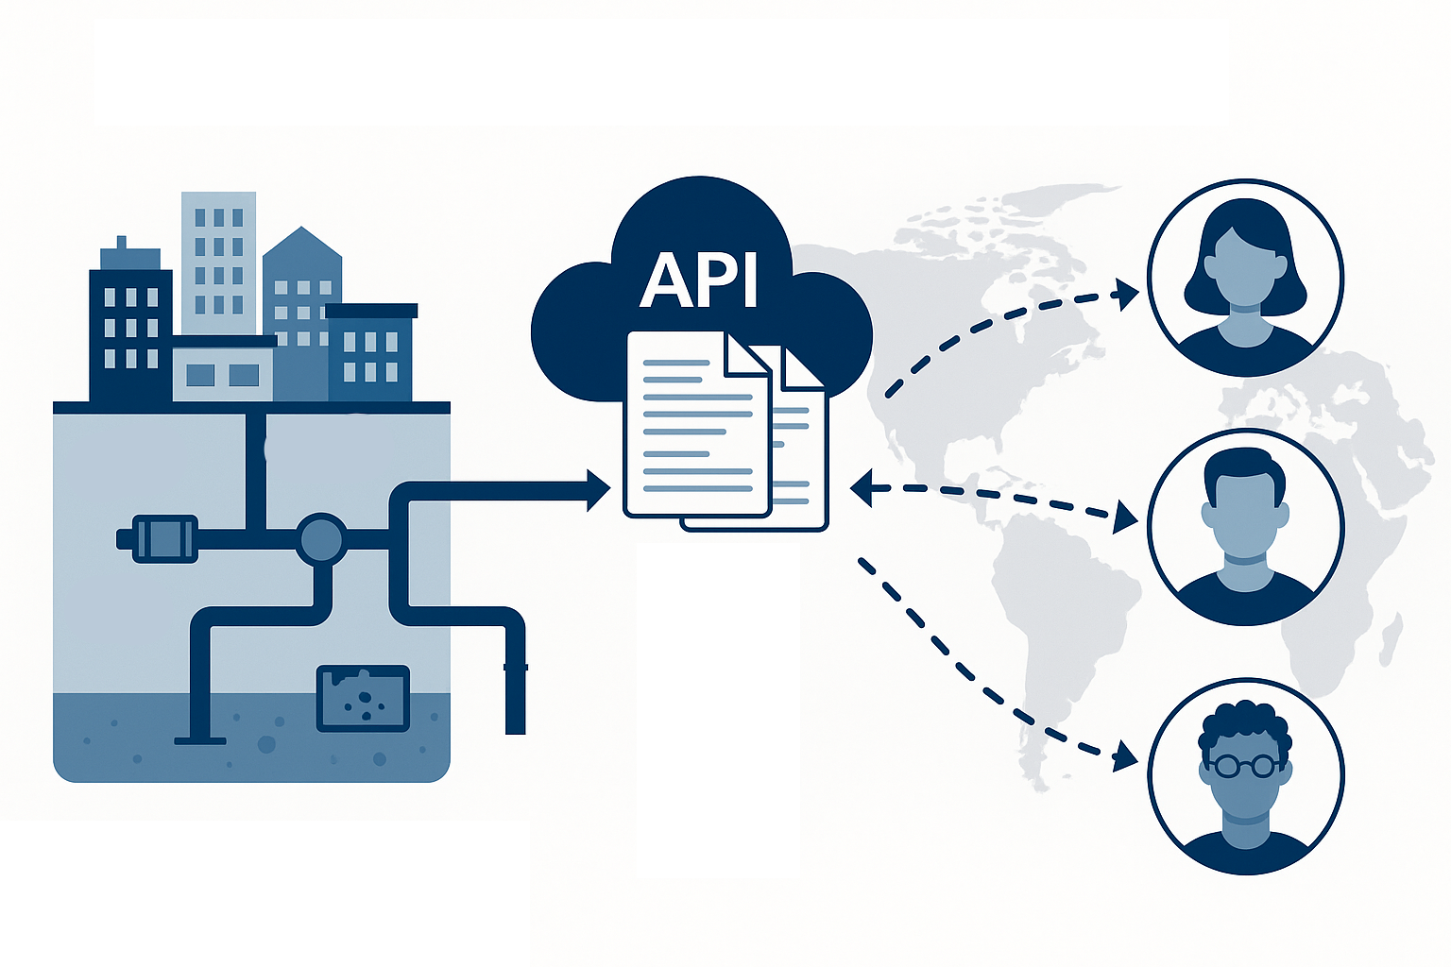
A FAIR metadata standard for observation data from urban drainage systems (WaterML-UD)
Alfredo Chavarría
Jörg Rieckermann

Slide 2
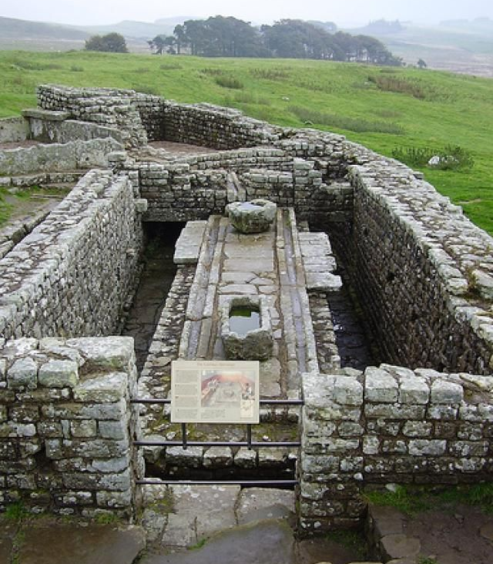
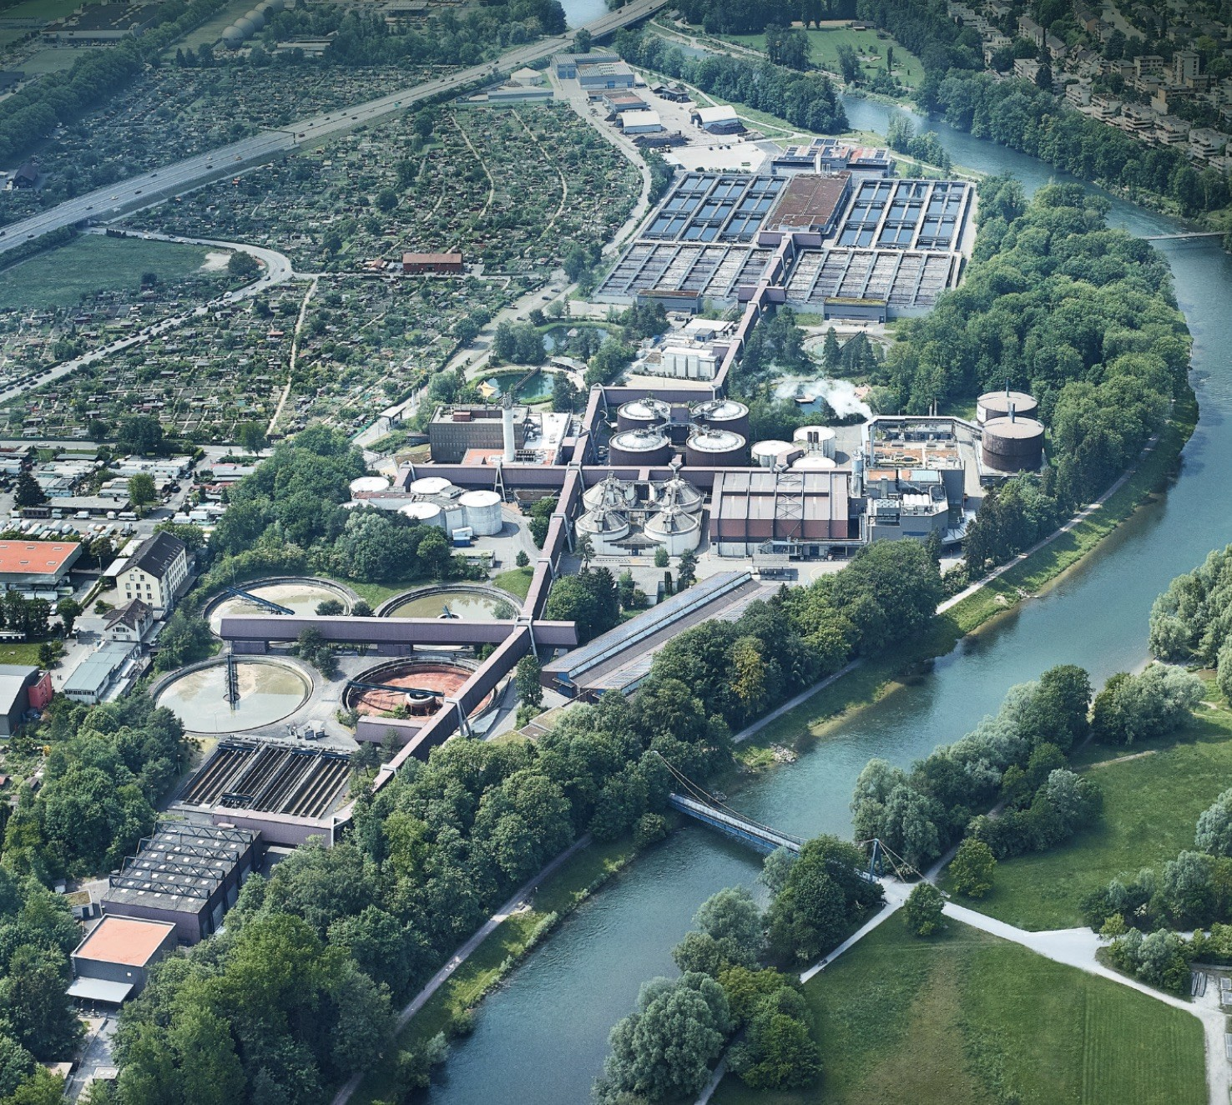

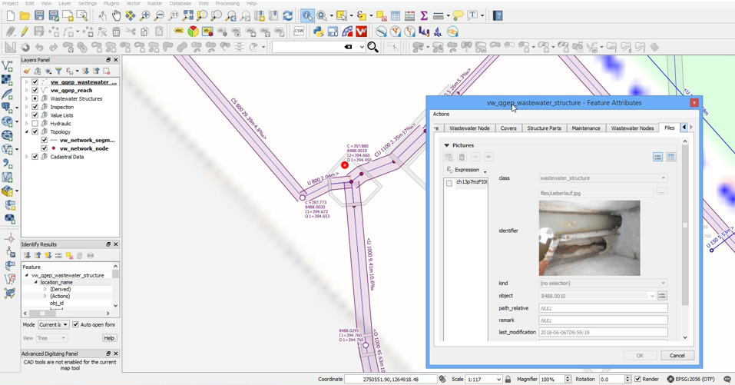
Urban Drainage Systems
complex systems
€ € € infrastructure
continuous monitoring from multiple sensors
towards digital representation

Slide 3

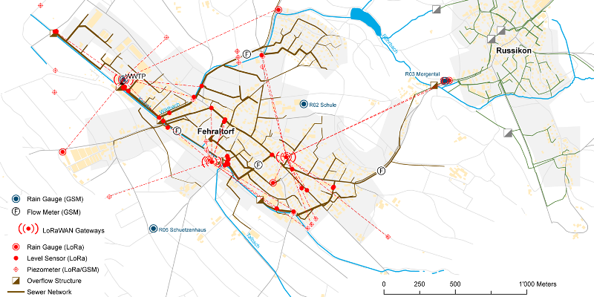
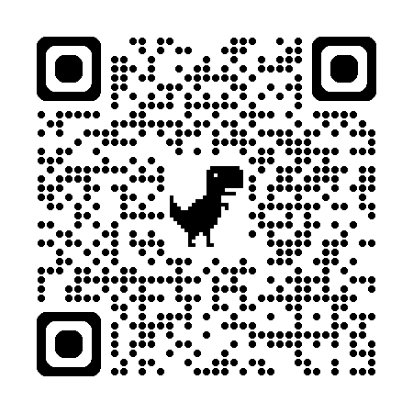


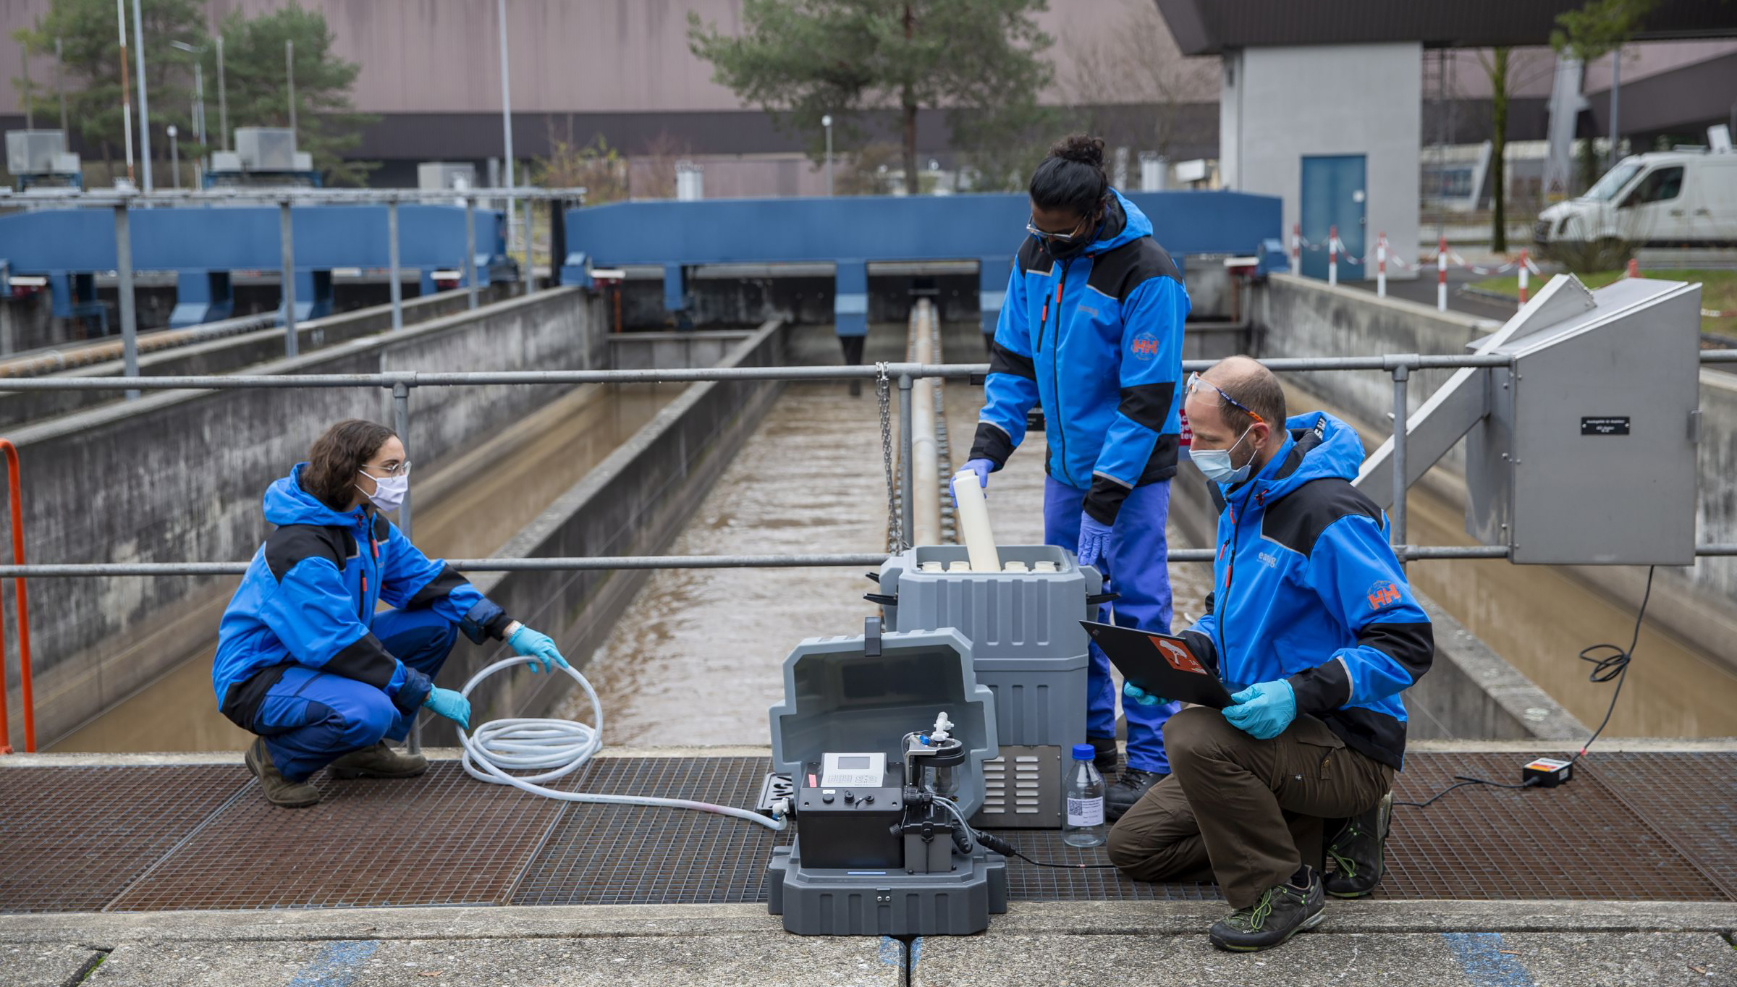
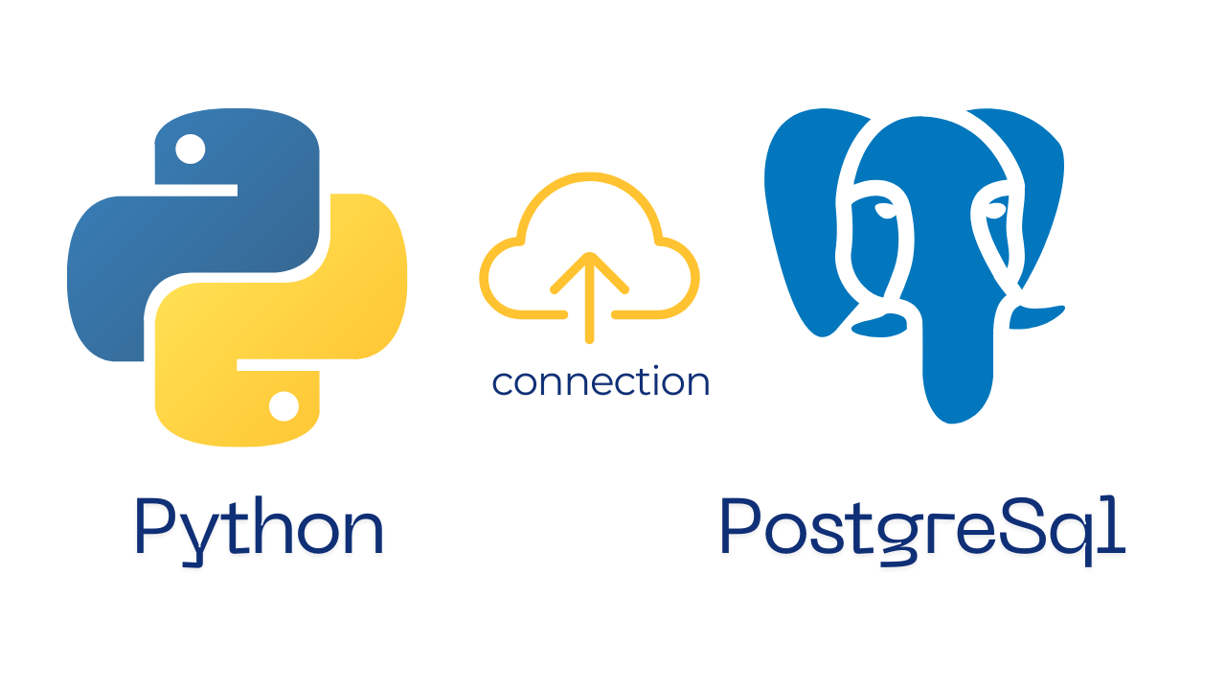
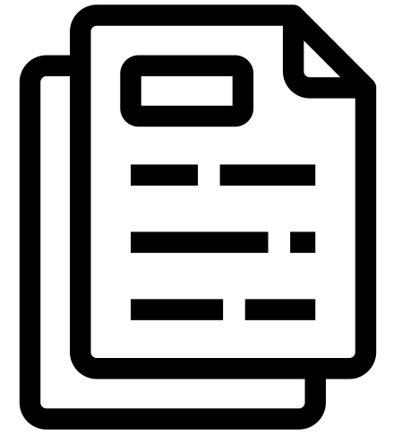

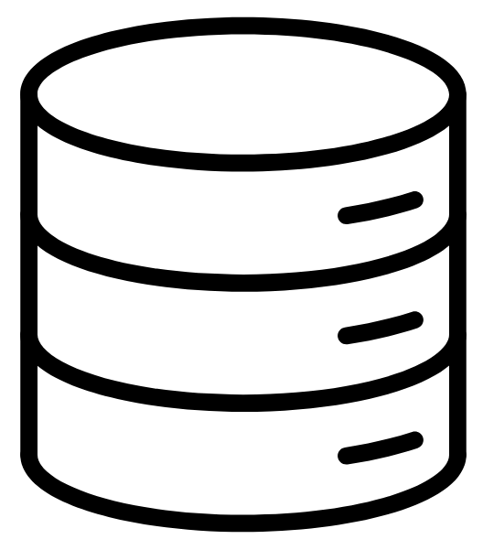
Use case: Urban Water Observatory
Open access dataset
………………………………………….
no standardized framework
long documentation
complex database structure
observations
storage
data format
users

Slide 4



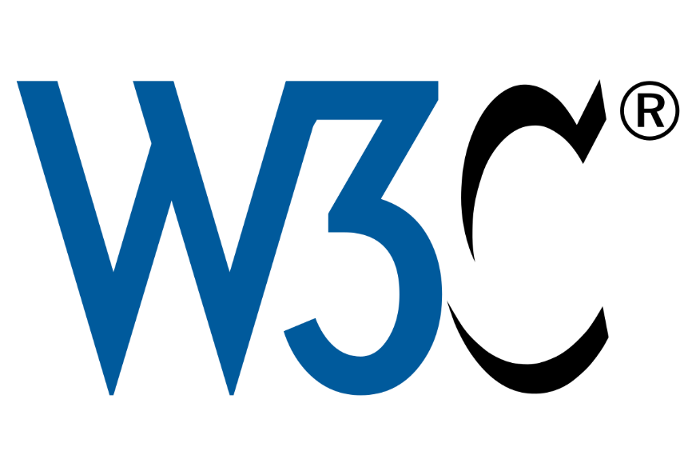
Don’t reinvent the wheel… Standards available… ?
SSN
SOSA

Slide 5
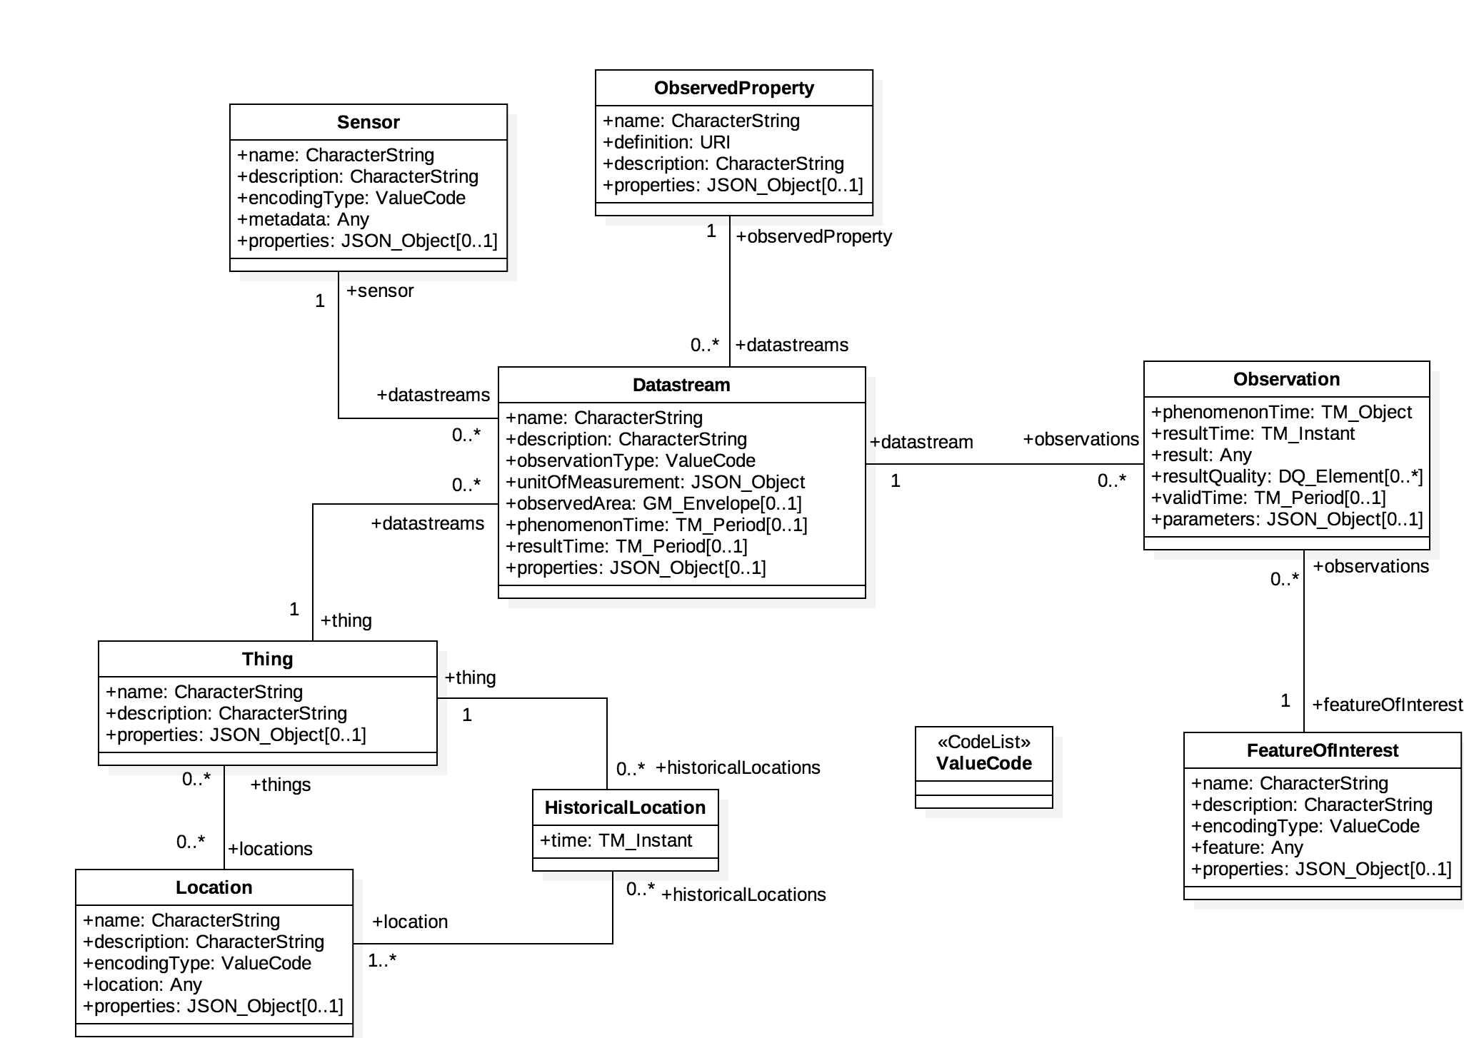

Use case: Urban Water Observatory

Slide 6
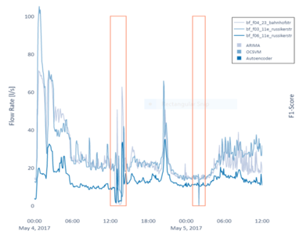
Use case: Urban Water Observatory
Flow rate
Ultrasonic flowmeter
Datastream
Result: 15 L/s.
Timestamp: 2025-01-26T10:30:00Z.
Sewer pipe section
Water flow in the sewer pipe
GPS coordinates 47.3769° N, 8.5417° E
Mapping process

Slide 7
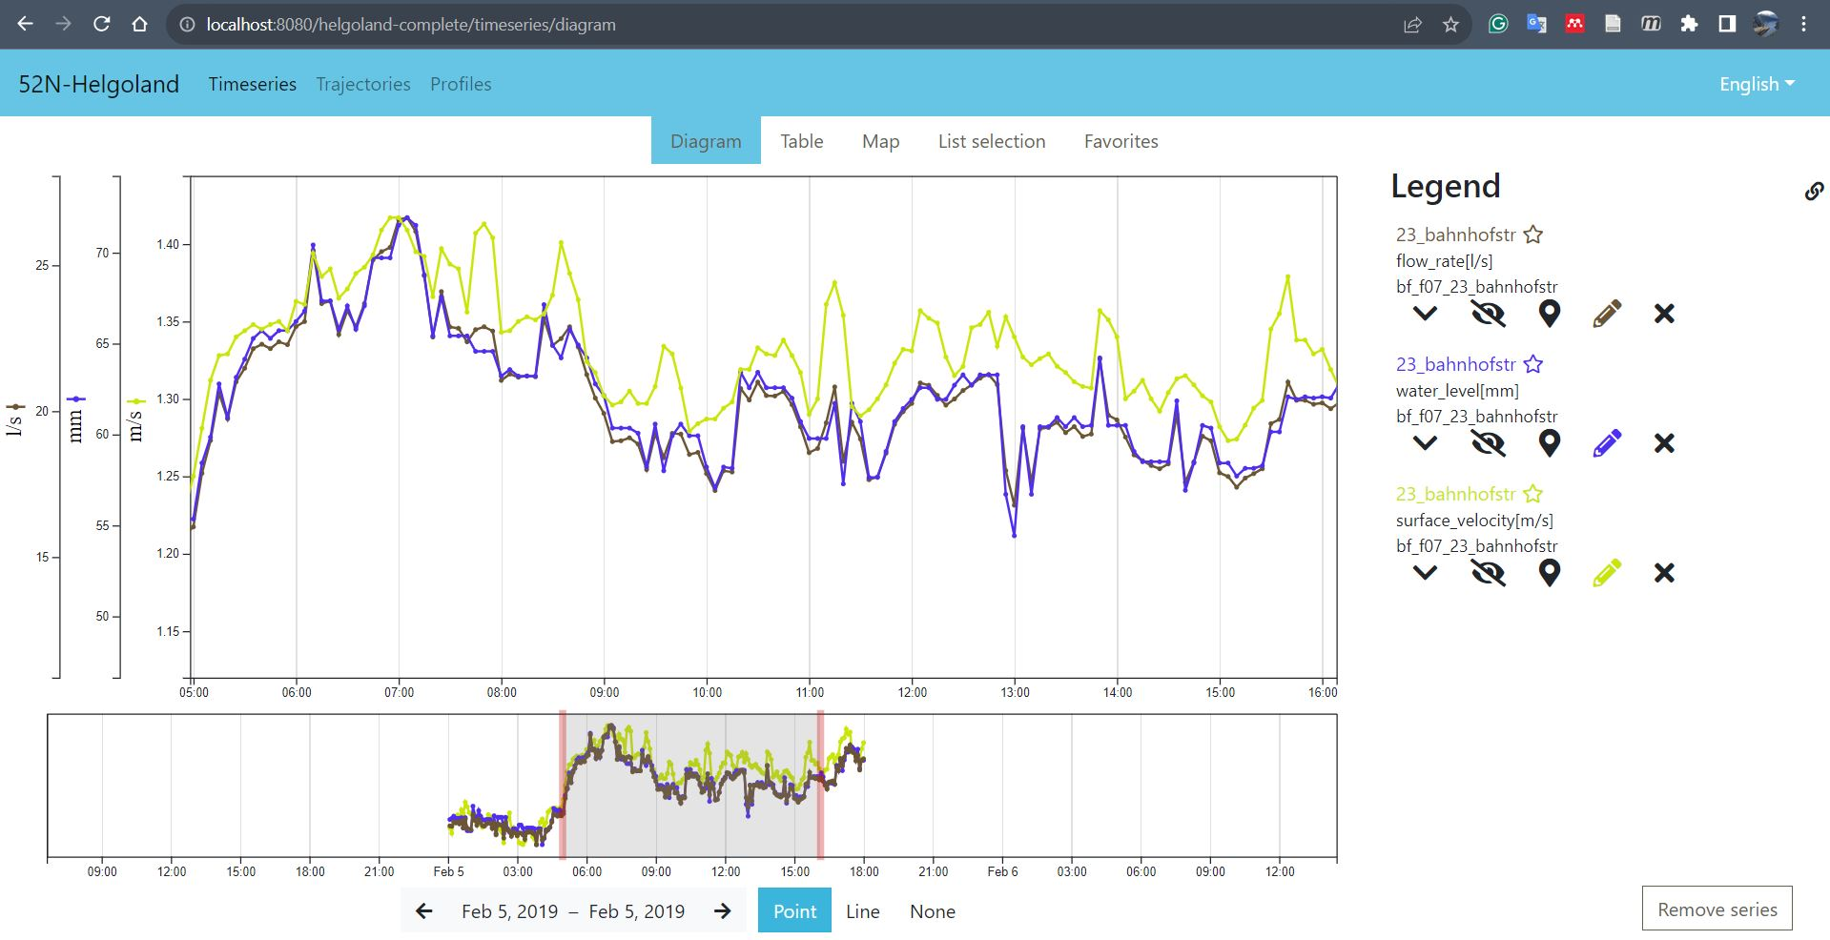
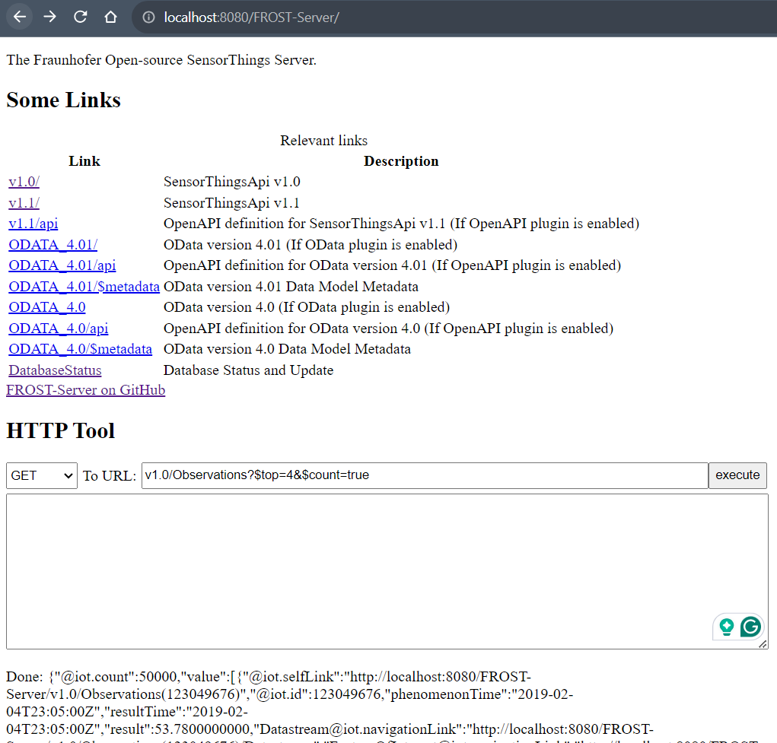
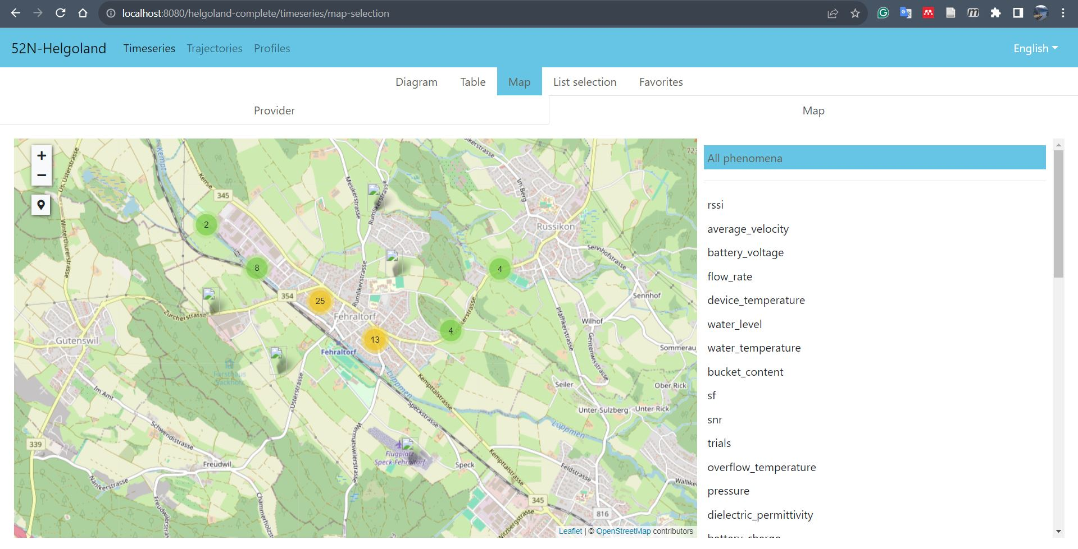
Use case: Urban Water Observatory

Slide 8

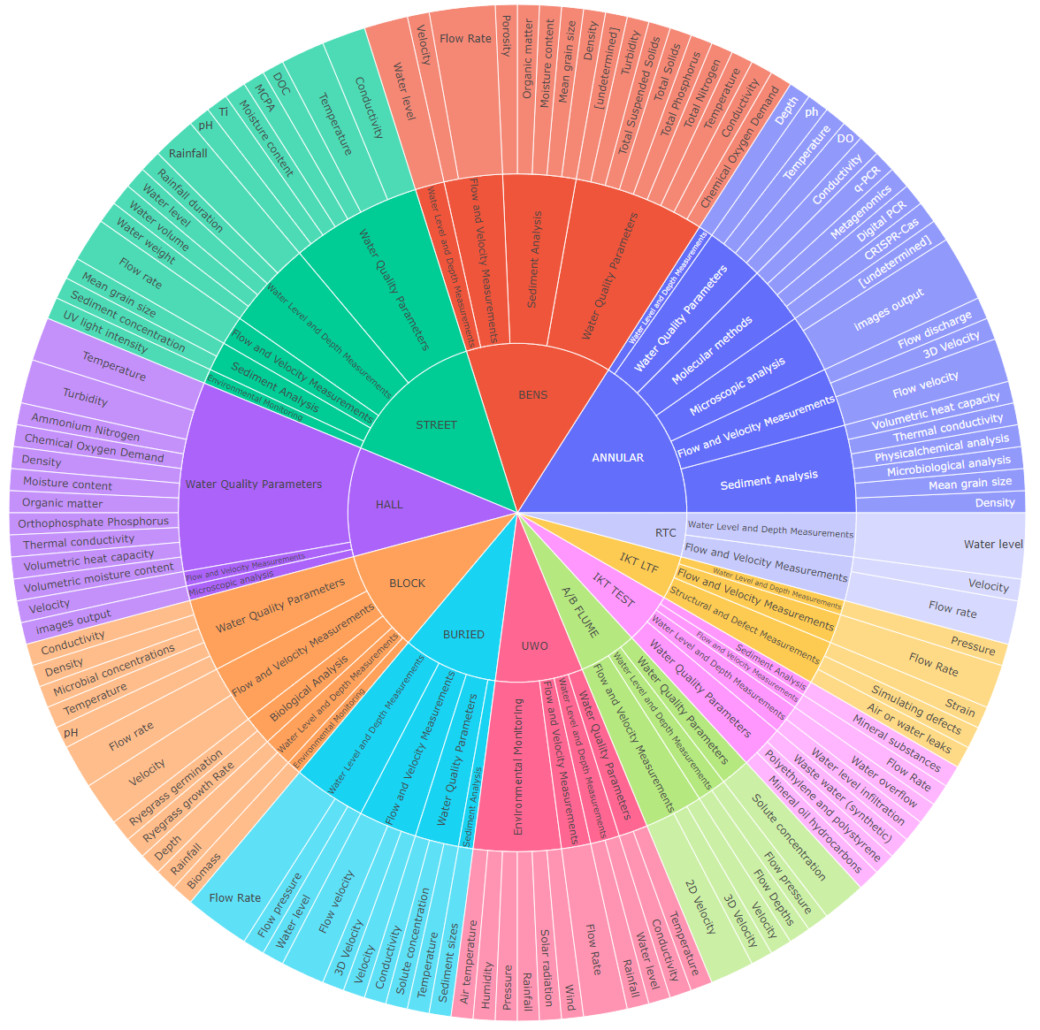
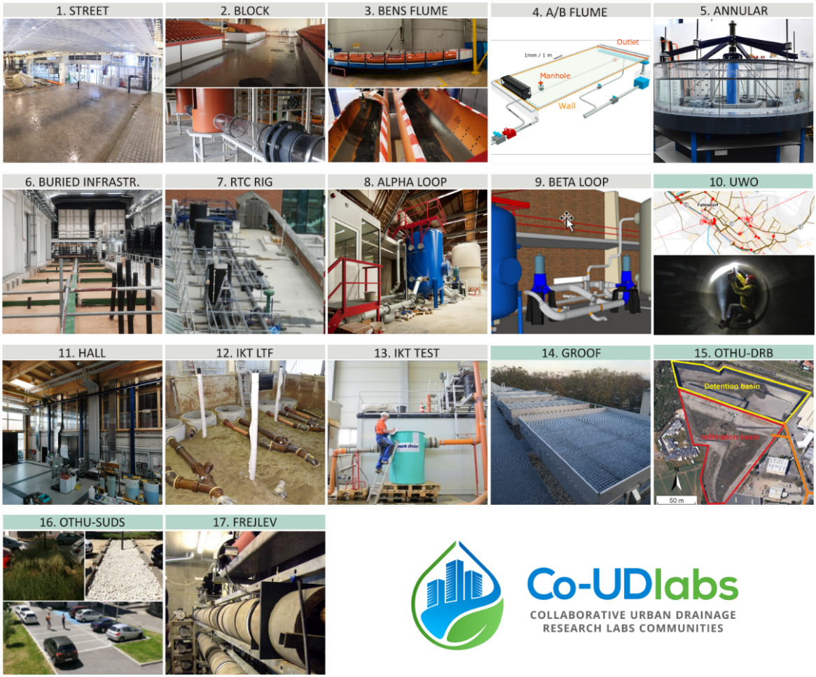
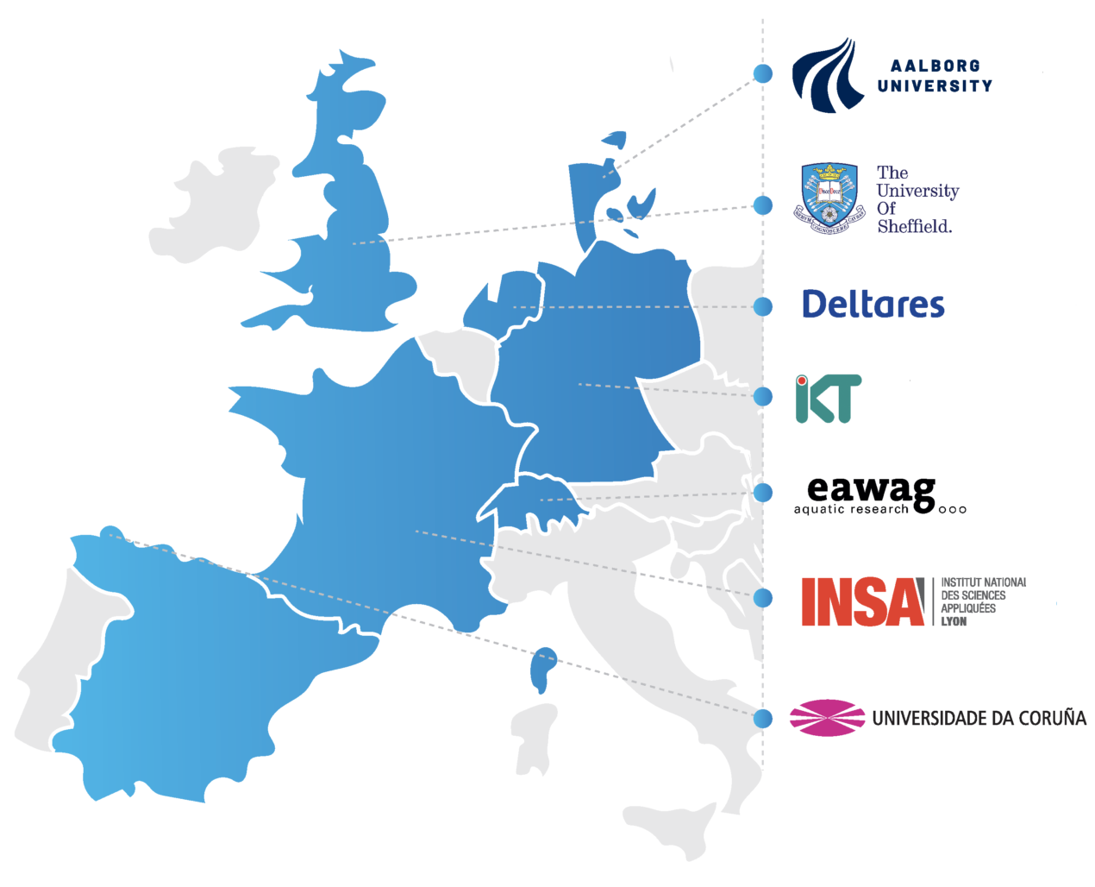
More use cases: Co-UDLabs
What are they measuring?

Slide 9

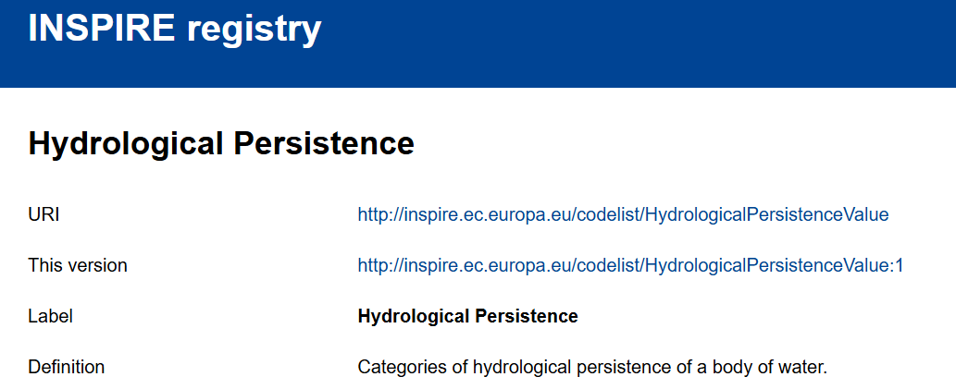
A complete data exchange standard for UDS
Community Workshops
Code lists (vocabularies)
Ontology
Conceptual model
Engineering standards
Glossaries
Local data models/ontologies
URIs

Slide 10
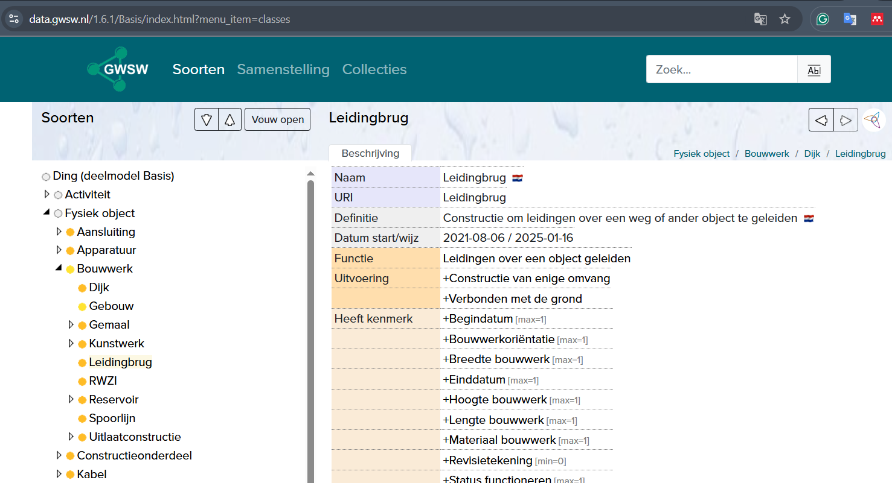
A complete data exchange standard for UDS
Code lists (vocabularies)
Ontology
Conceptual model
Define the structure
Model classes and properties
Multi-lingual
Reusable across systems
SSN
SOSA

Slide 11

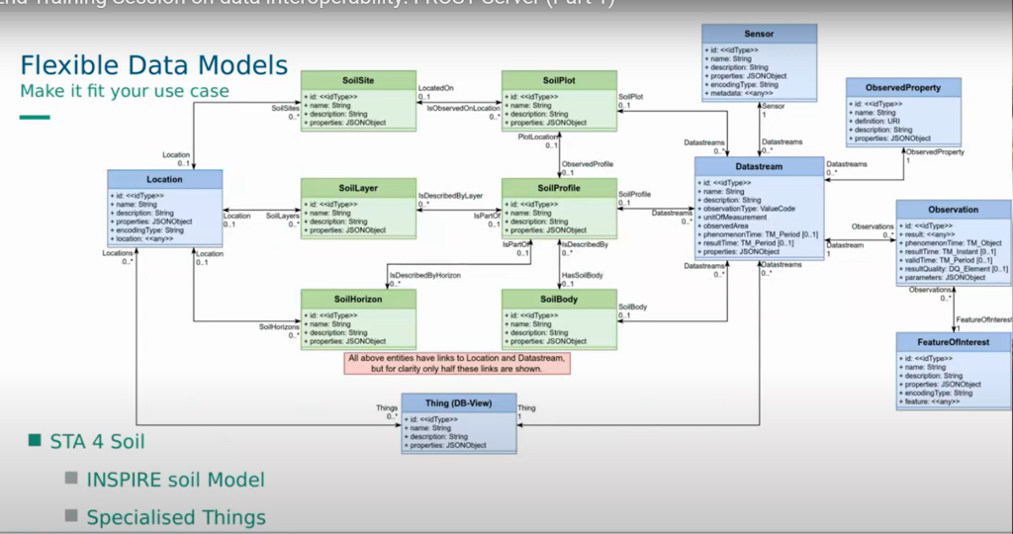
A complete data exchange standard for UDS
Code lists (vocabularies)
Ontology
Conceptual model
UML class diagram model

Slide 12
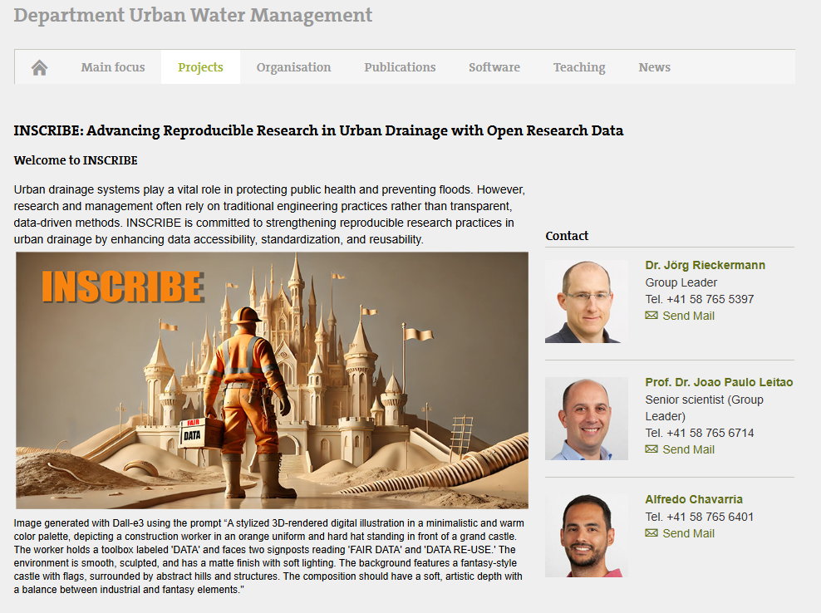
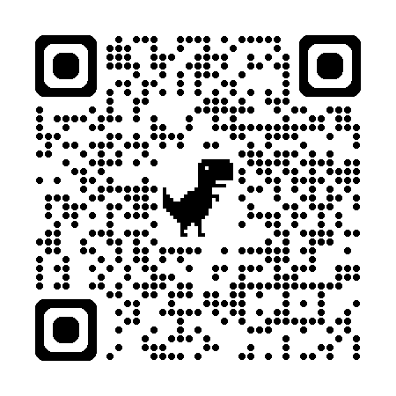
What the future of the project looks like
INSCRIBE
Exploring and strengthening reproducible research practices in urban drainage

Slide 13
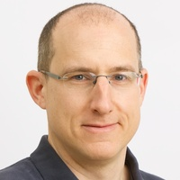
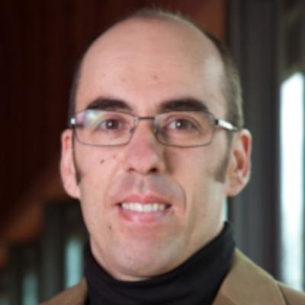
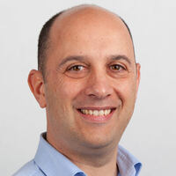
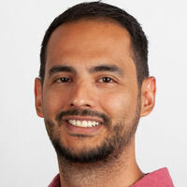
Thank you for your attention!
Questions, comments:
alfredo.chavarria@eawag.ch
Jörg
Luís
João
Alfredo

