Slide 1
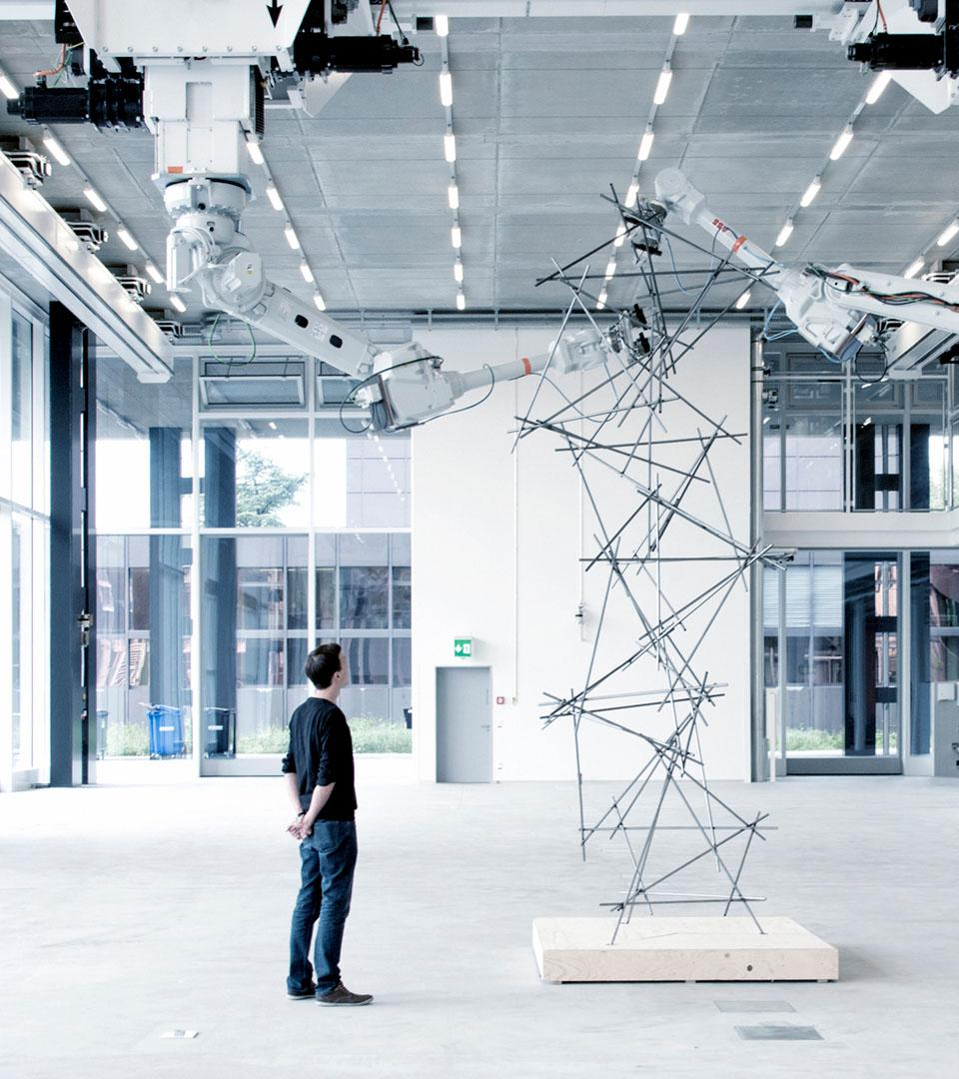
Advancing Open Research Data (ORD) Practices: collaboration and innovation in the ETH Domain

Slide 2
Welcome!

Slide 3
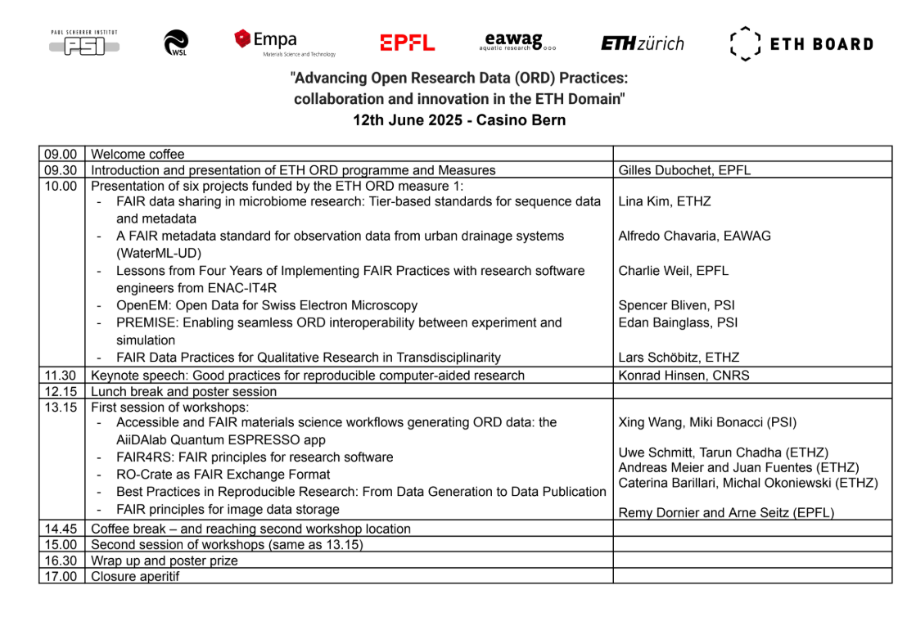
Agenda

Slide 4
The Measure in Numbers

Slide 5
We Supported:
59 Contribute
34 Explore
2 Establish
Three-tier model: a major feature
of this programme

Slide 6
These Were Competitive Calls
track | calls | # applied | # funded | Success rate
Contribute | 8 | 149 | 59 | 39.6%
Explore | 2 | 80 | 34 | 42.5%
Establish | 1 | 7 | 2 | 28.6%
Success rate shows importance
Excellent projects were funded (and rejected, too)

Slide 7
A Domain-Wide Programme
institution | contribute | explore | (co-) establish | % funding
ETHZ | 17 | 14 | (2) | 33.1%
EPFL | 33 | 12 | 1 | 30.9%
EMPA | 2 | 4 | (2) | 13.6%
PSI | 3 | 2 | 1+(1) | 13.3%
WSL | 3 | 3 | — | 5.6%
EAWAG | 1 | 3 | — | 3.4%

Slide 8
An Inclusive Process?
applicant | # funded | success rate
PhD students | 7 | 31.8%
Postdocs | 8 | 30.8%
Scientist / Senior Scientist | 39 | 42.4%
Professor / Head of Unit (or equivalent) | 40 | 44.4%
Other (e.g. IT, library) | 1 | 16.7%
applicant | # funded | success rate
Female | 18 | 43.9%
Male | 77 | 40.3%

Slide 9
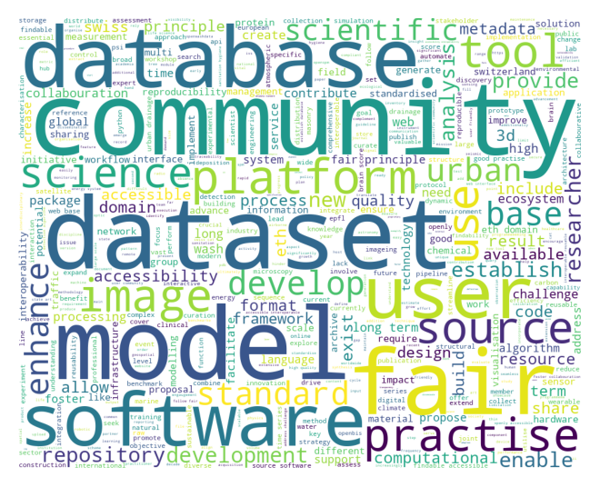
What Was Submitted?

Slide 10
Impact! (from 55 finished projects)
New or enhanced website(s), web interface, platform(s) and/ or infrastructure | 66
New or enhanced repositories and/or catalogues | 38
New or enhanced datasets and/or databases | 100
New or enhanced software, hardware, prototypes and/or other tools | 80
New or enhanced models, standards, guidelines, workflows, benchmarks, protocols and/or best practice | 77
Scientific publications directly related to project | 64
Presentations directly related to the project | 95
New collaborations (incl. with industrial partners) | 136

Slide 11
Thoughts on Open Science Funding:
Impact, Second-Order Effects, and Community

Slide 12
Why do we fund Open Research Data?
Funding is allocated for a purpose.
In this programme:
Researchers and service providers collaborate
Researchers are involved, working on real ORD practices
Develop Leadership in ORD practices

Slide 13
Researchers and service providers collaborate
Many collaboration between labs and services solve:
  Projects that are delayed/underperform because they can’t hire
  Better use of institutional resources
Are researchers in charge?

Slide 14
Researchers are involved,
Working on real ORD practices
Growing number of applicants
  Capacity (and imagination) for new ORD practices
  Takes time to emerge
Why not more young researcher projects?
Real ORD practices happen within communities
  Community engagement biggest challenge

Slide 15
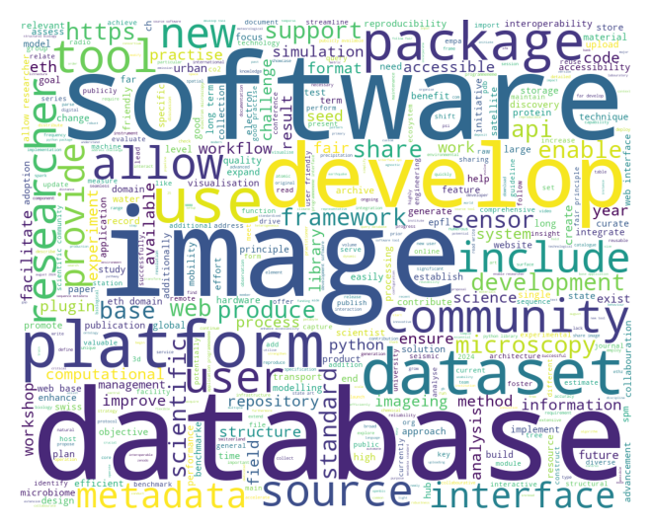
Develop Leadership in ORD practices
Proposals
Lay summaries
challenge of community

Slide 16
Let’s See…
Let’s Start…

